Slide 1
I Still Rise Project
Concentrating on refugee women’s needs

Slide 2
Introduction
World survey on Refugees
Turkey refugee survey
Main needs of Refugee women
What is the main aim of I STILL RISE project
Conclusion

Slide 3
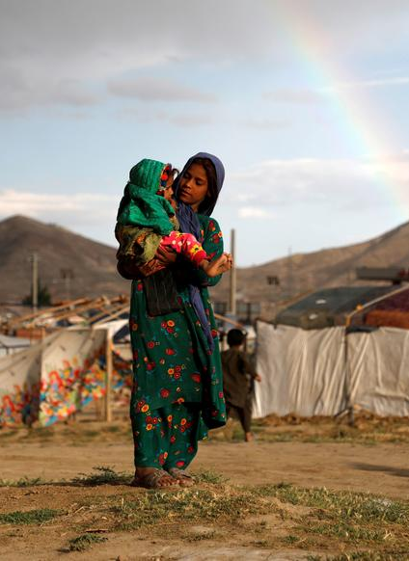
World Refugee survey
At the end of 2021, of the 89.3 million forcibly displaced people, an estimated 36.5 million (41%) are children below 18 years of age.
They are migrating to escape poverty, improve their livelihood and opportunities, or escape conflict and devastation in their own countries.
Between 2000 and 2015, the number of international migrants increased by 41 percent to reach 244 million. Almost half of them are women
Addressing the unprecedented large movements of refugees and migrants needs a more humane and coordinated approach that all countries can endorse and implement.

Slide 4
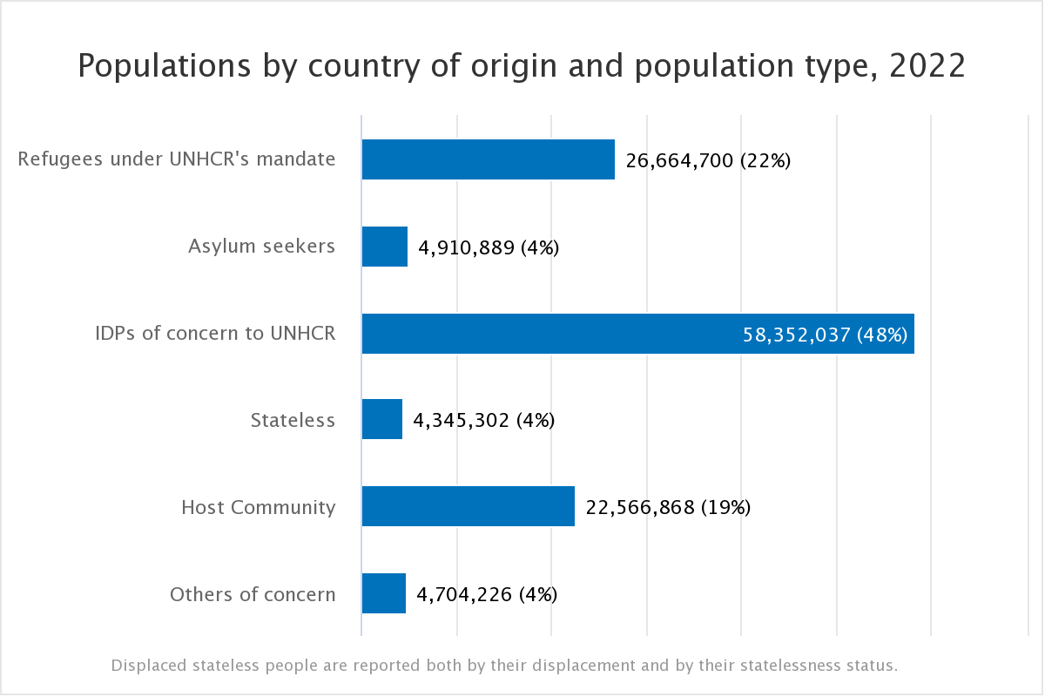
From 2000 till 2022 103 MILLION Forcibly displaced people worldwide

Slide 5
Turkey refugee survey

Slide 6
Refugee crisis in Turkey
Since, Turkey’s geographical position makes it the first reception and transit country for many refugees and migrants.
Turkey hosts the largest number of refugees, with 3.7 million people.
As the result of an unprecedented influx of people seeking refuge, the country currently hosts almost 4 million registered refugees (out of which nearly 3.6 million are Syrians) and is making commendable efforts to provide them with humanitarian aid and support. Other registered refugees are mainly from Iraq, Afghanistan, and Somalia.

Slide 7
How refugee crisis affected Turkey
Economic impacts
Turkey incurs high expenses related to refugee care (housing, employment, education, and health), including medical expenses, with minimal support from other countries.
Security impact
Most governments today perceive migration and refugee movements as a threat to their national interests. Refugee without formal documents and identification cards can be member of organization and societies which can be a thread to national security
Conflicts within host community
Economic and political pressures in host countries have led in turn to tensions at the social level, both between the refugee population and the local residents.

Slide 8
Refugee health crisis
  Depression, anxiety PTSD tends to be higher among migrants exposed to diversity
  lack of access to health services or experience barriers in accessing these.
  Data gathered from 23,040 patients at Doctors of the World clinics in 25 cities across Europe found that more than half (54.2%) of the pregnant women surveyed had not had access to antenatal care and only one-third (34.5%) of children seen had been vaccinated against mumps, measles and rubella and only slightly more (42.5%) against tetanus.
  One in five patients had given up seeking medical care or treatment. because of difficulties, including financial and language barriers, administrative problems and a lack of knowledge and understanding of their rights.
  deprivation during migration, poor living conditions and lack of adequate hygiene make refugees vulnerable to respiratory and gastrointestinal illness and skin diseases.

Slide 9
Main health services problems women

Slide 10

health problem in refugee women
Lack of knowledge about contraception methods
Lack of knowledge of about breast cancer
Lack of knowledge about menstrual hygiene and related vaginal infections
lack of Sexual education
Lack of knowledge about violence, sexual abuse and services related to the domestic violence issues.
Language as a barrier to access primary health care services.

Slide 11
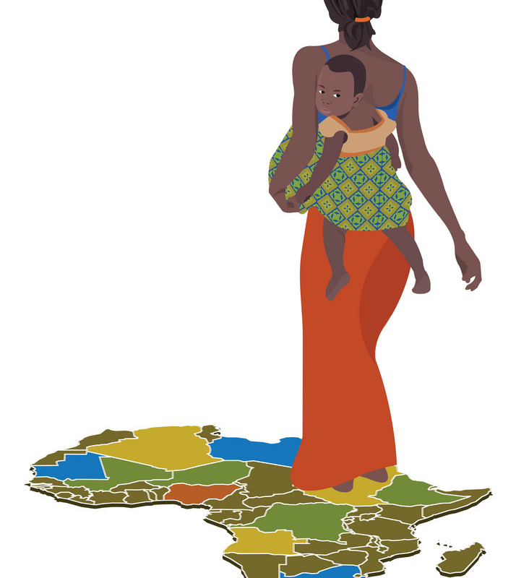
Leaving behind nights of terror and fear
I rise
Into a daybreak that’s wondrously clear
I rise
Bringing the gifts that my ancestors gave,
I am the dream and the hope of the slave.
I rise
I rise
I rise.
-Maya Angelou thank you

Slide 12

My body’s health matter:
My health is my capital
Providing menstural hygiene lessons to women
Teaching conconscious use of health services
Raising awareness about family planning and contraception uses.
Raising awareness about antenatal and postnatal care facilities.
Raising awareness about breast cancer
Raising awareness about vaginal infection and ways of prevention
HPV vacciniation rasing awarenss

Slide 13

My mental health and self-improvement matters:
A Reminder to ouselves: we are strong enough
Emotion’s map activity
Providing activities for rehabitilation
Art therapy
Bringing refugees and host community for strengthen harmony in the society
Socializing activities
Recycle your objects
Reading book hours
Different European culture information
activities in nature, promoting green areas

Slide 14

The caged bird sings:
I have a story to tell
Bring together activist entrepreneur women with local refugee women who share similar backgrounds and experiences.
Every woman has a story to tell platform (Tea hours activity )
activities in nature, promoting green areas

Slide 15

conclusion
With recent refugee crisis many people specially women and children has suffered mentally and physically. The post traumas related to displacement has cause many distress both in private and social life of individuals. The aim of I Still Rise project is to alleviate at least the negative impact of migration on women and increase awareness about facilities for refugee women in addition to rising awareness about importance of health.
Note: It is important to Contribute determination of new policies by considering the genders for the new migration waves that may be encountered.

Slide 16
Thank you
Leaving behind nights of terror and fear
I rise
Into a daybreak that’s wondrously clear
I rise
Bringing the gifts that my ancestors gave,
I am the dream and the hope of the slave.
I rise
I rise
I rise.
-Maya Angelou

Slide 17
Refernces:
Daynes L. The health impacts of the refugee crisis: a medical charity perspective. Clin Med (Lond). 2016 Oct;16(5):437-440. doi: 10.7861/clinmedicine.16-5-437. PMID: 27697805; PMCID: PMC6297302.
https://www.who.int/news-room/fact-sheets/detail/mental-health-and-forced-displacement 2022
https://journals.sagepub.com/doi/pdf/10.2968/058006011 2022
https://www.unhcr.org/4444afc80.pdf 2022
Berti, Benedetta. "The Syrian refugee crisis: Regional and human security implications." Strategic Assessment 17.4 (2015): 41-53.
https://en.wikipedia.org/wiki/Turkey%27s_migrant_crisis 2022
https://www.avrupa.info.tr/en/eu-response-refugee-crisis-turkey-710 2022
https://www.unhcr.org/refugee-statistics/ 2022

