Slide 1
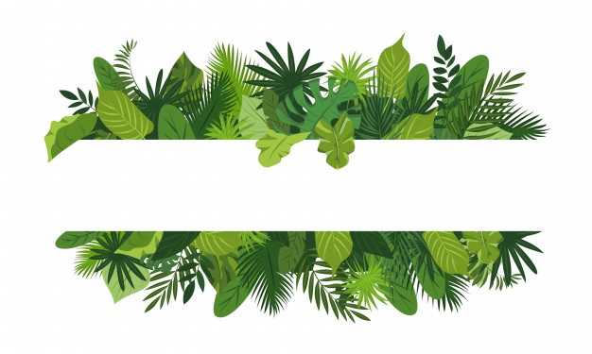
“Green Emotions” KA153 MOBILITY OF YOUTH WORKERS

Slide 2
Who?
We are a formally organized non-profit foundation, with the capacity for institutional self control. Fundación Plan B social bases its work on social education. Our actions are mostly determined by the educational intervention approach, through comprehensive education.
Our approach is a participant-based methodology, always putting the focus on our target group which is the youth, and more specifically rural youth with access to fewer opportunities. This is why we offer them a wide range of activities, which include leisure and recreational activities, employability programs, democratic dialogue with policy makers or academic support, among others, always aiming to improve their lives and to provide guidance in order for them to reach a successful adulthood.
Nowadays we lead the youth centers in Salamanca’s (Spain) nearby towns, in which we manage street education, cultural management and democracy and participation projects, as well as newly designed international projects like the one we will describe as follows.
PIC: 905528078 OID: E10022394
OTLAS: https://www.salto-youth.net/tools/otlas-partner-finding/organisation/fundacin-plan-b-educacin-social.15810/
WEB: https://planbeducacionsocial.com/foundation/

Slide 3
What?
Our idea is to create a KA1 mobility for youth workers project during the third week of september, targeting organizations working with young people related with the nature and how we feel the emotions in the nature in order for them to reflect on the role of nature as an emotional educational element and to improve our skills as youth workers in this field.
Goals
- To reflect about the power of nature in emotional education
- To understand outdoor activities as an educational tool
- To promote the implementation of educational context in the nature link with the emotions
- To encourage young people to focus in sustainability from the emotions
-To put together guidelines about good practices in the use of nature as an emotional educational element
-
Contents
- Nature as an educational resource and emotional resource
- Global sustainability
- Emotional Education link with nature
- feelings through nature
- Tools for environmental education with emotional care
- Transversal tools for emotional education

Slide 4
Nowadays youth is very disconnected from nature, and from the natural processes of the environment. They are focusing a lot on social networks and screens. This is pushing the young people to develop some emotional disorders and there are many researches that point to the connection with the natural environment with emotional wellness. The natural processes that constantly happen in the environment around us are a very powerful font of learning in many ways and connect with our emotional part. With this project we want to give it the importance it deserves in our work with youth.
Why?
On the other hand, it is very important that youth do not disconnect from the power of nature because it is the context where they live, and where they will live. So it is essential to focus on the sustainability of the planet as a whole, we are interconnected and we should take care of ourselves from the collective approach. The intercultural vision of a project like this is necessary to open the minds beyond our walls, and beyond tomorrow, to the future.

Slide 5
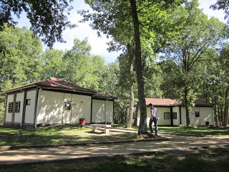
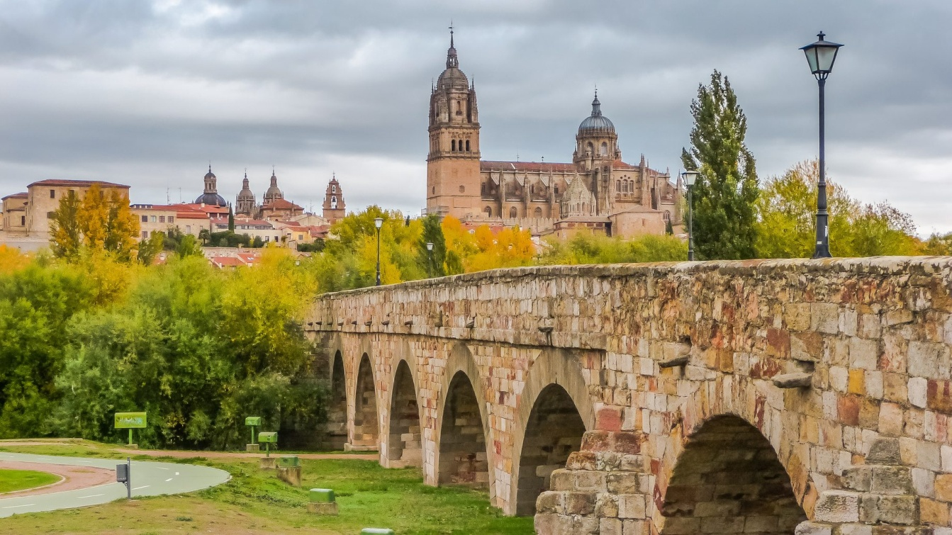
When? Where?
Second week of september aproximately .
(We can adapt the dates to the partners also)
In “La Legoriza” a beautiful place in the village of San Martin del Castañar, the montains near Salamanca (Spain)
IF YOU ARE INTERESTED IN BEING A PARTNER OF THE PROJECT PLEASE CONTACT US AT
europe@planbeducacionsocial.com

