Slide 2
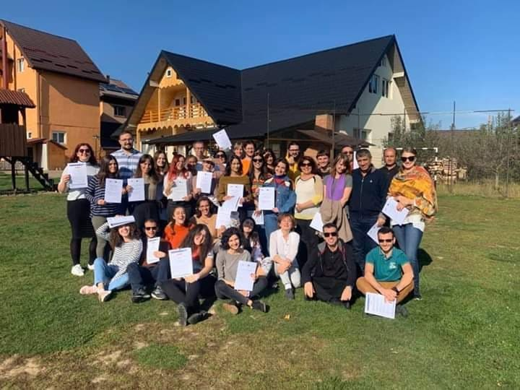
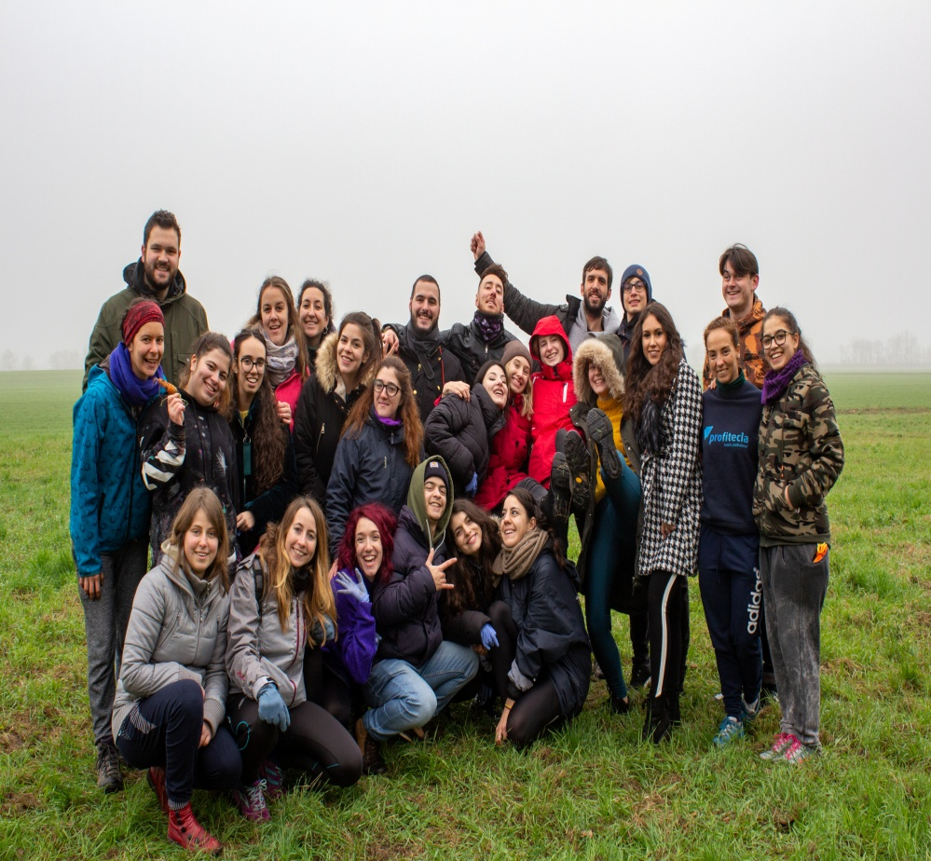
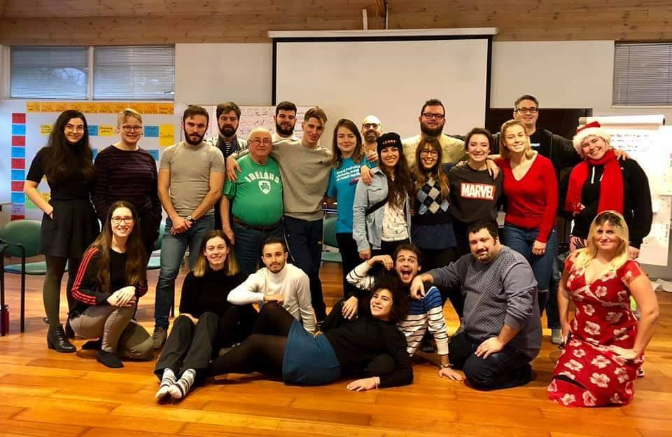
Who we are?
NON GOVERNMENTAL ORGANIZATION/ASSOCIATION
LOCATED IN THE AREA OF THESSALONIKI
ACTIVE IN THE FIELD OF YOUTHWORK AND INTERNATIONAL YOUTH MOBILITIES
Notes:
ΝΟΡΙΝΩΓΚΜΤΜΒΟΛΡΓΤ

Slide 3
FOUNDERS OF YOUTH EMPOWERMENT CENTER
ALEXANDRA CHATZIMIMIKOU
LLB of Aristotle University of Thessaloniki
Active Youth worker
Executive Director of ELSA(European Law Student Association) Greece
Instructor of Greek Language to individuals with immigrant/refugee background
Activist in the field of LGBTQI+ rights and gender equality
MICHAIL CHATZIMIMIKOS
B.A. in Politics/ M.A. in Social and Solidarity Economy
Trainer of Non Formal Education Activities
Young European Ambassador
Member of Thessaloniki Youth City Council
Managing European Funded Projects since 2017

Slide 4
How it all started?
Refugee Crisis of 2015, motivated us to become active in civic affairs
Since 2016, started participating in local and international workshops, seminars and projects
Valuable experiences gained through our volunteerism and active participation in other civil society organizations
But something was still missing…….

Slide 5
VISION
Youth organization, acting as a hub of new ideas and approaches
Having a social utility
Giving the chance to young people to develop and express themselves the way they feel like
Regardless sexual orientation, religion, nationality, economic and cultural background
With respect on the 17 SDGs of the UN

Slide 6
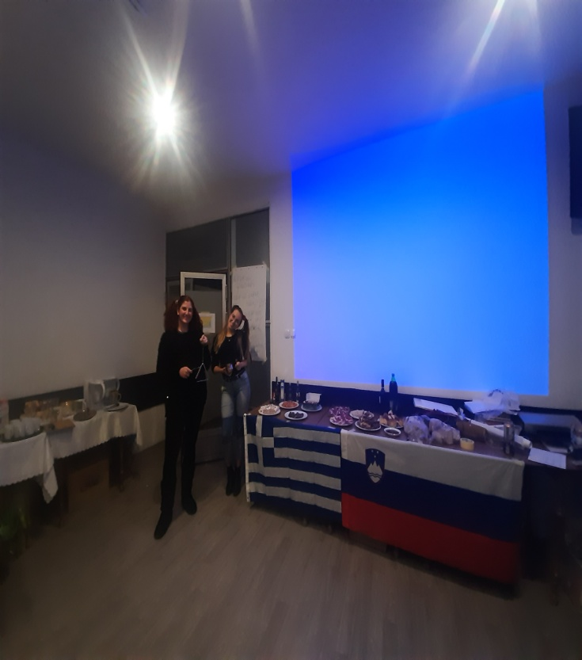
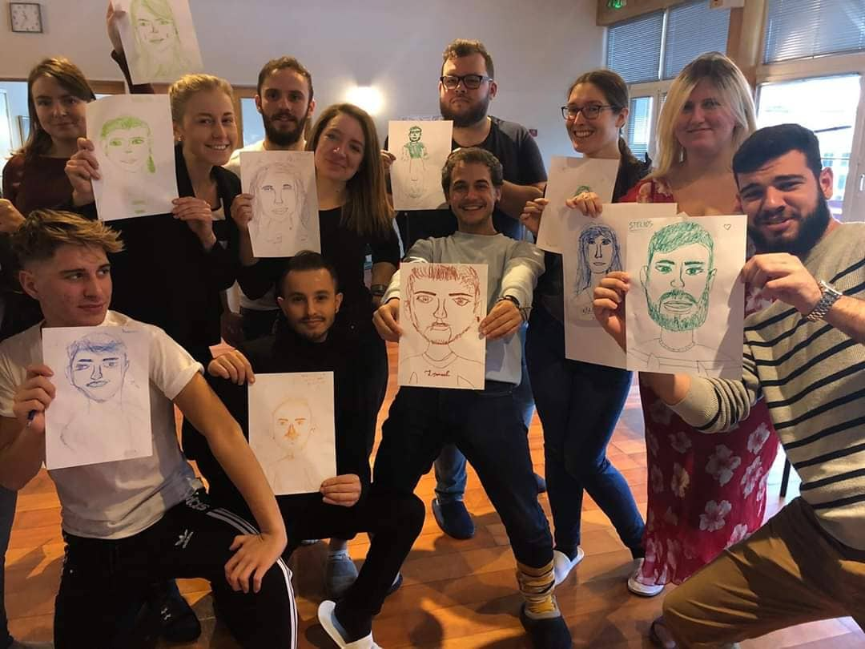
FIELDS WHICH WE ARE ACTIVE AND EXPERIENCED
Local level Youth work
Facilitation of workshops based on Non Formal Education Methods
Development of local and international projects
Synergy with other organizations in the area of Thessaloniki and implementation of local solitary activities( collection of food and clothes)

Slide 7
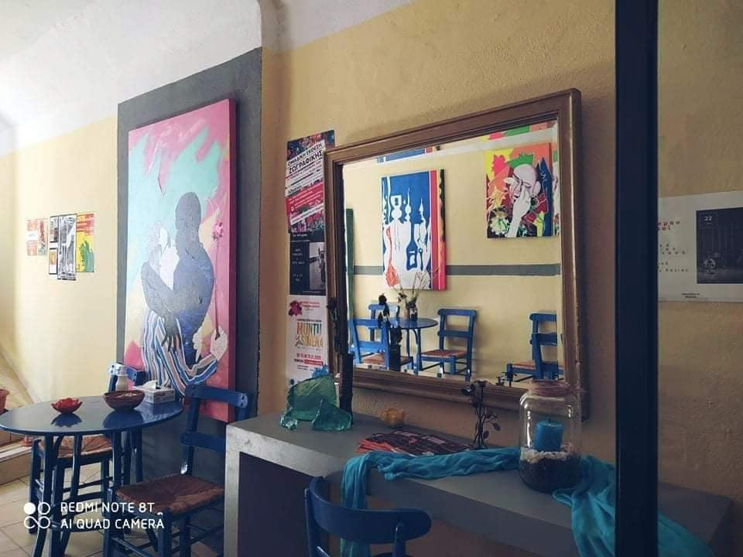
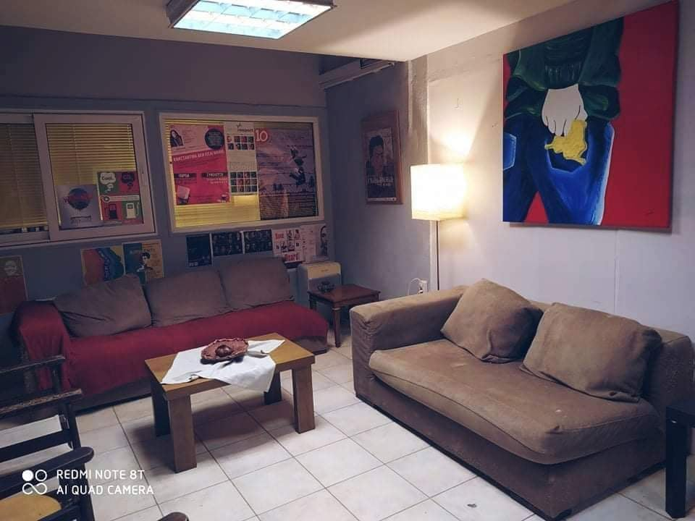
OUR YOUTH CENTER
Since fall of 2020, the space of Volunteer Center “Albatros” in the center of Thessaloniki is hosting our Organization and it gives us the chance to connect meaningfully with more young people!

Slide 8
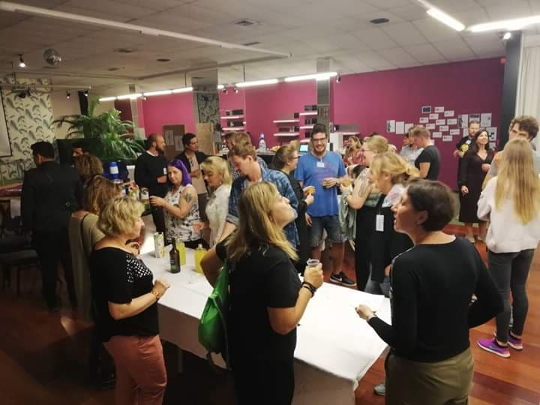
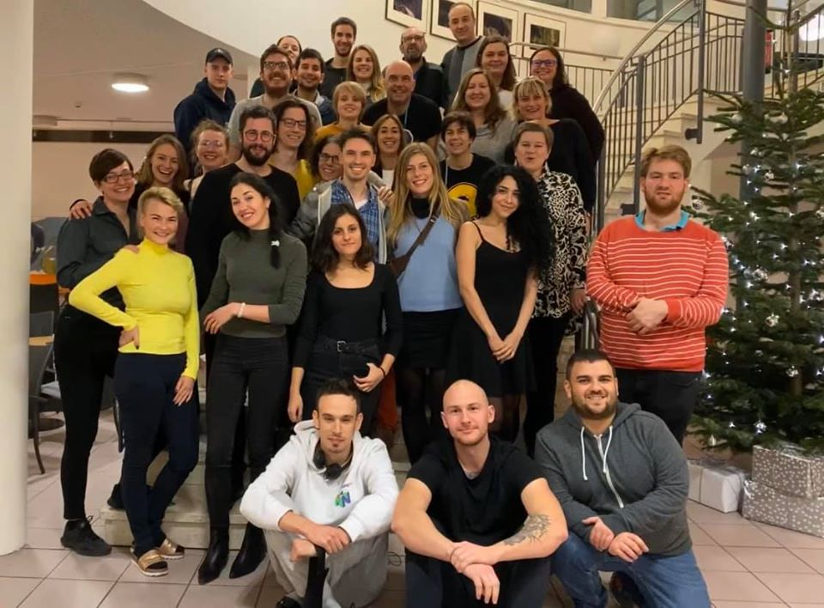
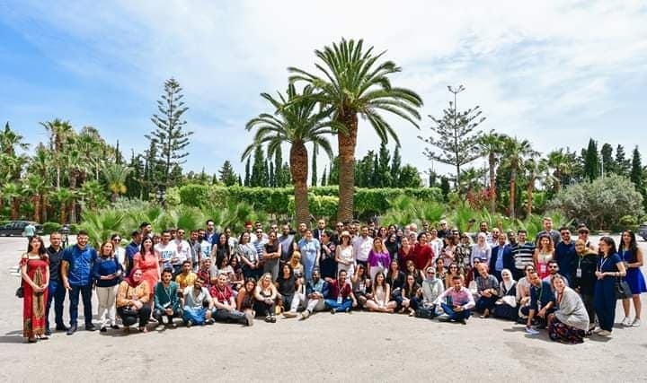
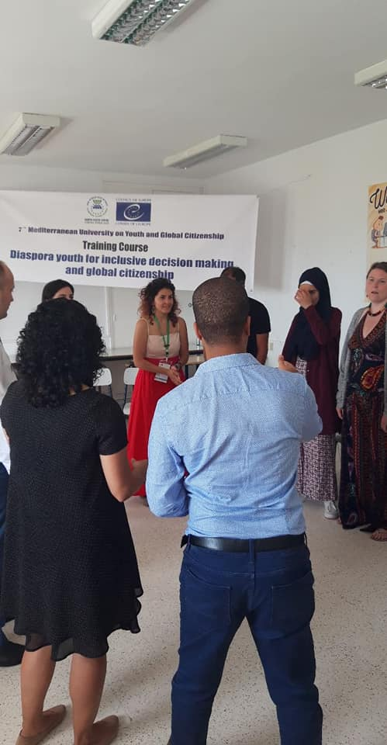
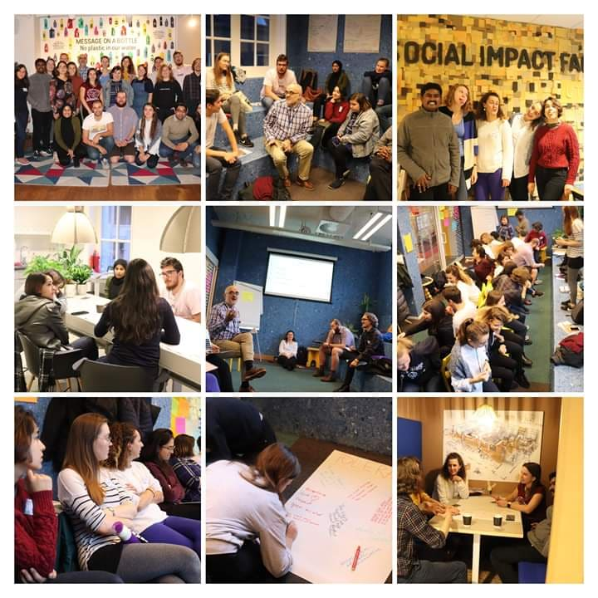
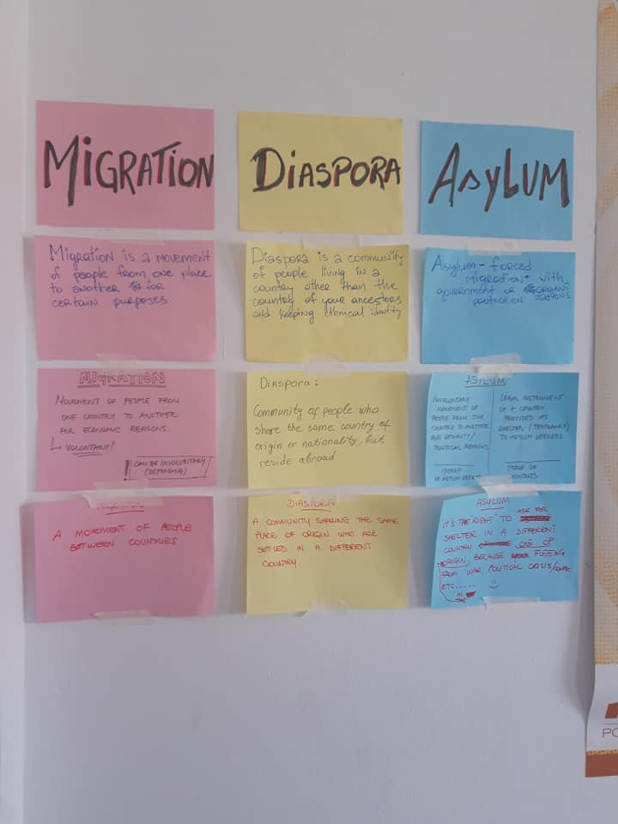
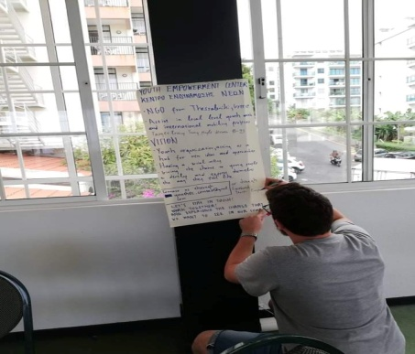
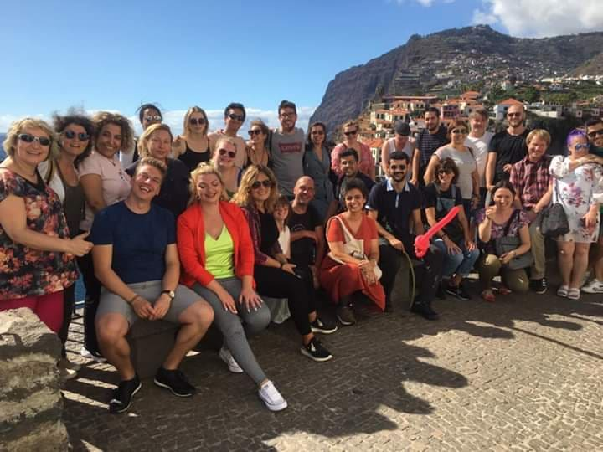
INTERNATIONAL REPRESENTATION

Slide 9
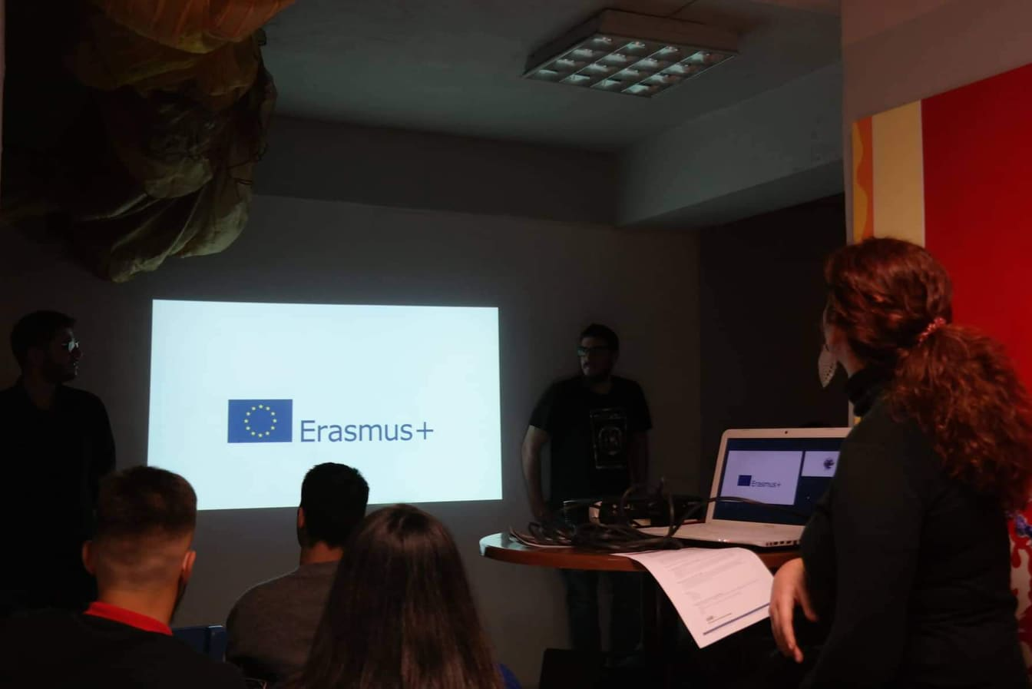
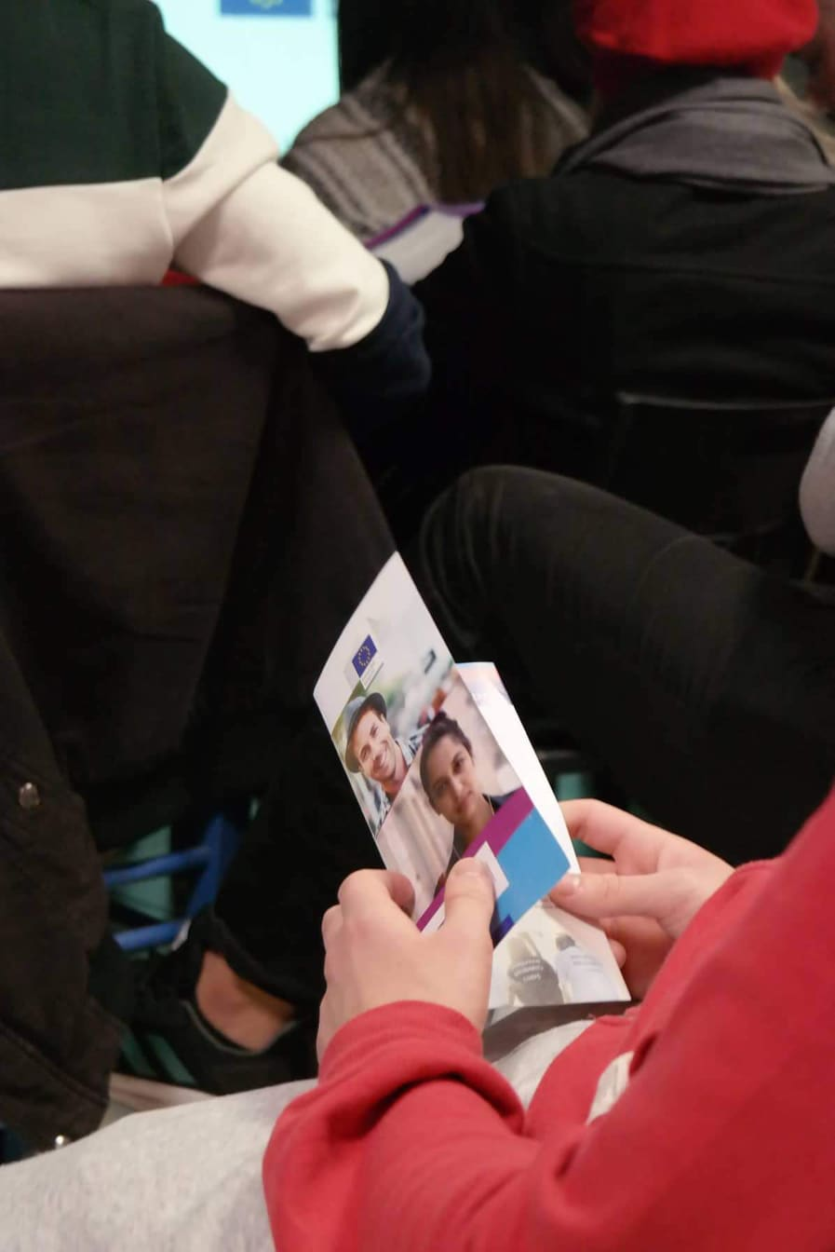
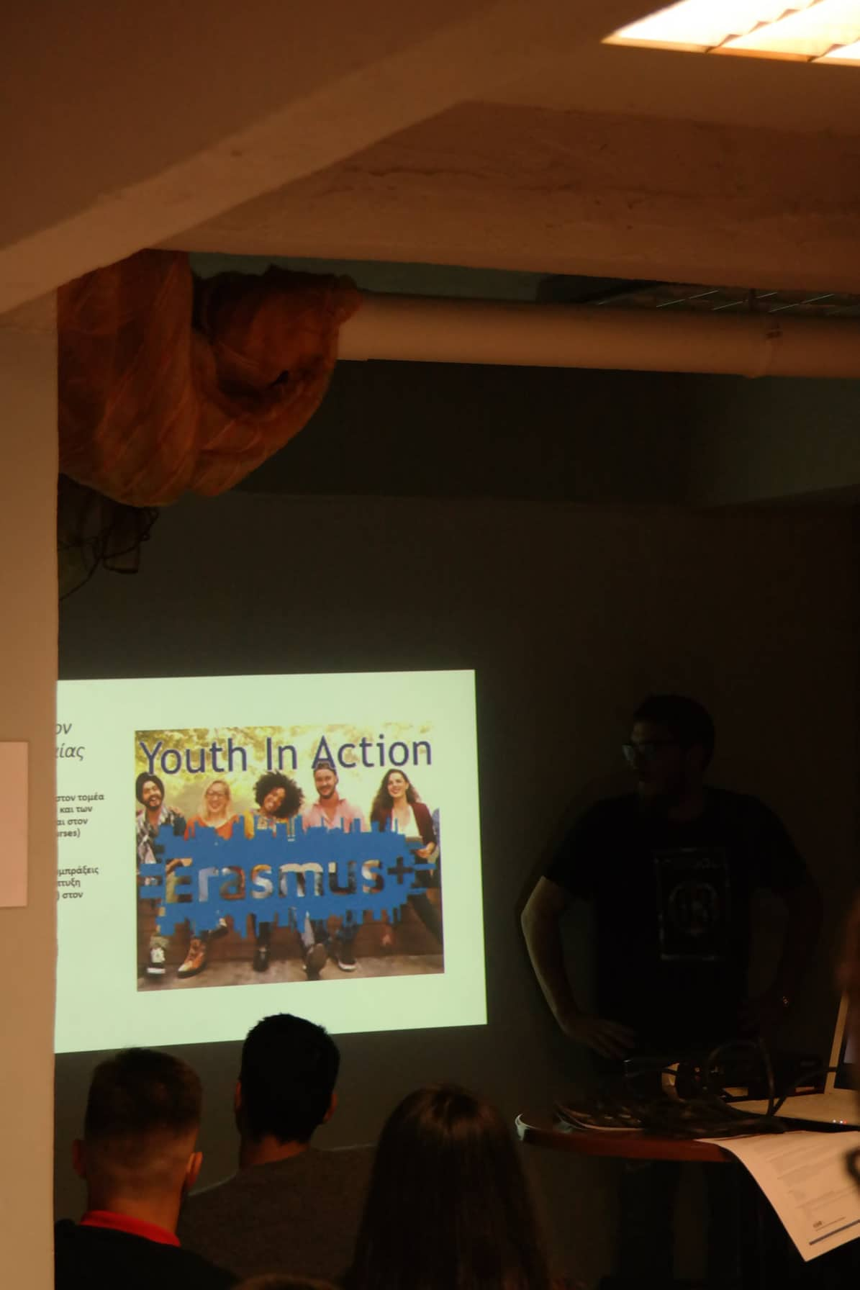
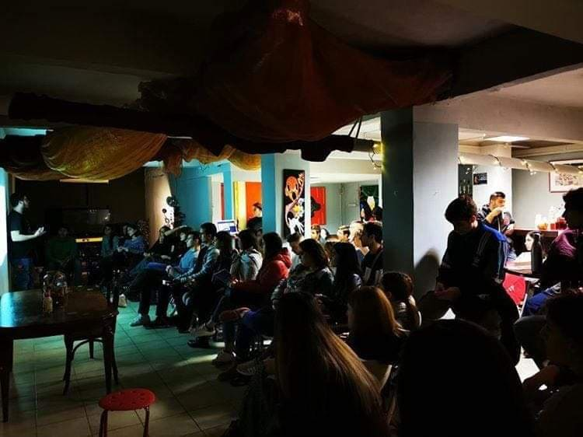
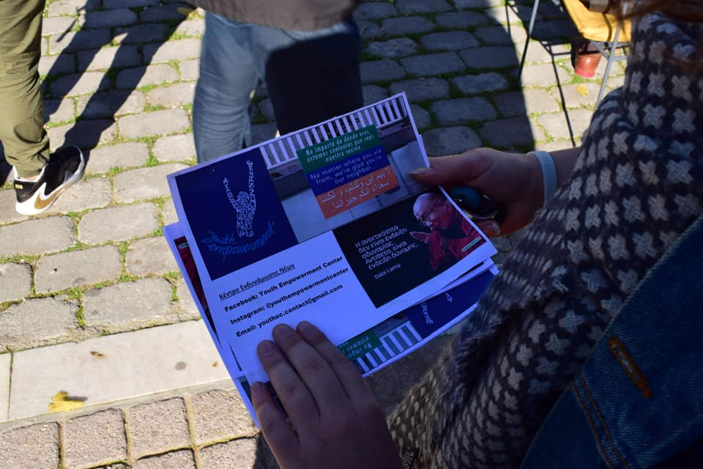
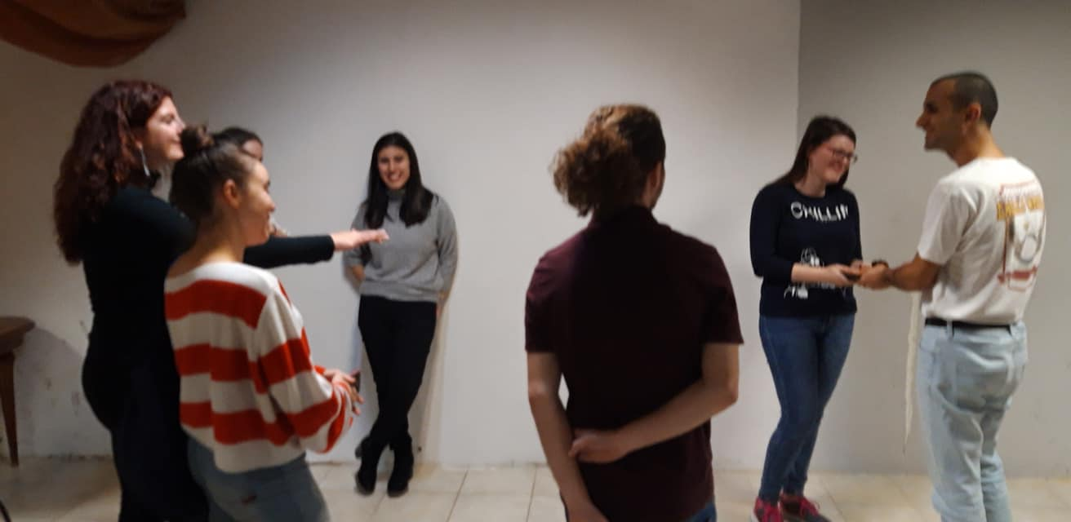
LOCAL ACTIVITIES (supporting young people on creating their own youth projects ,Erasmus+ info days, dissemination events)

Slide 10
EUROPEAN SOLIDARITY CORPS QUALITY LABEL (WITH SUPPORTING ROLE)
Since now, we can give the chance to young people from our community to participate in E.S.C. Volunteering projects abroad!

Slide 11
FUTURE GOALS
Host volunteers from abroad (ESC Quality Label)
Give the chance to more young people from our community to participate in international mobility programs
Coordinate KA3 projects in order to motivate young people to be more engaged in politics while achieving policy advocacy goals

Slide 12
YOU CAN FIND US THROUGH!
Youth Empowerment Center/Κέντρο Ενδυνάμωσης Νέων
@Youth Empowerment Center
https://youthecenter.wordpress.com/
Youth Empowerment Center

Slide 13
THANK YOU FOR YOUR ATTENTION!
LET’S STAY IN TOUCH!
WORK TOGETHER!
AND EXPERIENCE THE CHANGE THAT WE WANT TO SEE IN OUR COMMUNITIES!

