Slide 1
Sanad Youth for Development Foundation
Profile 2019

Slide 2
Who are we?
A non-profit, non-governmental, youth developmental institution licensed by the Ministry of Social Affairs by No. 2632 on 25/10/2017
We have been working with youth since 2013, in the name of SANAD Team for Development, on bridging the gap between them and their future through activities, projects and events that aim for supporting their academic and professional careers.
Over the past six years, we gained confidence and support from the most active entities in different sectors (governmental, private, local and international organizations) sectors, together with their support, sponsorship and partnerships we reached more than 26,000 actual beneficiaries through more than 35 projects were executed in five governorates: Damascus, Hama, Homs, Aleppo and Tartus.

Slide 3
Our Vision
A leading community with competent human resources that can contribute to build a better future and society.
Our Mission
Empower, engage and raise awareness of youth, and who have got the spirit of youth about the academic, professional and educational future choices, in partnership with professional entities and institutions that meet our standards to achieve mutual benefit and continuously contribute in the process of economic and social development

Slide 4
Our Goals
Raise awareness among young people about the concept of the labor market and the available future choices to them through awareness raising campaigns.
Bridge the gap between university students and their theoretical study through effective workshops and trainings.
Give young people the tools and skills to enter the labor market and help them to effectively identify their professional and academic careers.
Break the barrier between young people and operating companies in Syria and familiarize them with their activities directly through exhibitions and events.
Encourage entrepreneurship and promote self-employment by establishing a business incubator for entrepreneurs.
Provide spaces for youth through which they can practice their cultural, scientific and professional activities.
Conduct needs assessments for youth periodically to design and implement projects that serve the stated objectives.
Implement investment projects and activities in accordance with the our objectives to secure income for the institution to cover its needs and the compensation of the individuals working in it.
Raise awareness of Syrian heritage conservation through setting up workshops and projects that serve this.

Slide 5
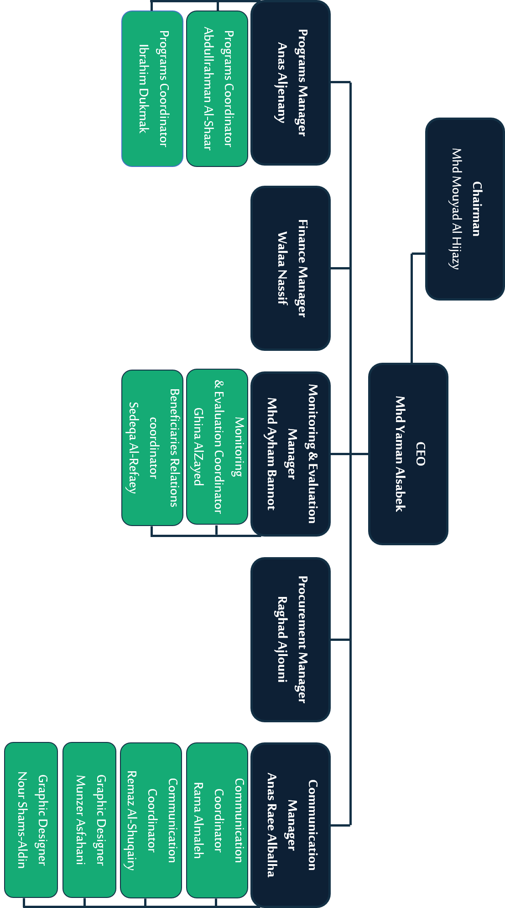
Organization Chat
Notes:
منسق التواصل
مصمم غرافيك
مدير القسم المالي

Slide 6
شركائنا
Private Sector
Banks
Telecommunication companies
Commercial and industrial companies
Training institutes and centers
Advisory firms
Development sector
Local and international organization (NGOs & INGOs)
charities
Voluntary teams
Initiatives
Public sector
Ministry of social affairs
Damascus University
Labor market Observatory

Slide 7
Our Programs
Entrepreneurship & Private Projects Program
Employment & Career Path Program
Academic Path Program
Social Participation Program

Slide 8
1- Employment & Career Path Program
Empower young people entering the labor market with what suits their qualifications through specialized training workshops or field visits, and a set of interactive activities.
Project Title | Project Description | Number of Beneficiaries
 | Specialized training workshops for students of (economics, medicine, engineering and information,…) to enable them to have the tools and skills to enter the labor market. | 3471
 | A forum for all potential and effective labor market entities as well as academic institutions, voluntary groups, initiatives and business incubators with students and graduates from various colleges and disciplines. | 20500
Notes:
اسم المشروع – الوصف –عدد المستهدفين
هدف البرنامج
حذف رقم تيكيت 2

Slide 9
1- Employment & Career Path Program
Empower young people entering the labor market with what suits their qualifications through specialized training workshops or field visits, and a set of interactive activities.
Project Title | Project Description | Number of Beneficiaries
 | Specialized educational and training courses offered by educational institutes, and private centers in five governorates. | 1228
 | A forum for medical college students aims to make them aware of available choices for them and the basic skills that they must have. | 67
 | Awareness-raising sessions for all students in all disciplines to make them aware of their academic & professional career. | 444
Notes:
اسم المشروع – الوصف –عدد المستهدفين
هدف البرنامج
حذف رقم تيكيت 2

Slide 10
2- Entrepreneurship & Private Projects Program
Empower, support and engage young people, entrepreneurs, micro projects and independent businesses with the knowledge, skills and necessary tools to establish and sustain their business to help them & others.
Project Title | Project Description | Number of Beneficiaries
 | Support Syrian youth through consultations and training necessary to start any private or independent business and provide them with the necessary funding to establish their projects through several supporting entities. | 196
 | A forum for freelancers aims to promote freelancing, highlight the most important experiences and achievements of Syrian youth in this field and help young people interested in reaching the most important companies and platforms that support this kind of work. | 274
Entrepreneurial summer school | A training camp for youth aims to give them the tools through practical training that helps them determine their leading path | 30
Notes:
حذف الرقم شيفت 2

Slide 11
3- Academic Path Program
Support the academic career and educational attainment of youth, helping them to obtain internal or external scholarships, as well as encouraging self-learning and empowering their scientific research skills.
Project Title | Project Description | Number of Beneficiaries
 | A forum for medical students in all specialization & scientific research workers that aims to highlight the skills and tools of scientific research, that ends with medical research competitions. | 68
 | Social Research forum empower masters students, graduates and researchers, and those interested in this field, with scientific research tools and scientific research methodology, through professional training that ends with presenting research proposals to finally help them completing their research papers. | 116
 | Master's degree scholarships in business and economic disciplines offered by Dr. Osman Aiidi Foundation. | 33

Slide 12
4- Social Participation Program
Support & participate with stakeholders, institutions, initiatives and individuals to achieve common benefit and contribute to continuing of economic and social development process.
Project Title | Project Description | Number of Beneficiaries
 | A project that uses debate and negotiation as tools to raise awareness and highlight the questionable issues facing Syrian youth | 46
 | The project aims to train young people in business, entrepreneurship and social leadership | 26
 | SANAD is the youth partner in Al Baraka Bank Business Leadership Initiative - Takween The project aims to support entrepreneurs and turn their ideas into reality. | 22

Slide 13
4- Social Participation Program
Participate and support stakeholders, institutions, initiatives and individuals to achieve common benefit and contribute to continuing of economic and social development process.
Project Title | Project Description | Number of Beneficiaries
International Youth Day | A forum for effective and influential youth within their community, to highlight and discuss the most important issues facing Syrian youth | 198
 | UNHCR World Youth Initiative 2015 aims to empower women, children and youth. Sanad supported young people and prepare about 27 beneficiaries to be leaders of empowerment in their communities | 27
Gates | E-gateways that aim to enhance Arabic content to be more valuable, specially business content.

Slide 14
Our goals are crossed with SDGs objectives
Through supporting entrepreneurs and freelancers to generate their own income
Through Academic Path Program, aware youth about education and provide them with tools to pursue their education
Through our standards that emphasize accepting beneficiaries regardless of their gender
by creating & offering jobs opportunities within different sectors
Networking with various governmental, private and development entities to unite efforts to have a sustainable impact

Slide 15
Geographical distribution of the foundation’s projects:
Aleppo
1
Hamah
4
Tartus
2
Homs
2
Damascus
30

Slide 16
Contact us
 | Damascus | Hama
 | Hamra st – Al-Kuwait Building no.4 – 4th floor | Old city – Al-Tawafra st – next to khan-kah mosque – ground floor
 | 0993350600 0113354145 | 0993350588
 | info@sanadyouth.org
Social Media Websites: /Sanadtfd |  | Bank Account Number: 202694 Syrian International Islamic Bank

