Slide 1



EPHESUS YOUTH TEAM
INFORMAL YOUTH GROUP FOR ERASMUS+ PROJECTS

Slide 2

WE STARTED WORKING ON 20 APRIL 2018
WE ESTABLISHED IN İZMİR, TURKEY
WE HAVE IDENTIFIED 7 WORKING TOPICS
7 HANDS IN OUR LOGO REPRESENT 7 WORKING TOPICS
NOW WE ARE AN INFORMAL YOUTH GROUP THAT CARRIES OUT PROJECTS AND ACTIVITIES ON THIS ISSUES…

Slide 3

Ephesus Youth Team carries out activities regularly for their young members and volunteers. Besides it produces and conducts national projects, develops partnership on the determined 6 mission topics. Especially the youth in particular to classified as woman, person with disability, refugee, minority and in disadvantaged on the subject of sociality, economy, geography etc. - each individual who lives in Turkey (between 18-30 years) is focus group of Ephesus Youth Team
Our organization aims at both working on rights and problems of the youth like woman & people with disabilities in the society and contributing to their development without being unhealthy and behind the times. Besides, we carry on our works for popularizing the volunteering between the youth and being high level of participation in volunteering activities.

Slide 4


Slide 5
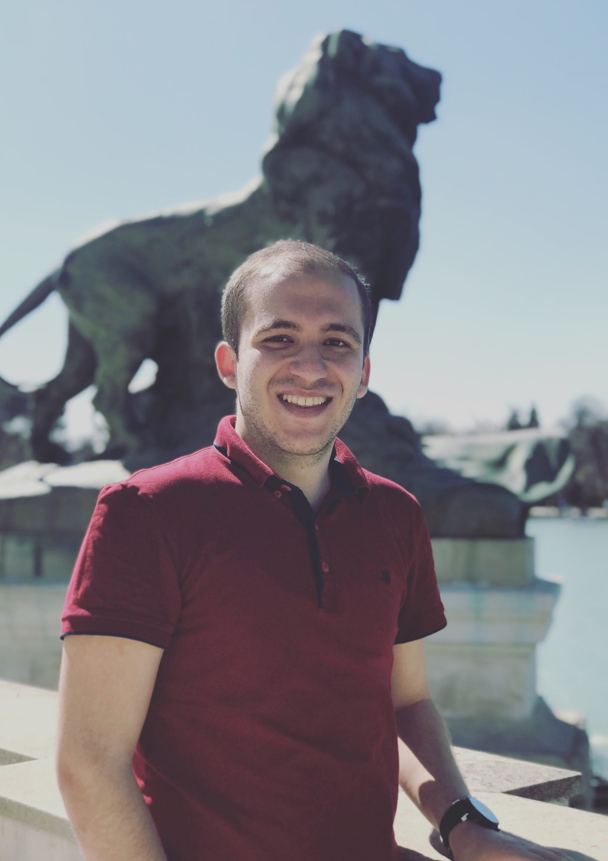
MEHMET KEPENEK
PRESIDENT OF OUR ORGANIZATION
STUDENT OF MECHANICAL ENGINEERING
TASKS
Corporate Represantation
General Coordination
International Correspondence and Coordination
Web Site and Social Media Management

Slide 6
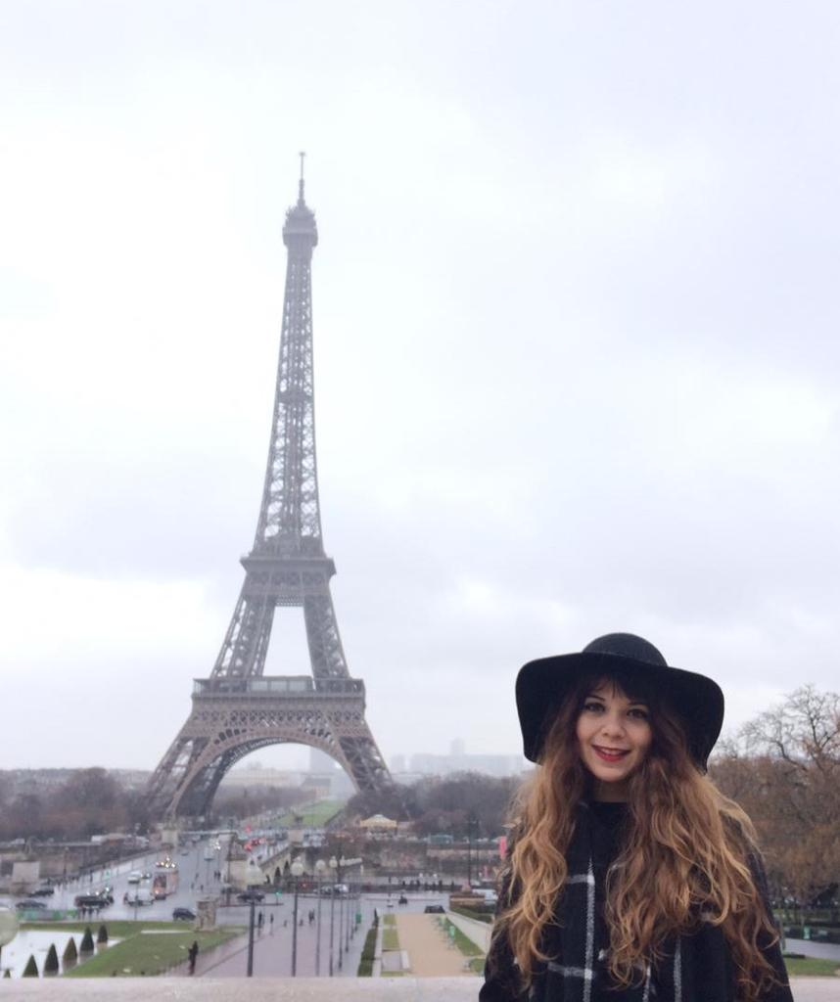
Nesli Geray
VOLUNTEER OF OUR ORGANIZATION
FOOD ENGINEERING GRADUATE
TASKS
Tracking Project Documents
Member of Volunteer Support Team
Updating Partnership Database

Slide 7
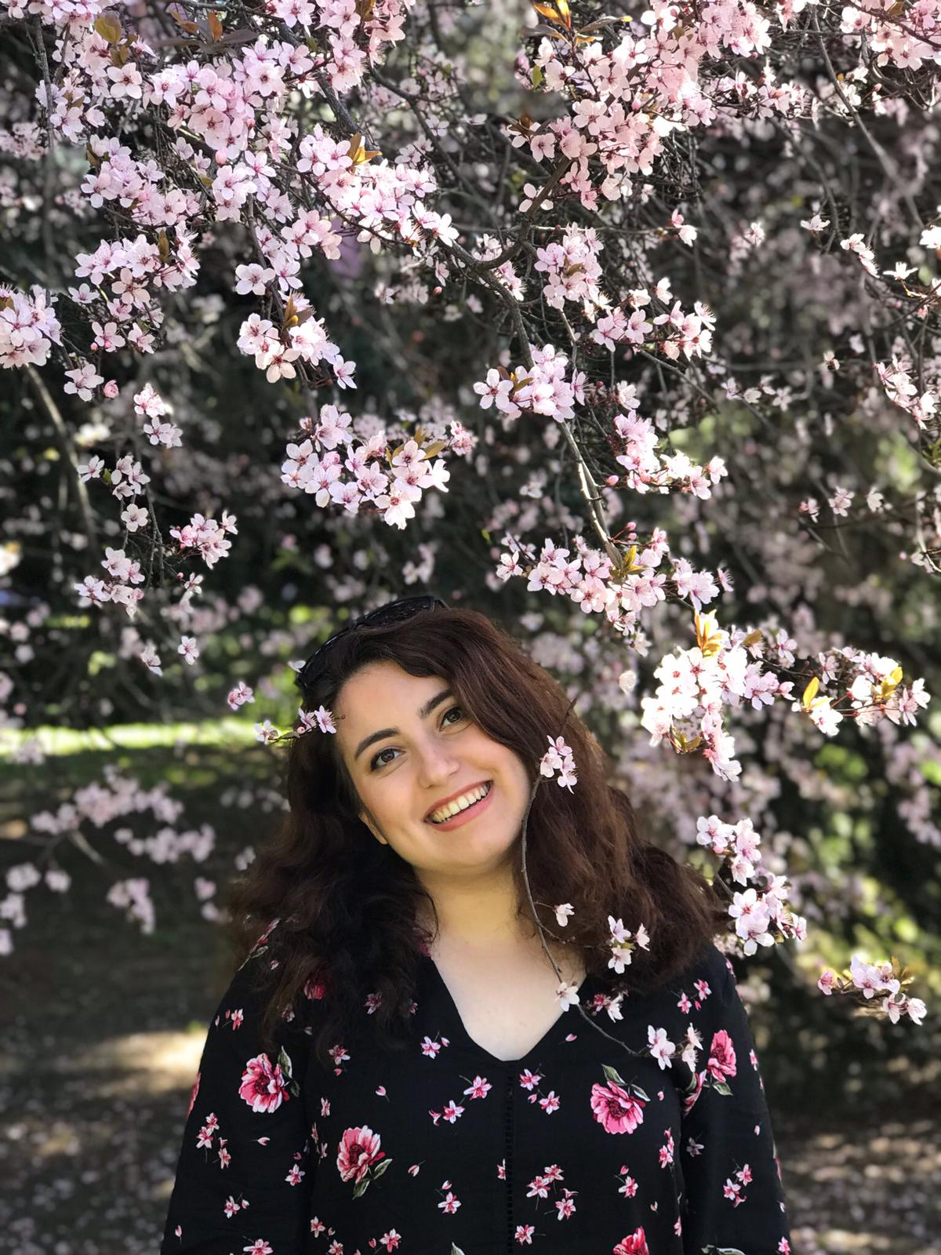
YAĞMUR DENİZ
VOLUNTEER OF OUR ORGANIZATION
PSYCHOLOGY AND SOCIAL SERVICE GRADUATE
TASKS
Organazing Erasmus+ Information Seminars
Member of Volunteer Support Team
Responsible for Communication

Slide 8

OUR WORKING SUBJECTS
Youth Rights and Problems
Refugees and Migrant
Healty Lifestyle and Ecology
Supporting Disadvantaged Groups
Voolunteerism
Technology Based Deveploment
New Media and Social Media

Slide 9

OUR NATIONAL PROJECTS

Slide 10
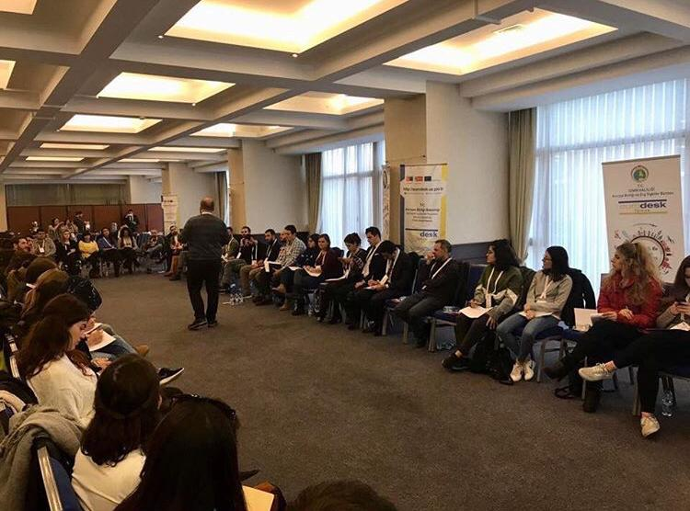
Project Cycle Management For Youth
3-5 DECEMBER 2018
İzmir, Turkey
Young People From All Of Turkey
(İzmir Eurodesk Contact Points)

Slide 11
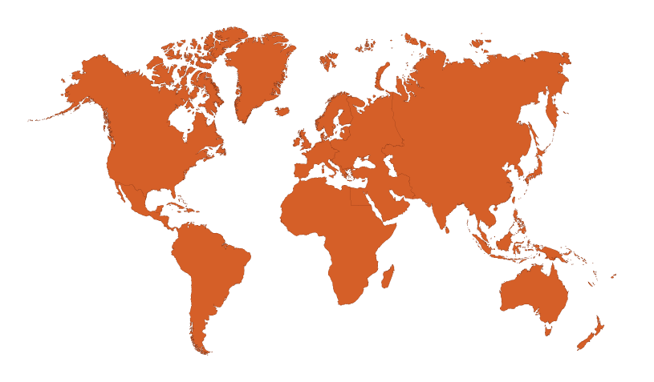
OUR INTERNATIONAL PROJECTS

Slide 12
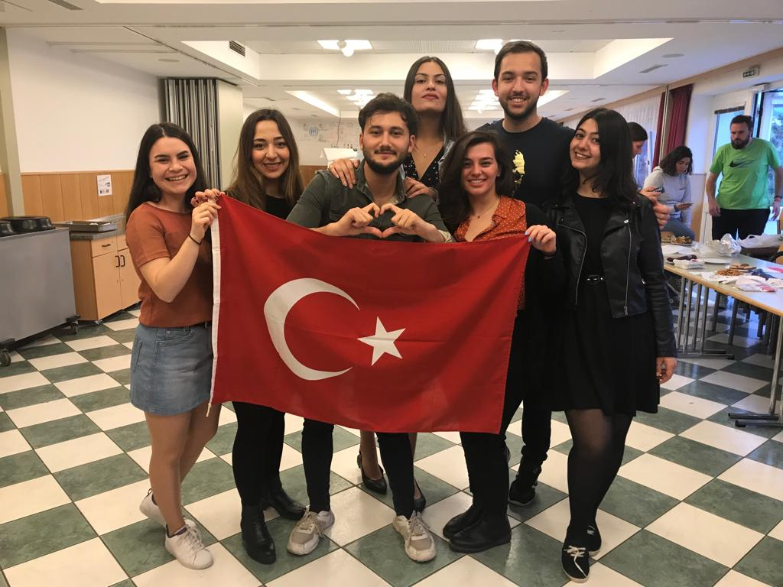
Equality Call For All
17-25 MAY 2019
Klaffer, Austria
Bulgaria, Italy, Portugal, Romania, Slovenia, Hungary, North Macedonia, Austria and Turkey

Slide 13
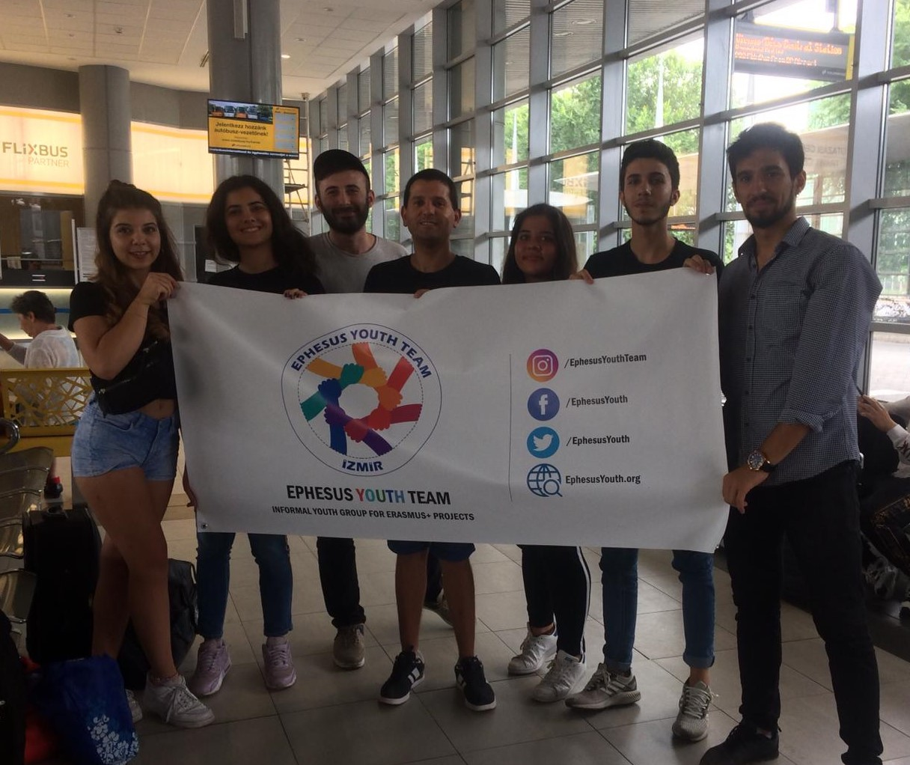
Entrepreneurship Idea And Establishment Of An Enterprise In Community
29 JULY - 03 AUGUST 2019
Sturovo, Slovakia
North Macedonia, Poland, Slovakia and Turkey

Slide 14



Slide 15


www.ephesusyouth.org
Facebook and Twitter: @EphesusYouth
Instagram: @EphesusYouthTeam
E-mail: EphesusYouthTeam@gmail.com
WhatsApp: +90 232 261 8847

