Slide 1
İZMİR INSTITUTE OF TECHNOLOGY
İZTECH
www.iztech.edu.tr
Notes:
1

Slide 2
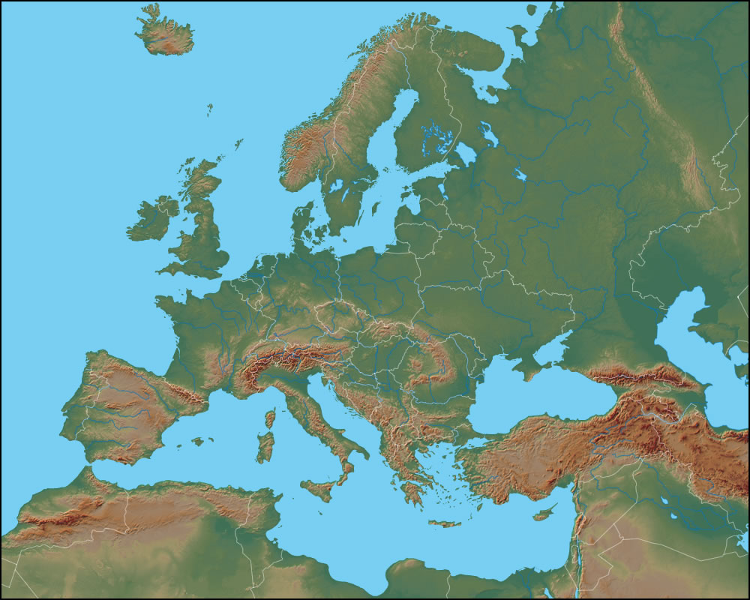
İzmir
www.iyte.edu.tr

Slide 3
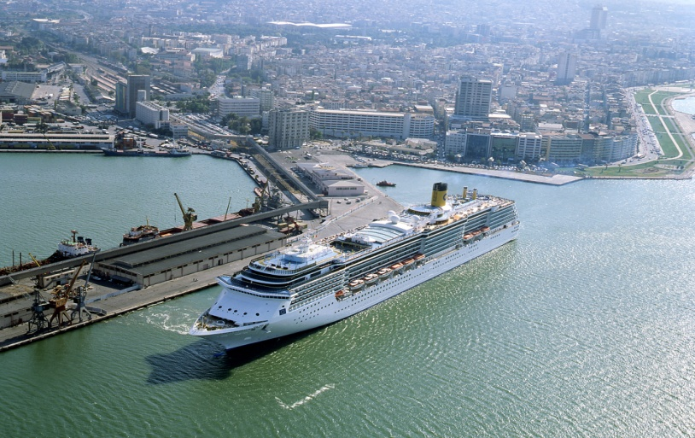
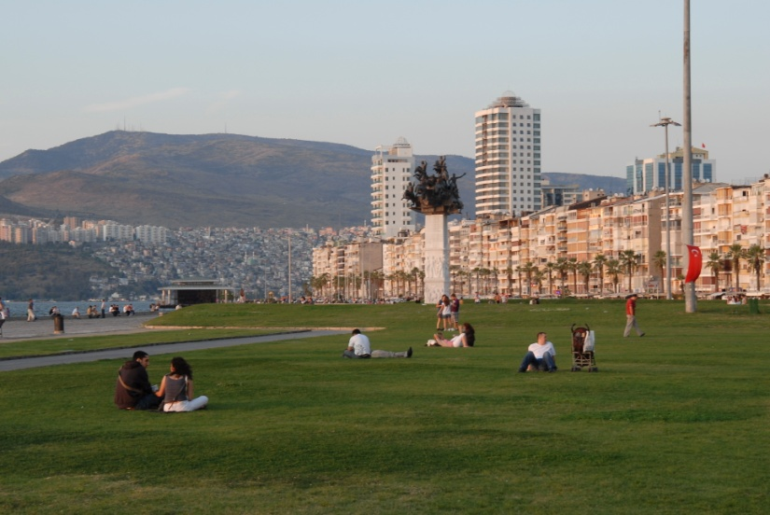
I. ABOUT İZMİR
3
"İzmir" probably derives from the
former Greek name "Smyrna”
Close to historic sites like Ephesus, Pergamon and Priene
The second largest port and the
third largest city in Turkey
Mediterranean climate
www.iyte.edu.tr

Slide 4
II. İZMİR INSTITUTE OF TECHNOLOGY
Founded in 1992 as a state university
The only Turkish Institute of Technology in Turkey
Emphasis is on education and research in science and technology
Language of instruction is English
The campus is in Gülbahce / Urla/ İzmir
3.500 hectares campus area & 132.000 square meters closed area
(The biggest campus area in İzmir)
www.iyte.edu.tr

Slide 5
FACTS AND FIGURES (2015)
5
Students:
 | Female | Male | Total
Undergraduate | 1293 | 1599 | 2892
Master | 472 | 506 | 978
PhD | 214 | 159 | 373
Total: | 1979 | 2264 | 4243
Number of International Students: 152 from 50 different nationalities
www.iyte.edu.tr

Slide 6
FACTS AND FIGURES (2015)
Employees:
907 employees (Academic Staff: 523; Administrative Staff: 384)
Academic staff
Assistant Professors: 81
% 62 of the faculty received their PhD Degrees from foreign
universities.
Associate Professors: 45
Professors: 60
Instructors + Research Assistants + Experts + Lecturers + Translators = 337
www.iyte.edu.tr

Slide 7
MISSION AND VISION
Mission
To carry out advanced research, education and production as well as
publication and counselling in the field of science and technology
Vision
To be a leader in science and technology and a unique world university
in terms of its educational standards
www.iyte.edu.tr

Slide 8
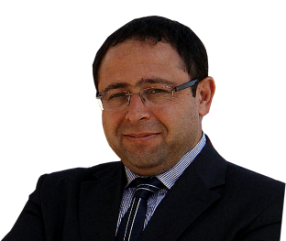
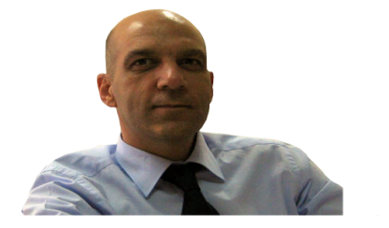
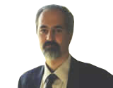
THE ADMINISTRATION
Prof. Dr. Mustafa GÜDEN
Rector
Administration
Board
Senate
Prof. Dr. Ahmet Nuri BAŞOĞLU
Vice Rector
Prof. Dr. Serdar KALE
Vice Rector
Prof. Dr. Ahmet E. EROĞLU
Rector’s Advisor
www.iyte.edu.tr

Slide 9
OUR RANK IN TURKEY
The number of refereed articles in the international journals per faculty
member is 1.36 (2014)
Total Publication Amount: 2313 (1995-2014)
İzmir Technology Development Zone ranks 2nd on the 2013 Performance
Index.
Most of the faculty have awards of
1. Turkish Academy of Sciences 2. The Scientific and Technological Research Council of Turkey 3. International Awards
www.iyte.edu.tr

Slide 10
RESEARCH FACTS
Number of Tübitak Projects: 243
Budget of Tübitak Projects : 42.353.378,33 TL
+ 343.224,00 €
Number of Santez Projects: 23
Budget of Santez Projects: 6.201.999,88 TL
Number of EU Projects: 19
Budget of EU Projects: 2.679.046,00 €
www.iyte.edu.tr

Slide 11
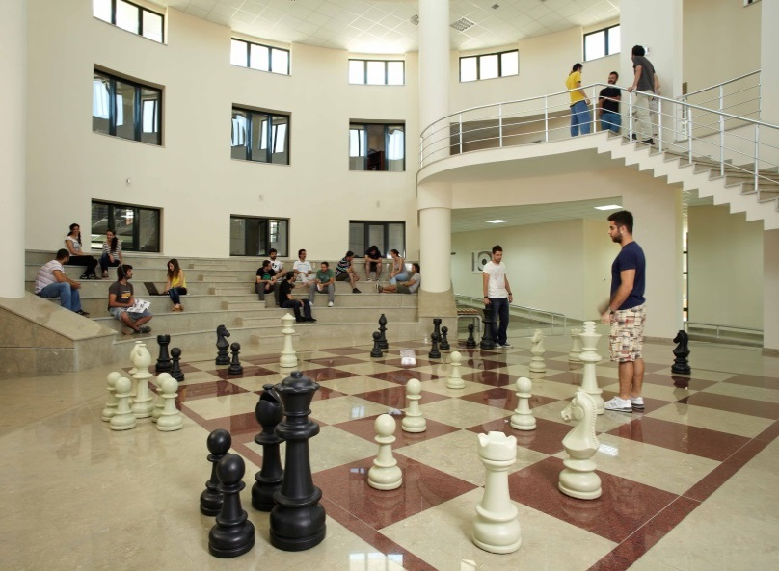
III. FACULTIES, DEPARTMENTS AND PROGRAMMES
3 faculties with 20 departments
Programmes
-12 undergraduate programmes
-24 master programmes (2 interdisciplinary)
-18 doctoral programmes
www.iyte.edu.tr

Slide 12
Rectorate
Faculty of Science
Faculty of Engineering
Faculty of
Architecture
The Graduate School
of Eng. & Sciences
Research
Centers
School of Foreign
Languages
Computer Eng. (BS, MS, PhD)
Industrial
Design (MS)
Environmental Development
Application and Research
Center
INTEGRATED RESEARCH CENTER
Physics
(BS, MS, PhD)
Chemistry
(BS, MS, PhD)
Bioengineering (MS in
Biotechnology, PhD in
Bioengineering)
Architectural
Restoration (MS,
Non-thesis MS, PhD)
Computer Application
& Research Center
Biotechnology &
Bioengineering
Research Center
Mathematics
(BS, MS, PhD)
Electrical & Electronics
Eng. (BS, MS, PhD)
Architecture
(BS, MS, PhD)
Molecular
Biology and Genetics
(BS, MS, PhD)
Food Eng. (BS, MS, PhD)
City & Regional
Planning (BS, MS, PhD
in City Planning, MS in
Urban Design)
Geothermal Energy Research
and Application Center
Civil Eng. (BS, MS, PhD)
Photonics
(MS, PhD)
Center for Materials Research
Chemical Eng. (BS, MS, PhD)
Neurosciences
(MS, PhD)
Mechanical Eng. (BS, MS, PhD)
Continuing Education Center
Materials Science and Eng.
(MS, PhD)
Environmental Science and Eng.
(MS, PhD)
Engineering Management
(Non-thesis MS)
Service Department:
General Cultural
Courses
Interdisciplinary
Programmes
Energy Systems Engineering
(MS)
Energy Eng. (MS)

Slide 13
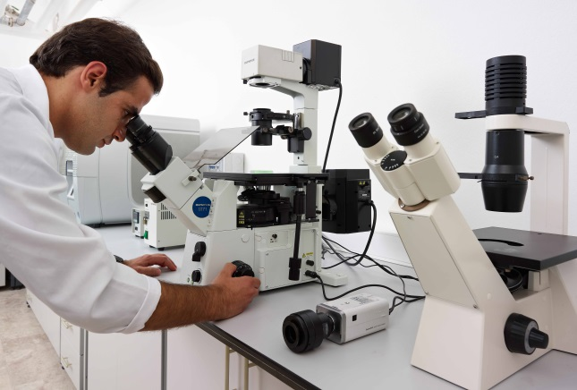
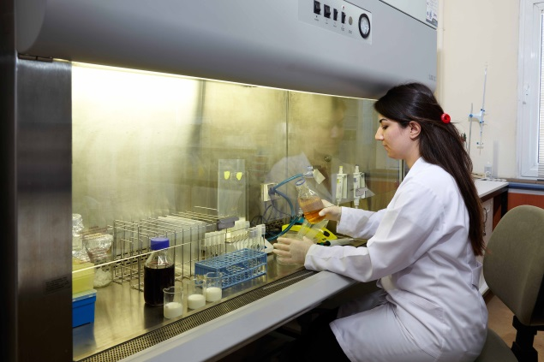
DEPARTMENTS AND RESEARCH AREAS
Department of Mol. Bio. & Genetics
Research Areas: Molecular Biology, Cancer
Biology, Plant Genetics & Biotechnology,
Immunology
Department of Chemistry
Research Areas: Physical Chemistry, Organic
and Inorganic Chemistry, Environmental Chemistry
www.iyte.edu.tr

Slide 14
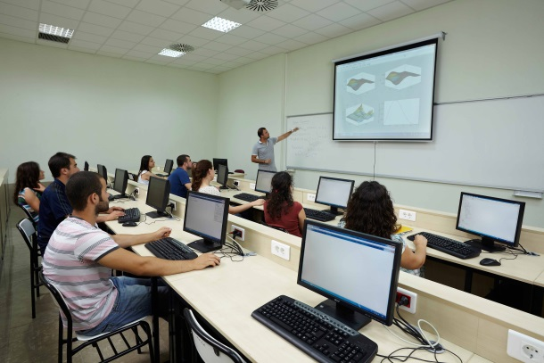
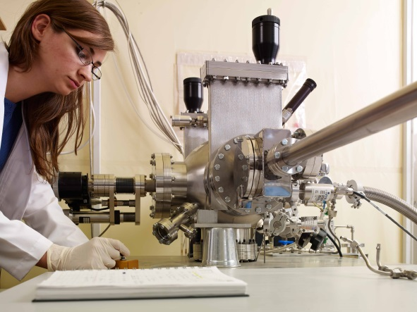
DEPARTMENTS AND RESEARCH AREAS
Department of Mathematics
Research Areas: Algebra, Mathematical
Physics, Numerical Analysis, Spectral Theory
Department of Physics
Research Areas: Condensed Matter Physics, High Energy Physics, Cosmology, Optics
www.iyte.edu.tr

Slide 15
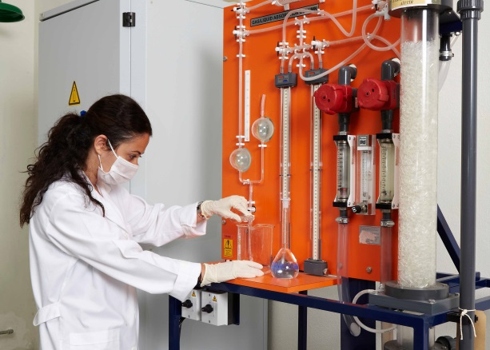
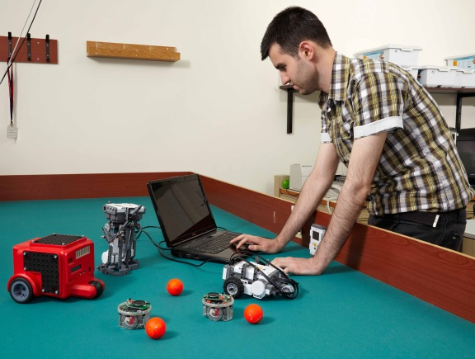
DEPARTMENTS AND RESEARCH AREAS
Department of Chemical Engineering
Research Areas: Catalytic Reaction Engineering, Composite Materials, Zeolites, Process Control
Department of Computer Engineering
Research Areas: Computer Networks, Software Engineering, Wireless Networks,
Artificial Intelligence
www.iyte.edu.tr

Slide 16
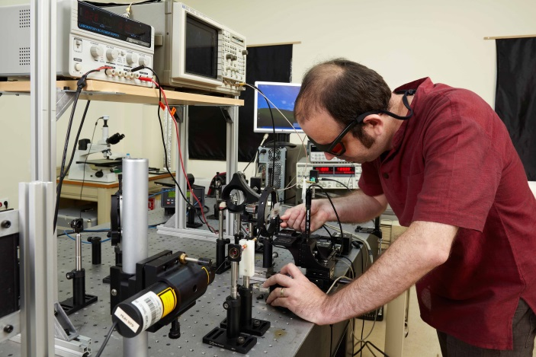
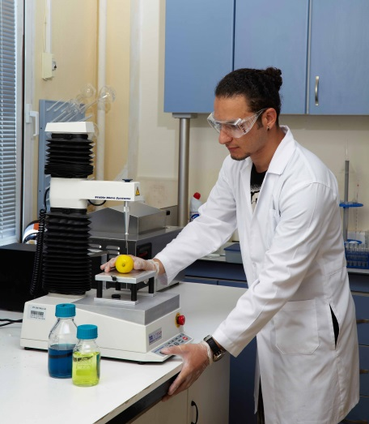
DEPARTMENTS AND RESEARCH AREAS
Department of Elect. & Electro. Eng.
Research Areas: Image Processing, Audio Processing, Microwave &Antenna, Statistical Signal Processing
Department of Food Engineering
Research Areas: Food Quality Control, Food Safety, Functional Foods, Fermentation, Downstream Processing
www.iyte.edu.tr

Slide 17
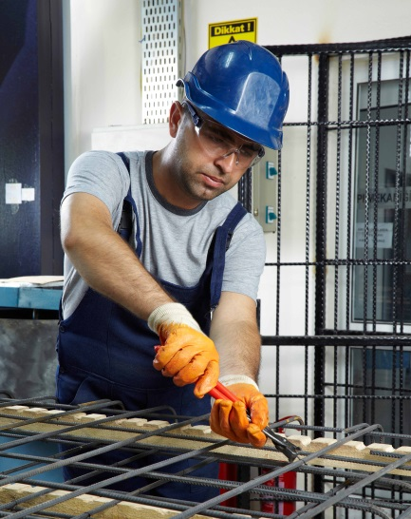
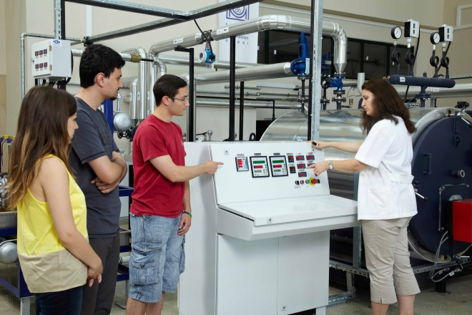
DEPARTMENTS AND RESEARCH AREAS
Department of Civil Engineering
Research Areas: Water Resources Engineering, Construction Materials, Geotechnical Engineering
Department of Mechanical Engineering
Research Areas: Mechatronics, Material Technologies, Composites-Biomaterials, Nanomaterials, Robotics
www.iyte.edu.tr

Slide 18
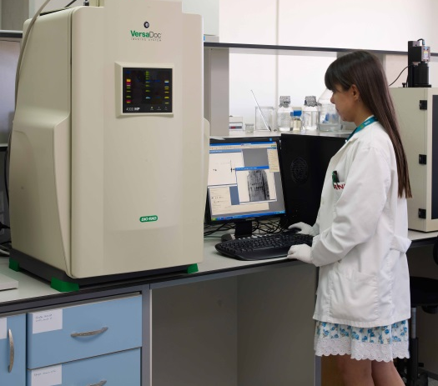
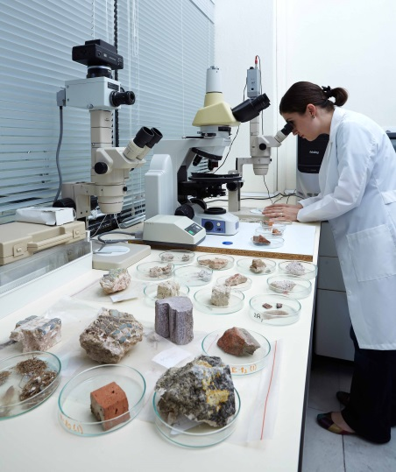
DEPARTMENTS AND RESEARCH AREAS
Department of Bioengineering
Research Areas: Biomedicine, Biomaterials, Drug Development and Delivery, Cancer Nanotech. , Biochips, Biomechanics, Bioinformatics...
Department of Materials Science and Engineering
Research Areas: Ceramic, Polymer, Metal and Composite Materials Processing and Characterization, Nano Material Synthesizes and Characterization
www.iyte.edu.tr

Slide 19
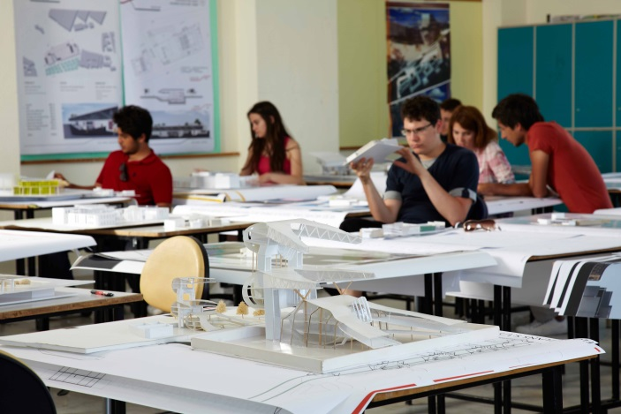
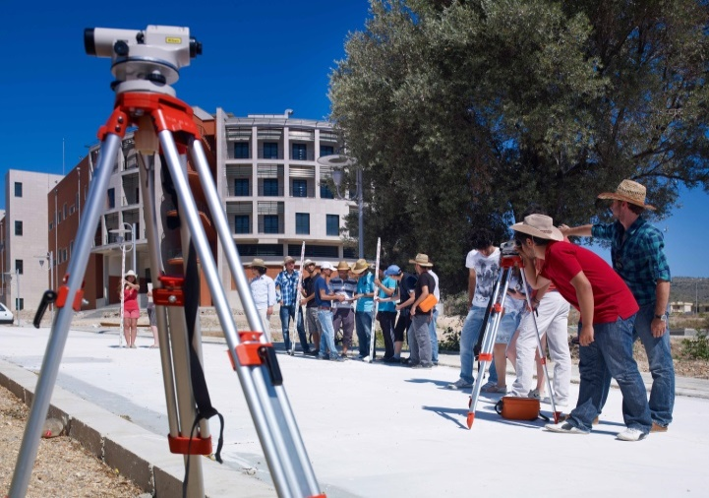
DEPARTMENTS AND RESEARCH AREAS
Department of Architecture
Research Areas: Modern Turkish Architecture, Contemporary Turkish Architecture,
Ottoman Architecture, Cultural Studies and Architecture
Department of City and Regional Planning
Research Areas: Planning Theory, Urban Transportation and Infrastructure,
Urban Policy and Land Use Planning
www.iyte.edu.tr

Slide 20
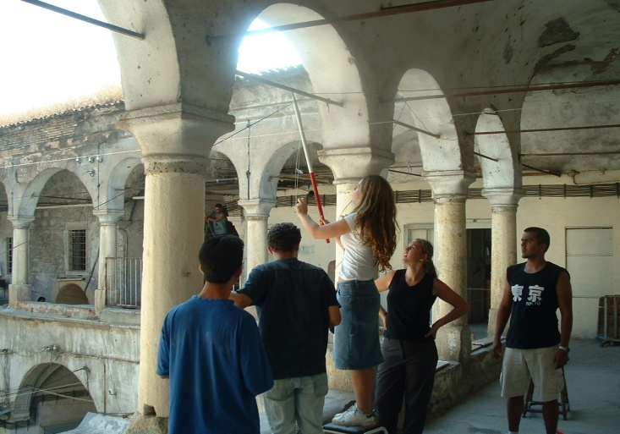
DEPARTMENTS AND RESEARCH AREAS
Department of Architectural Restoration
Research Areas: Conservation and Rehabilitation of Historical Buildings, Conservation of Archaeological Sites, Conservation Problems of Historical Building Materials
Department of Industrial Design
Research Areas: Gendered Design, Culture and Design, Cultural Studies, Transportable Mobile Houses
www.iyte.edu.tr

Slide 21
NEW DEPARTMENTS AND RESEARCH AREAS
1. Department of Photonics: Photonic Devices, Photonic Materials, Photonic
Systems, Nanophotonics
Department of Neurosciences: Technologies needed for Neurosciences,
Preclinical Studies
3. Department of Energy Systems and Engineering: Energy Efficiency, Energy
Management Systems
4. Department of Environmental Science and Engineering: Analysis and
Characterisation of Wastewaters, Wastewater Treatment Methods
www.iyte.edu.tr

Slide 22
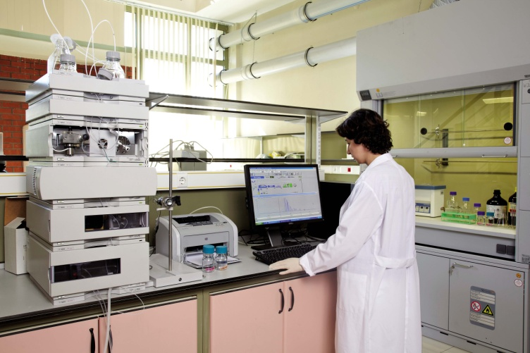
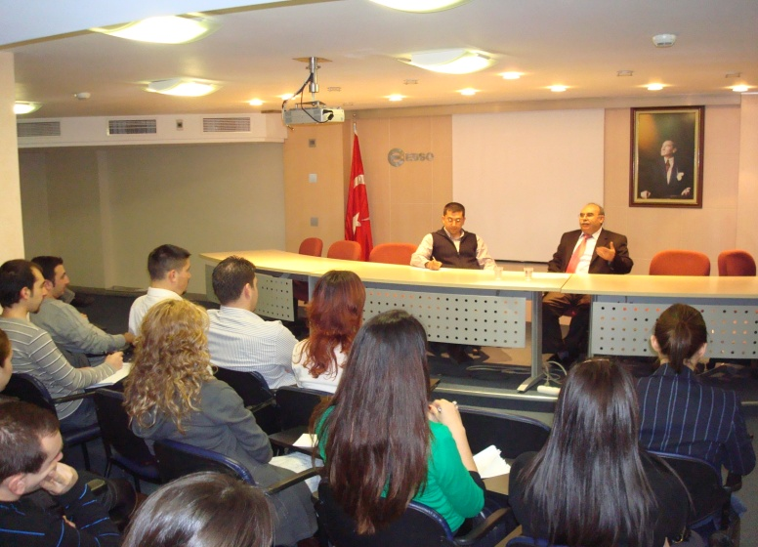
INTERDISCIPLINARY PROGRAMMES
Energy Engineering
Research Areas: Solar Energy, Geothermal Energy, Wind Energy, Energy Efficiency, Energy Management Systems
Engineering Management
Research Areas: Project Management, Total Quality Management, Management Information Systems, Marketing and Managerial Economics
www.iyte.edu.tr

Slide 23
IV. INTEGRATED RESEARCH CENTER
Having 6.000 m² closed area and
being the most comprehensive complex
in Turkey, the Integrated Research Center
incorporates the centers below:
Center for Materials Research
Environmental Development
Application and Research Center
Geothermal Energy Research and
Application Center
Biotechnoloy and Bioengineering
Research Center
Computer Engineering and Research Center
www.iyte.edu.tr

Slide 24
INTEGRATED RESEARCH CENTER
Biotechnoloy and Bioengineering Research Center
Acts as a developed central
laboratory under the university
President
Its infrastructure was started in
2007 and was completed
successfully in 2009
A complex which involves 9
laboratories serving in a total
area of 580 m2
Computer Application & Research Center
Established in 1994
Develops university’s informatics
infrastructure
Promotes informatics research
and applications
www.iyte.edu.tr

Slide 25
INTEGRATED RESEARCH CENTER
Environmental Development Application and Research Center
Established in 1997
Conducts scientific and
technological research on
environment releated topics
Runs cooperative activities with
other universities, state
institutions and private sector
Geothermal Energy Research and Application Center
Established in 2005
Carries out research-development
and testing–training activities on
geothermal energy
The Center has the strongest
infrastructure in terms of
geothermal energy in Turkey
www.iyte.edu.tr

Slide 26
INTEGRATED RESEARCH CENTER
Center for Materials Research
Established in 2001
Evaluates existing raw material
resources
Supports research and
application projects which will
enable the development needed
by industry
Offers consulting and education
services to private and public
institutions
Continuing Education Center
Established in 2001
Contributes to the development
of cooperation of the IZTECH
with the public institutions, the
private sector and international
organisations
Organizes national or international
education programmes
www.iyte.edu.tr

Slide 27
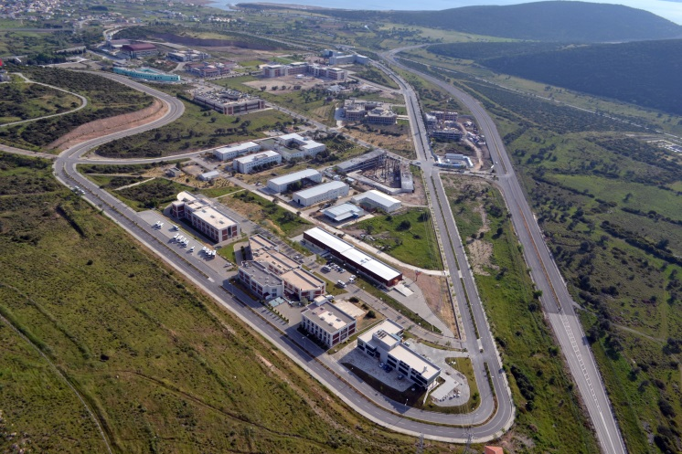
V. İZMİR TECHNOLOGY DEVELOPMENT ZONE
Technopark:
İzmir Technology Development Zone has 145
R&D firms and 900 R&D staff in 2015
The Zone ranks number 2 among all
technoparks in the annual performance index
of Technology Development Zones in 2013
First Controlled Project Supported Innovation
Center in Turkey will come into service in the
Technopark.
www.iyte.edu.tr

Slide 28
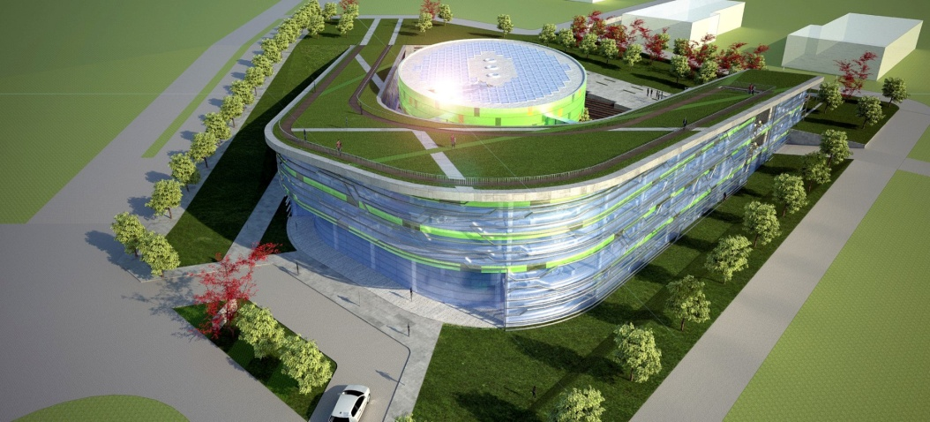
İZMİR TECHNOLOGY DEVELOPMENT ZONE
Innovation Center:
Innovation Center acts as an incubator
not only for the enterprising firms but
also for the students having
improvable ideas
www.iyte.edu.tr

Slide 29
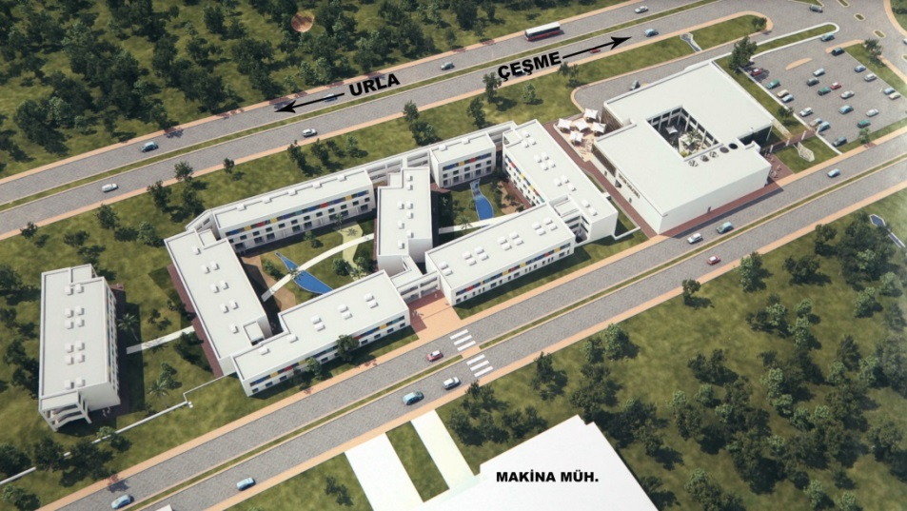
VI. LIVING CENTER FOR GRADUATE STUDENTS
It involves a market, cafes, bookstore, restaurants.
The Center serves in a total area of 1900 m2 and includes a Guesthouse with single, double and quadruple rooms
Capacity of the Guesthouse: 520 people
www.iyte.edu.tr

Slide 30
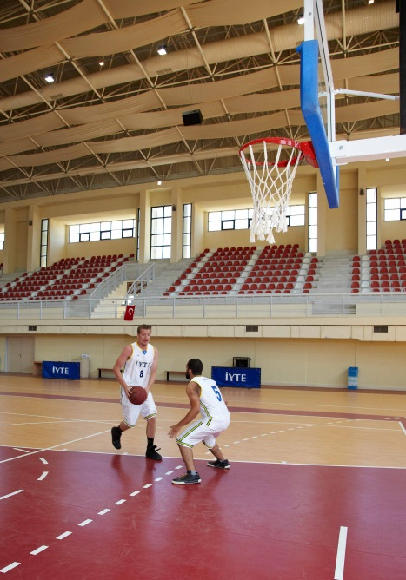
VII. CAMPUS LIFE
Health Services: Physical Health Care and Psychological Support is provided by Health Center
Sports Facilities: Sports Hall (Capacity: 1200 people), Fitness Center, Synthetic Football Pitch, Volleyball Court, Basketball Court, Miniature Golf Course, Semi-Olympic Swimming Pool
Social Activities: Concerts, Folk Dances, Modern Dances, Cinema, Theatre Plays, 47 Student Clubs
Scholarship: Scholarship opportunities for students
www.iyte.edu.tr

Slide 31
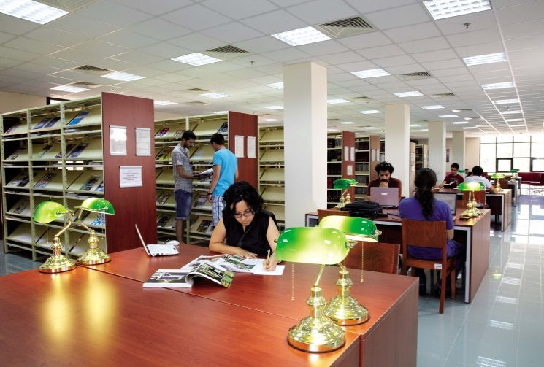
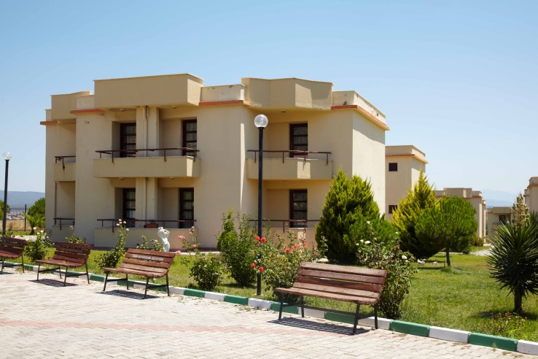
CAMPUS LIFE
Food Services: Central Cafeteria (Capacity: 5000 people), Canteens in different Departments and Cafeterias
Accomodation: State Dormitory (Capacity:
1032 people), Living Center for Graduate Students (Capacity: 520 people )
Library : Ranked among the best 29 library buildings built in the last 4 years in Europe in 2008
www.iyte.edu.tr

Slide 32
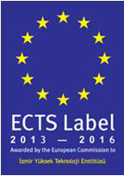
VIII. INTERNATIONAL RELATIONS
Diploma Supplement Label: 2013-2016
ECTS Label: 2013-2016
Number of Erasmus Bilateral Agreements: 101
Bilateral Agreements (Non Erasmus): 11
Total Number of Outgoing Erasmus Students (Study+Placement Mobility) (2005-2016): 669
www.iyte.edu.tr

Slide 33
EXCHANGE STUDENT NUMBERS/ OUTGOING-ERASMUS
Academic Year | Study Mobility | Placement Mobility | Total
2005-2006 | 16 | - | 16
2006-2007 | 26 | - | 26
2007-2008 | 29 | - | 29
2008-2009 | 28 | 5 | 33
2009-2010 | 48 | 14 | 62
2010-2011 | 47 | 13 | 60
2011-2012 | 59 | 15 | 74
2012-2013 | 56 | 17 | 73
2013-2014 | 71 | 24 | 95
2014-2015 | 79 | 26 | 105
2015-2016 | 78 | 18 | 96
TOTAL | 537 | 132 | 669
www.iyte.edu.tr

Slide 34
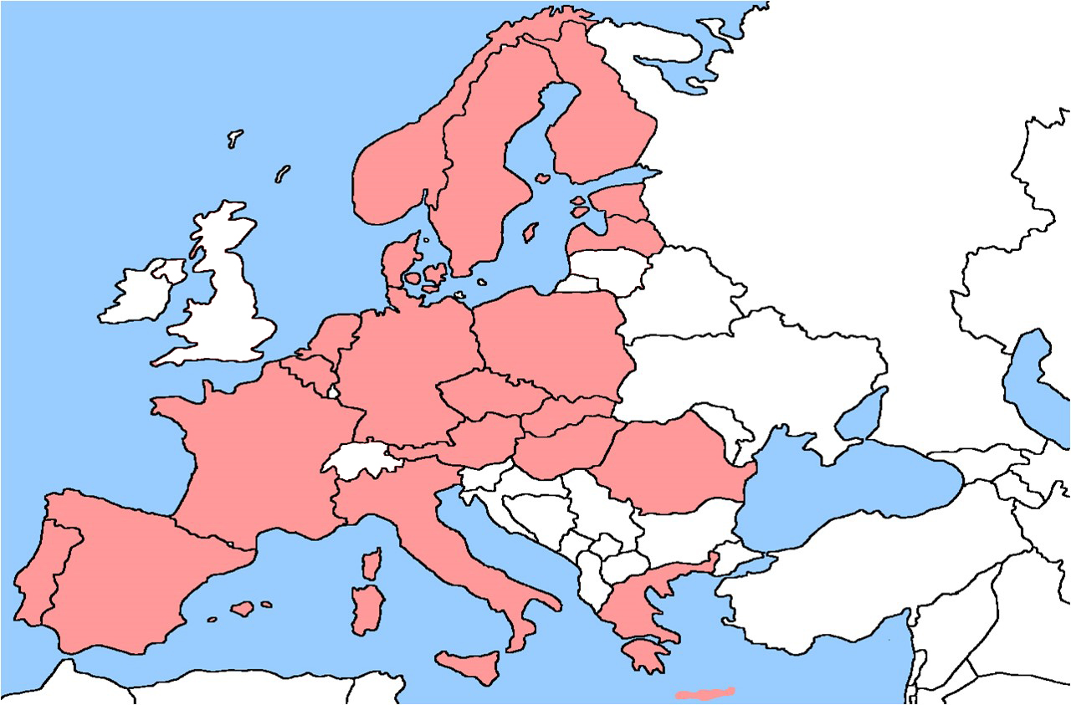
INTERNATIONAL PARTNERS
(ERASMUS)
1
Total = 101 Agreements
34
4
5
1
4
1
1
14
3
16
3
3
7
2
2
3
3
17
4
7
www.iyte.edu.tr

Slide 35
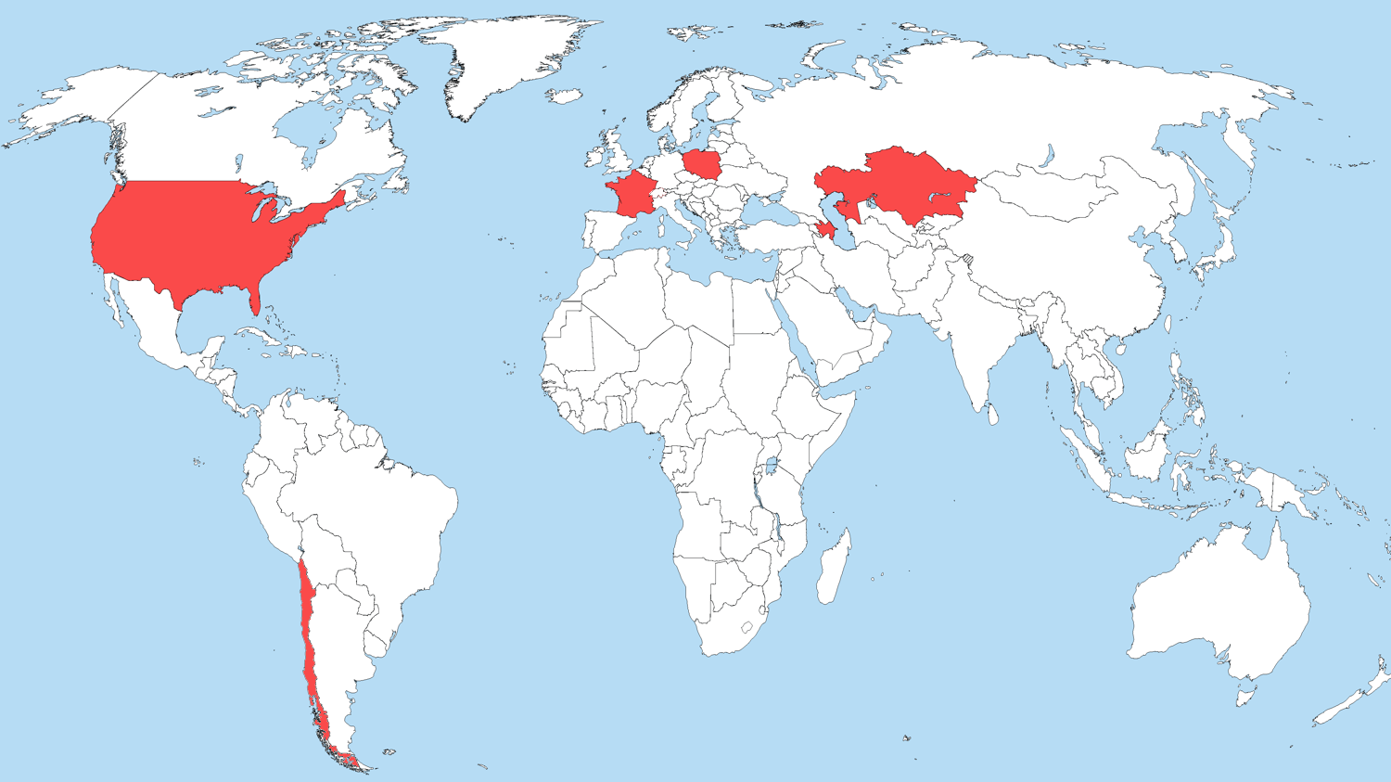
1
1
1
3
4
1
INTERNATIONAL PARTNERS (NON ERASMUS)
www.iyte.edu.tr

Slide 36
INTERNATIONAL PARTNERS (NON ERASMUS)
USA (3 agreements) Univesity of Delaware, Newark, Delaware, USA
Coe College, Cedar Rapids, IA, State of Iowa USA
Slippery Rock University , Pennsylvania USA
Azerbaijan (4 agreements) Qafqaz University, Baku, Azerbaijan
Azerbaijan National Academy of Aviation, Baku, Azerbaijan Khazar University, Baku, Azerbaijan Baku State University, Baku, Azerbaijan
France (1 agreement) University of Rouen, Rouen, France
Kazakhstan (1 agreement)
Ahmet Yesevi University , Turkistan , Kazakhstan
Poland (1 agreement)
Warsaw University of Life Sciences-SGGW, Warsaw, Poland
Chile (1 agreement)
Pontificia Universidad Catolica de Chile (PUC) , Santiago , Chile
www.iyte.edu.tr

Slide 37
OUR VISION IS TO BE MORE AND MORE INTERNATIONAL
www.iyte.edu.tr

