Slide 1


HOSTING ORGANIZATION

Slide 2


ABOUT US
EUROPE FOR ALL is a private non-profit organization operating all around the Italian territory. It was founded in 2010 by a group young people to promote educational and training programmes both at European and International level, aiming to develop skills and human resources while improving the European labour market. The main ambition of Europe for all is to encourage cultural exchanges to enrich the professional and personal life of each European citizen. The main ambition of Europe for all is to encourage cultural exchanges to enrich the professional and personal life of each European citizen.
Through the constant commitment of all the members, the association promotes intercultural exchanges. So EUROPE FOR ALL improves the educational and vocational system through a variety of activities in order to strengthen the awareness of being part of Europe/to strengthen the awareness of the European dimension.

Slide 3
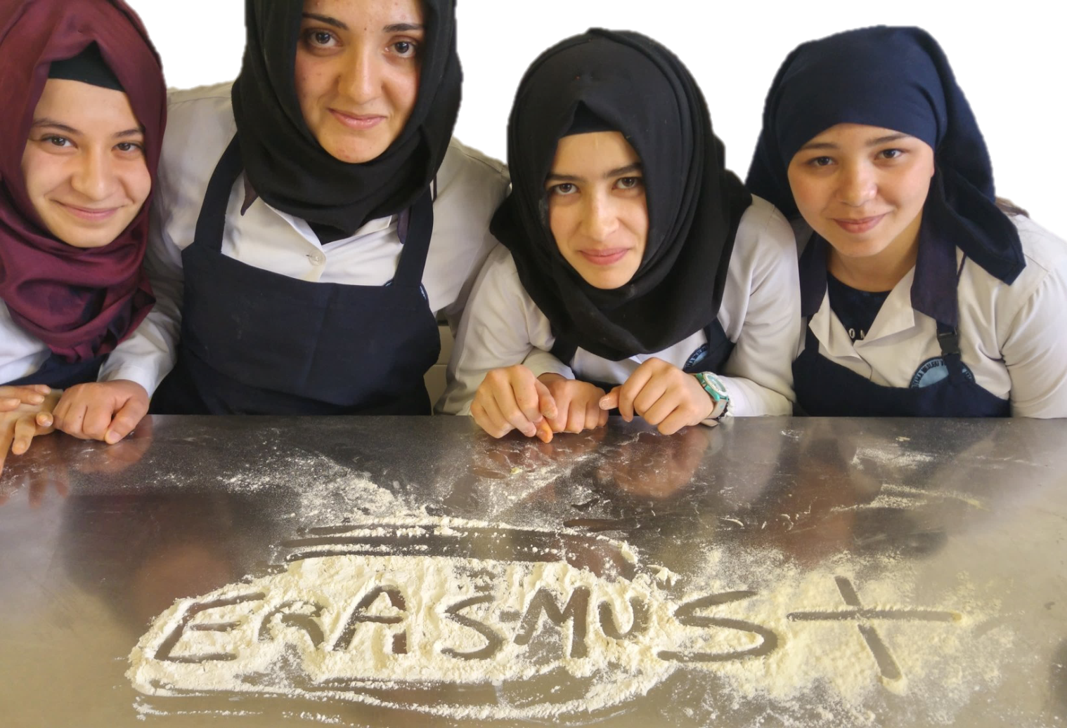

OUR WORK
Training & Education
Promotion of European pathways for work-linked training, including language learning;
Organization and management of social and cultural exchanges with EU and non-EU Countries;
Courses and activities for orientation and vocational, qualification, requalification training and continuous updating for extra-Community and disabled people too;
Preparation Courses at the start to transnational mobility projects;
Teaching activities for trainees, through language, social and pedagogical training;
Activities for employment;

Slide 4
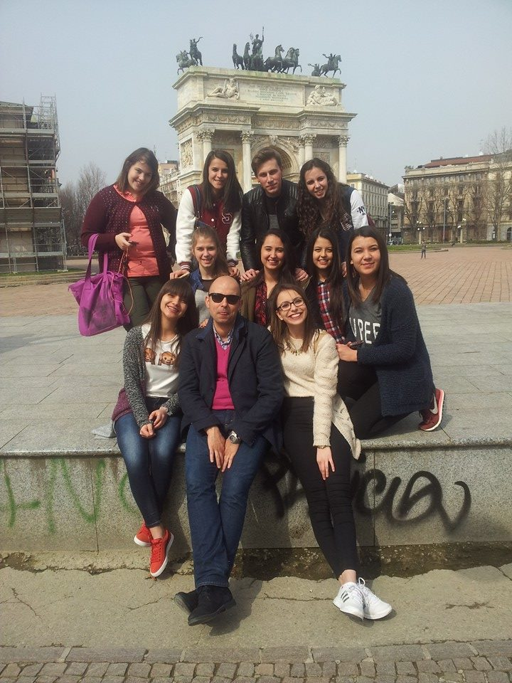
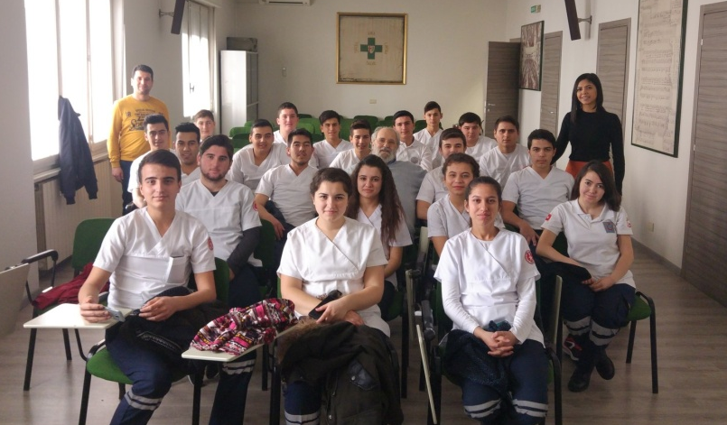
OUR SERVICES as Hosting Organization
The main functions Europe for All has to realize mobility projects:
Management and organization for the pick-up service from/to the airport till the accommodation;
Organization of internships and practice;
Language course;
VET courses
Final certification;
Monitoring and tutoring of all participants during the stay;
Accommodation arrangement;
Organization for the local transport;
Planning of socio-cultural visits;
Regulation of the follow-up procedures, the monitoring and tutoring process, orientation during the period of stay;
Cooperation with the sending organization;
Sharing the report documents;
Dissemination of the final results gained during the exchange;
Quality and commitment of the partnership.

Slide 5
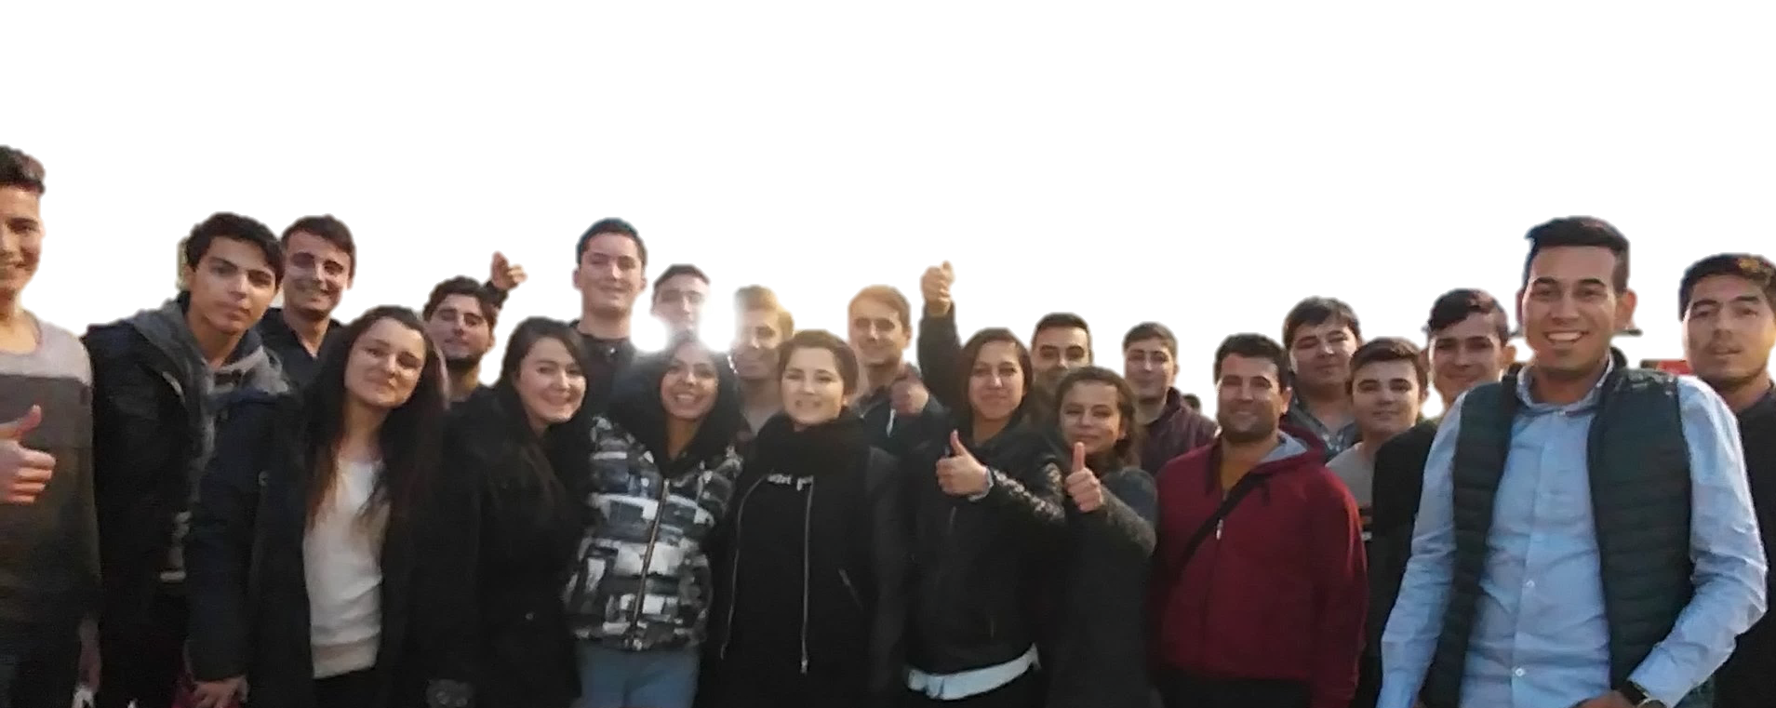
CONTACT & LINKS
Emanuela Sapone
European Project Coordinator
Phone: (0039) 3475127847
Skype: Emanuela Sapone
Via vespri siciliani 20147, Milano
Visit us on Facebook and
http://www.europeforall.org/it/

