Slide 1
KA2 Project “eSkills for Volunteers”

Slide 2
Partnership
Asociación PROJUVEN
Associazione di Promozione Sociale Futuro Digitale
Associação Intercultural Amigos da Mobilidade
Asociatia GEYC

Slide 3
The duration of the project is 20 months and the main objective is to reinforce ICT digital knowledge in order to strengthen social inclusion and uniform the basis of work of ICT-active organisations.
The expected outcome is to improve quality of awareness, raising activities and also encouraging young talents especially from diverse, fewer opportunities or disadvantaged backgrounds.

Slide 4
Summary of the project
The importance of digital skills for both social inclusion and employability has been made an high priority by the European Commission and reinforced in the recently published “Eskills Manifesto” introduced by Vice President Ansip. Ansip notes that
“The ICT skill gap is growing to unacceptable level”.

Slide 5
They are regular users of technology but research shows that they often not have the relevant skills to be savvy or competent users.
Furthermore as youth unemployment is a major issue all other Europe, mastering these skills is becoming critical to fill the huge gap created by the digital revolution.

Slide 6
Target groups are:
Youth workers
Youth volunteers
Being active in digital education and relying on volunteers in our own organisations is fundamental.
Therefore we have identified new opportunities and challenges for capacity building and improvement of youth work in that specific field.

Slide 7
The specific objectives to achieve
To empower youth workers and volunteers to fully exploit all the potentials of digital education and digital skills.
To give the possibility to NGOs to count on volunteers/young ICT experts.
To establish an innovative way of learning by using Information and Communication Technologies (ICTs) methodologies and virtual collaboration.

Slide 8
The specific objectives to achieve
To compose a set of learning materials as open educational resources (OER).
To strengthen formal and non-formal learning for young people across Europe.
To foster inclusive education.

Slide 9
The project includes the follow activities
An extensive research based on real needs of organisation and volunteers involved in digital education.
A training activity for youth workers / volunteers.
An Open Online Course with video material available to those wishing to develop and improve their skills and practices in managing volunteers in the non-formal digital education space.

Slide 10
The project includes the follow activities
A European report available to all stakeholders and interested parties to give a clear overview on the current challenges and opportunities as well as demonstrating project results, study case and best practices in the field.

Slide 11
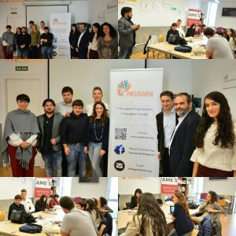
The Kick-off Meeting of the project Málaga, Spain

Slide 12
Contactos
CONTACTOS
Get in touch with us at: info@e-volunteers.eu
Oficial website: www.e-volunteers.eu
Francesco Ruberto
Project manager
E-mail: president@projuven.org
Phone: +34 633884707

Slide 13
ASOCIACIÓN PROJUVEN
YOUR RELIABLE PARTNER FOR
EUROPEAN PROJECTS

