Slide 1
“Supporting Education, Serving Future”
October 2017 / Izmir, TURKEY
www.incivakfi.org
/incivakfi
/incivakfi

Slide 2
About Us
Cevdet Inci Educational Foundation (İNCİ VAKFI) established by Philantropist, entrepreneur and businessman Mr. Cevdet İNCİ (1922-2004), serves with consistency and quality to fulfill its vision «Supporting Education, Serving Future” since 1985.
The Foundation runs active projects in areas such as; education, art, welfare through establishing partnerships with public and private entities (including Inci Group of Companies - Inci Holding). Primarily focuses on education of children, youth, and adults.
CEVDET İNCİ
Founder
Member of 2nd Generation of the İnci Family. Ex-president of the Inci Holding Board (2007-2010). Mother of 2, grandmother of 3 dhildren. Personal interests: Reading, cycling, swimming, photography, gardening.
facebook.com/serife.eren
twitter.com/erenserife
linkedin.com/serifeincieren
ŞERİFE İNCİ EREN
President

Slide 3
Cevdet İnci Educational Foundation
Members of the Board of Trustees
Şerife EREN (President)
Ümit ELBİRLİK
Meral ZAİM
Perihan İNCİ
Neşe GÖK
Members of the Board
Şerife EREN (President)
Ece ELBİRLİK ÜRKMEZ
Meral ZAİM
Perihan İNCİ
Aygül ÖNAL
Members of the Supervisory Board
Şelale ZAİM GORTON
Bahadır SADE
Cengiz HÜR

Slide 4
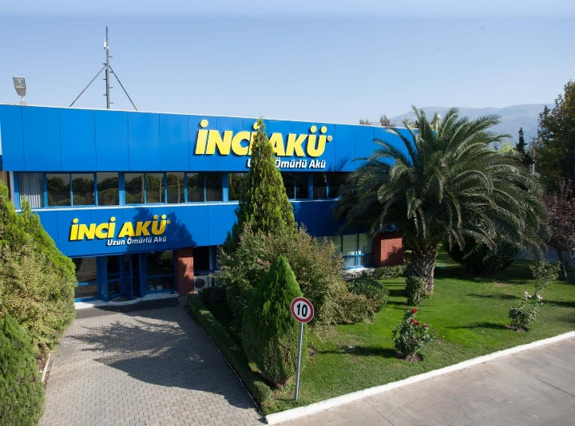
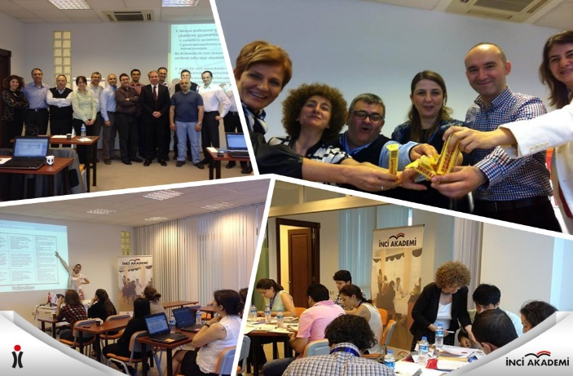
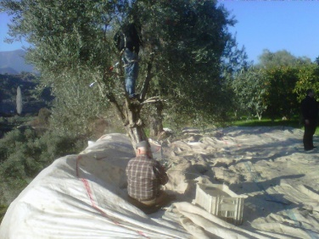
Info & Sources of Income
Cevdet İnci Educational Foundation is one of the most successful and renowned civil society organizations in Izmir. The continuous social engagement and transparent structure of the foundation has been awarded by the Turkish State (Council of Ministers Decision 2008/13848) in 2008 granting the Foundation with ’immunity from taxation’ (donators’ 5% of annual income will be utilize with tax-exemption).
Sources of income for the foundation:
Annual donations from İnci Holding and affiliates,
Rental income from the Foundation’s real estate properties,
Sales of agricultural products (fruits, olives and olive oil) cultivated on the Foundation’s farms,
Revenue generated from the Foundation’s commercial educational academy for professional trainings and courses (İNCİ AKADEMİ),
Independent donations from third parties.

Slide 5
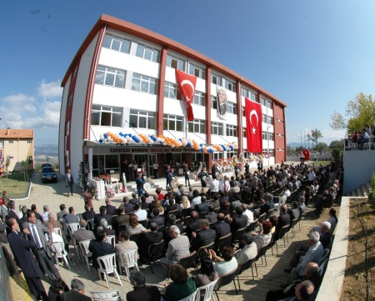
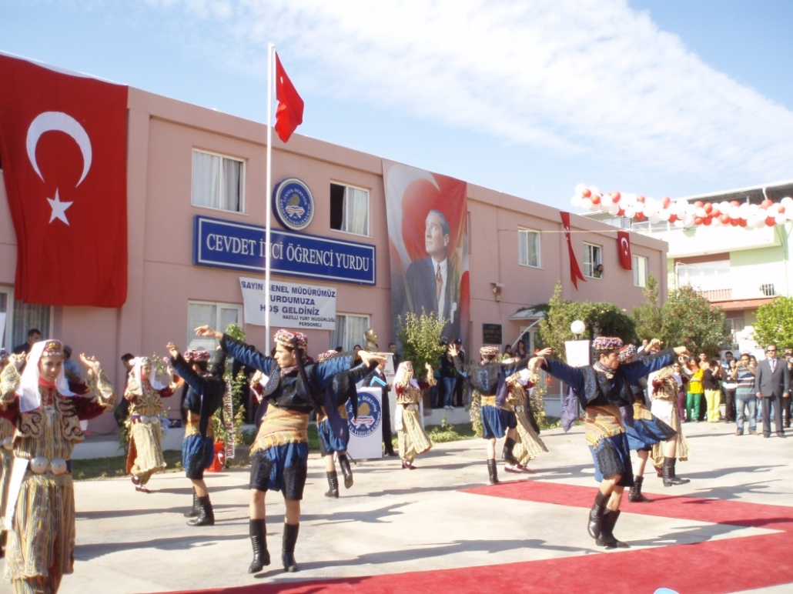
Contribution to Education
Schools & Dorms
Scholarship Cathegories
Private Scholarship Fund (for all grades)
Success Scholarship (for University students)
Memnune Yarenci İnci Scholarship (for MYİ vocational school students)
Contribution Scholarship (for İnci Group employees’ children)
Adnan Menderes University Sultanhisar Cevdet İnci Vocational High School
KYK Sultanhisar Cevdet İnci Dormitory
Adnan Menderes University Memnune Yarenci İnci Vocational High School

Slide 6
Contribution to Education – Scholarship Info
CEVDET İNCİ EDUCATION FOUNDATION SCHOLARSHIP CHART
 | Scholars # | Scholarship (TL)
Private Scholarship Fund (first & second grade scholars from 2016)
2015 – 2016 | 151 | 275.170
2016 - 2017 | 53 | 70.560
2017 - 2018 | 37 | 70.250
Success Scholarship (University)
2015 – 2016 | 5 | 14.850
2016 - 2017 | 114 | 330.100
2017 - 2018 | 83 | 262.586
Memnune Yarenci İnci Scholarship (Vocational High School)
2015 – 2016 | 10 | 22.500
2016 - 2017 | 10 | 22.500
2017 - 2018 | 10 | 22.500
Contribution Scholarship (for İnci Group employees’ children)
2015 – 2016 | 311 | 106.600
2016 - 2017 | 367 | 114.800
2017 - 2018 | 361 | 152.100
Maxion Manisa Vocational School Scholarship
2015 – 2016 | 47 | 18.800
2016 - 2017 | 15 | 12.000
2017 - 2018 | 20 | 20.000
2017- 2018 TOTAL | 511 | 527.436

Slide 7
Contribution to Technology – Cevdet İnci Incentive Awards
Cevdet İnci Incentive Awards, are monetary awards for the teams who work for İnci Group companies and demonstrate proven improvements in production, productivity and service quality activities through various projects.
The projects can apply in three categories:
Production
Service
Research & Development

Slide 8
Mobile Library
“Mobile Library” was launched on April 2015 and it aims to educate and help students and their parents, also to increase reading habits and intellectual knowledge.
Mobile Library serves relatively disadvantageous school areas and operates in open public squares. With collaboration from public entities; the project currently has reached more than 55,000 people and 18,000 books have been borrowed.

Slide 9
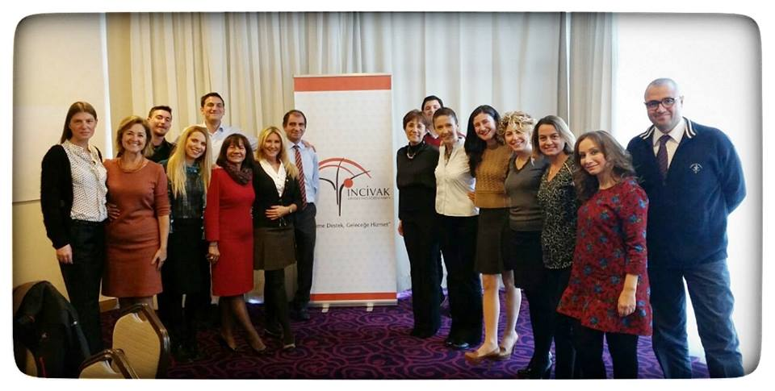
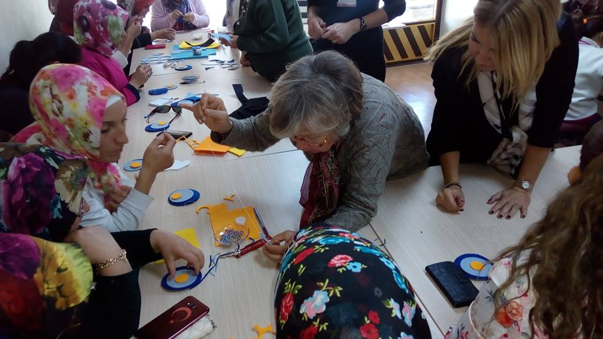
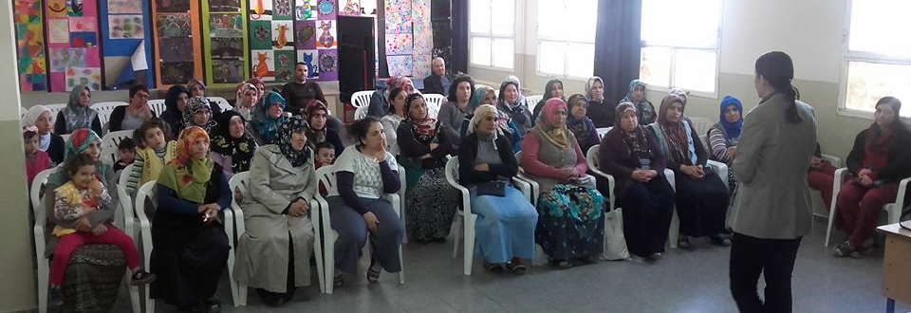
Parental Education Seminars
Promoting Women Handicrafts
The project is not only providing books to children but also educating the parents through “Awareness Trainings for Parents” lead by expert volunteers of the foundation on law, family, health, communication, hygiene, and healthy social life.
246 hours were spent in 123 sessions and 7800 participants were welcomed as of July 2017.
Handcraft workshop sessions are held for women with economic hardships who live in the rural areas of Gaziemir / Izmir. With its volunteer teachers, Inci Foundation provides the neccessary training for its participants to enable them to generate additional income for their families.

Slide 10
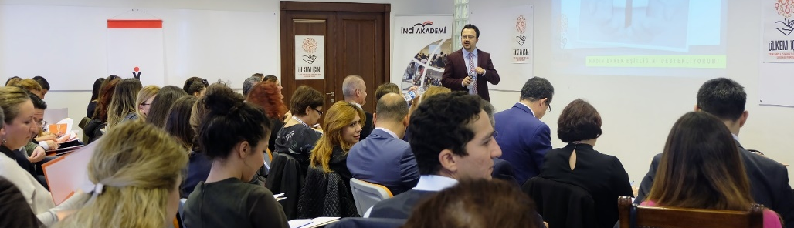
The content of the program is targeted towards development of;
Self-improvement,
Leadership,
Finance,
Technical Knowledge,
Sales & Marketing,
Philosophy.
Entire mark-up revenues of Inci Academy’s activities are transferred to the scholarship fund of the Cevdet Inci Educational Foundation.
Inci Academy is the winner of Leadership Development Project Award
http://www.inciakademi.com/
The educational initiative aims to develop leadership skills by awareness of personal and professional competency and was launched in 2012.
As of October 2017; 7685 people had been trained on 342 different topics .

Slide 11
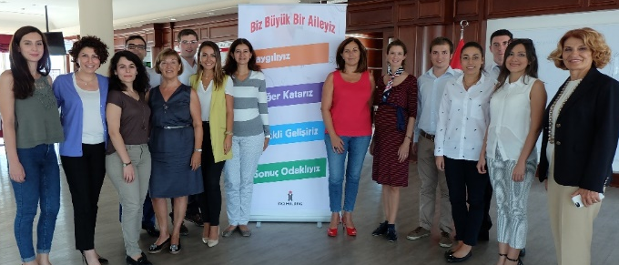
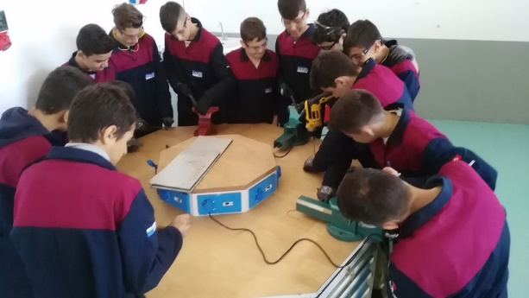
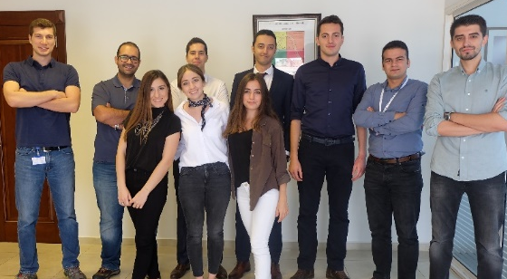
Manisa Yunus Emre Vocational Education & Training Center
Management Trainee Programme
25% of the Inci Group of Companies’ (Inci Holding) employees are from the Y Generation. Since 2011, Inci Academy organizes the Management Trainee Programme – Genc Inciler (eng. Young Pearls) – in order to develop the leaders of tomorrow, starting with their first steps in their career. Programme covers intensive trainings for the young candidates.
Aims :
Developing skills of high school students by ‘on the job training’ basis,
2017-2018 academic class was launched on October 03rd, 2017 with 13 students,
The aforementioned students consist of Maxion company employee’s or their relatives’ & friends’ children,
Class hours on Mondays and workshop activities on the other four days.

Slide 12
İnci Foundation Children Orchestra
The project was launched in 2016 in collaboration with public & private institutions. The orchestra using a non-formal education method of “El-Sistema”. El Sistema has been applied for almost 40 years globally and does not discriminate talent.
Raising successful young musicians with the power of art will help shape good personality traits for the children.
Enthusiastic 65 children (between the ages of 6-18) are attending musical trainings 3 days a week. Developing a hobby that can be transformed into a career opportunity for their future is the main advantage of the project. Children of the Orchestra started mini-concert experiences at various platforms and have garnered admiration from the authorities

Slide 13
EU Projects
İnci Foundation is proud to be the first accredited foundation in İzmir for Erasmus +: European Voluntary Service by the authority of Ministry for EU Affairs – Turkish National Agency İnci Foundation is ready to conduct EU projects related with Key Actions of the European 2020 Strategy.
https://europa.eu/youth/volunteering/organisation/919793383_en

