Slide 1
Welcome to Hrvatska Udruga Mladih (HUM)
Croatian Youth Association
January 2015
Citta di Castello

Slide 2
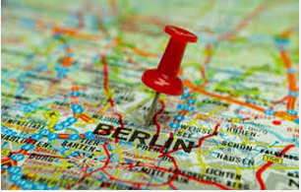
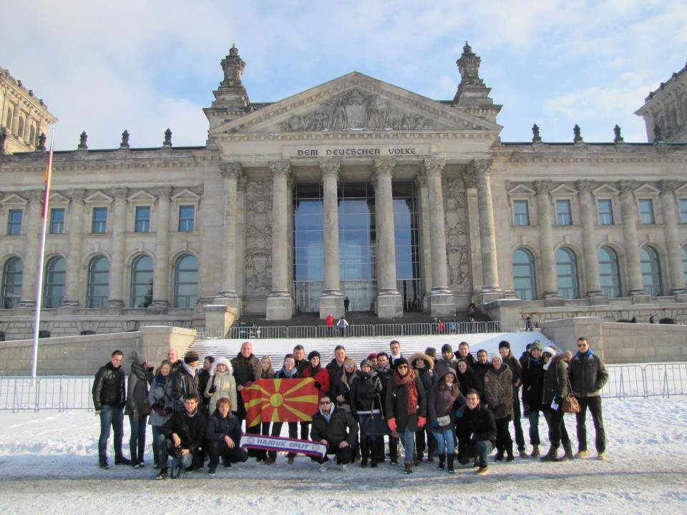
Everything started in in December 2012

Slide 3
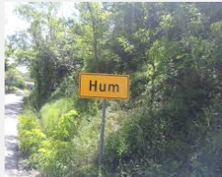
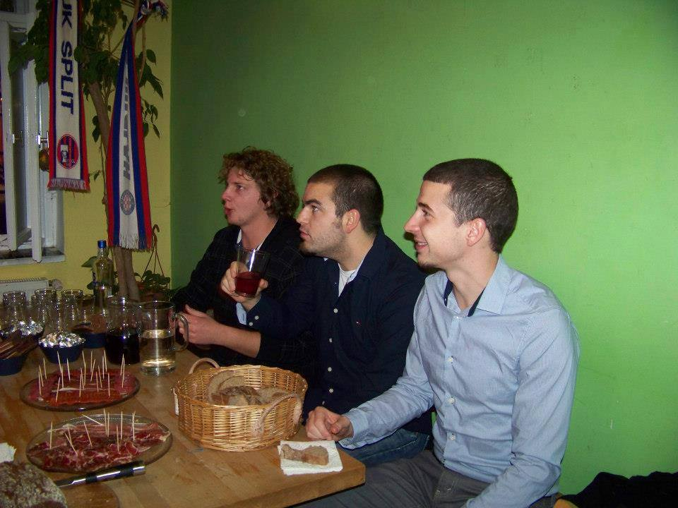
HUM is not the smaller city in the world but…
…but it is Croatian Youth Association which is founded by 3 friends
Bruno
Zoran
Stipe

Slide 4
Key facts:
2013.
HUM becomes partner of various organizations
Founded HUM
January
February
March
Applied for the first project funded by the EU
Sending participants all around Europe. Cooperation with Croatian NA

Slide 5
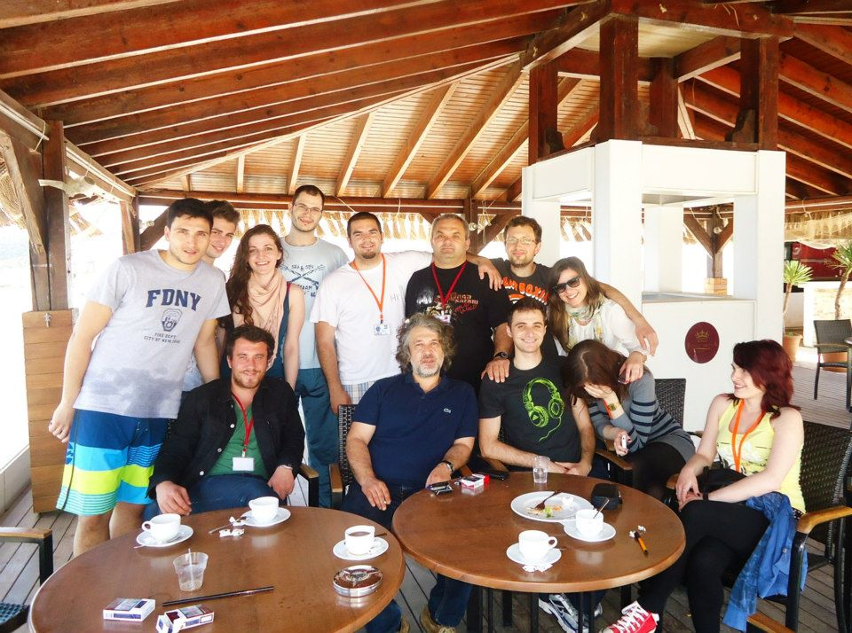
April 2013.
Bodrum, Istanbul, Mersin – Turkey
Great news from Croatia – First project approved

Slide 6
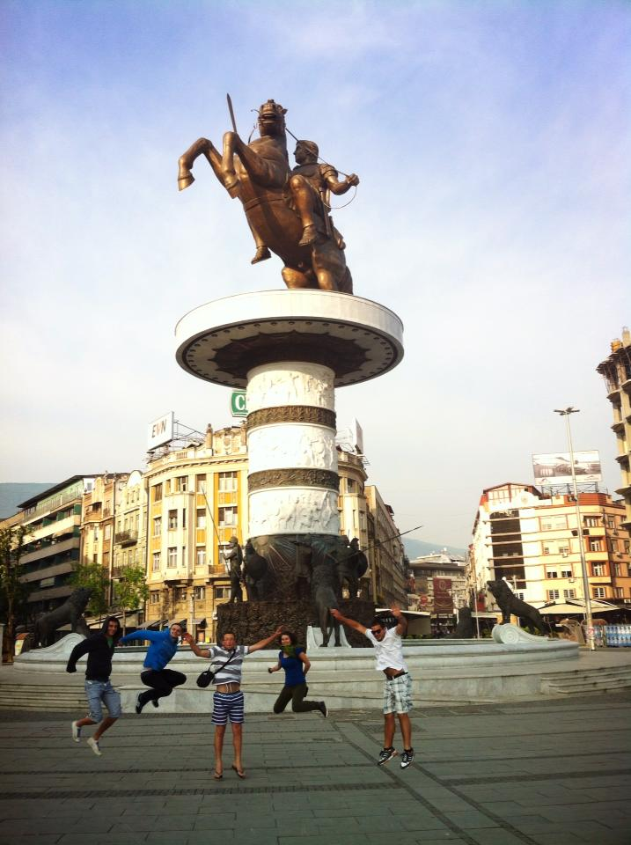
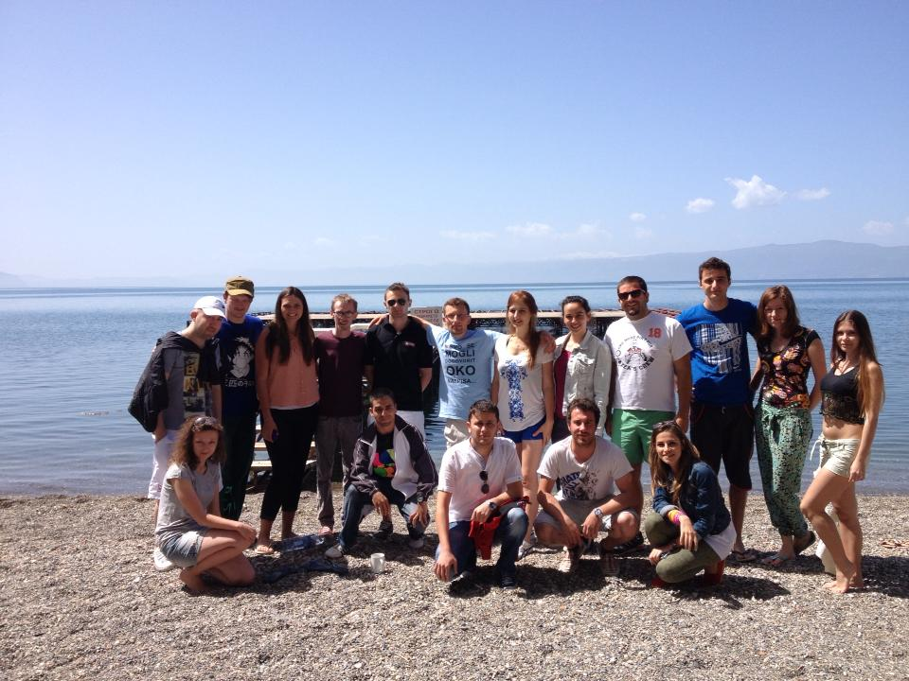
Preparations for organization of the project
At the same time we started to send members of HUM abroad

Slide 7
Face it! Youth for activity and respect in common Europe Project ID: HR-11-E20-2013-R1
Timing: 24.05. - 02.06.2013
Place: Vrgorac ( Dalmatia ), Croatia
Participants: 30 youngsters from Croatia, Bulgaria, Turkey, Romania ,Poland and Macedonia
Aim of the project: The multilateral youth exchange aimed to gather young people with different backgrounds from the Program countries to share, discuss and to build self-confidence and take own initiative through creative workshops, inquiries, discussions and street activities.
The key element of the project was encouragement in participation, volunteering in public life and facilitating the achievement of their potential as active and responsible European citizens making them active against xenophobic and racist tensions in their local communities and in Europe.
Finally this should lead to a public Action day where the results of the mutual cooperation will be presented.

Slide 8
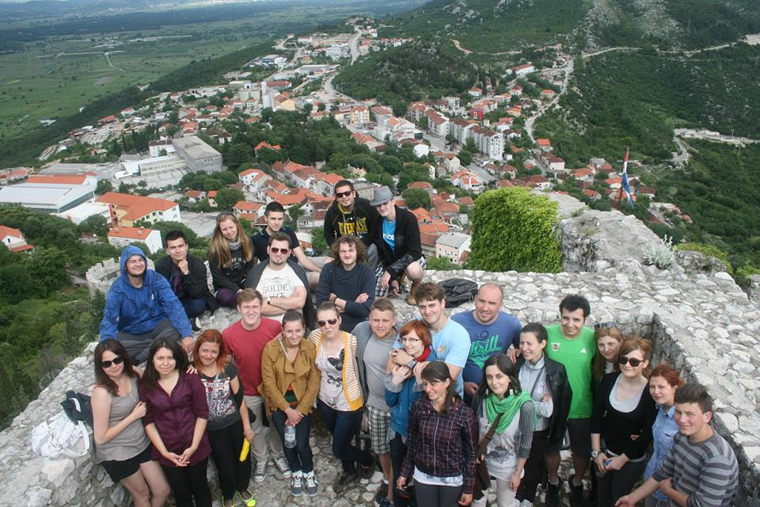
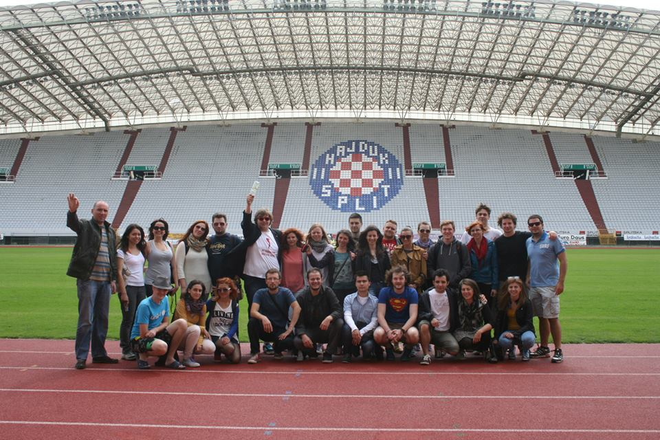
http://youtu.be/X7trksLLvQo

Slide 9
Act(i)On. Empower your voice with Forum Theatre
Project ID: HR-43-E30-2013-R3
Timing: 21.02-27.02.2014
Place: Zagreb, Croatia
Participants: 30 youngsters from Croatia, Bulgaria, Spain, Turkey, Italy, Malta, Romania, Czech Republic
Aim of the TC: was to challenge the target group, to inspire the others , especially the young people from ethnic minority groups, to start bringing upon stage solutions to their problems and to motivate them to act not only on stage, but also in their real life.
The training course was for everyone who is working with people from minorities, for people who use theater to help others, for everyone who is interested to work with oppressed groups in the society.
If we want to help to others we should realize our own stereotypes. The participants in the Training course including Forum theatre as a main method can use it to help the others to solve their doubts and to understand the other point of view or at least that there is other point of view, which is not always good, but it exists and they need to live with it and try to change it when it’s connected with oppression.

Slide 10
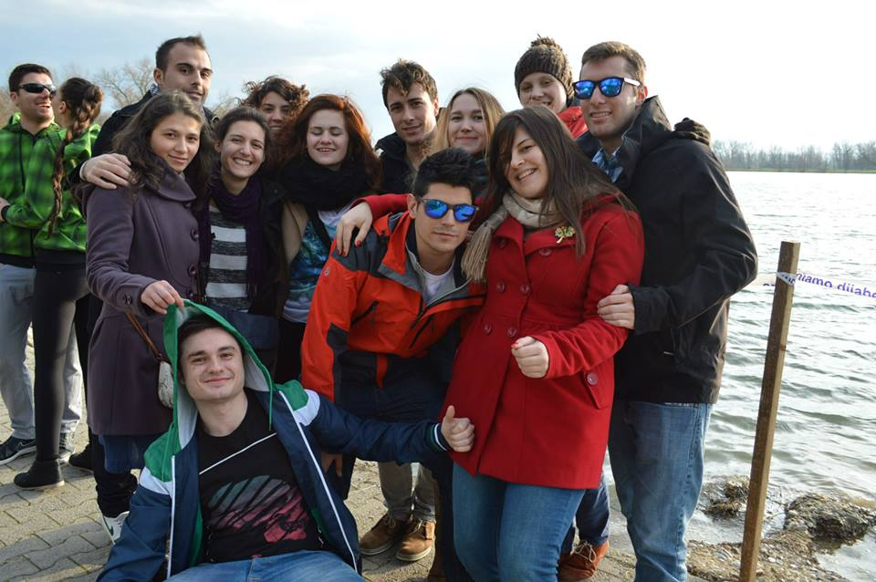
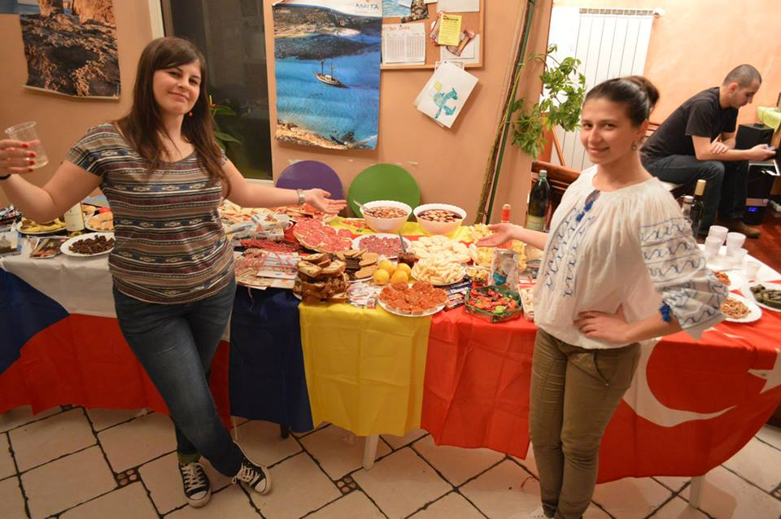
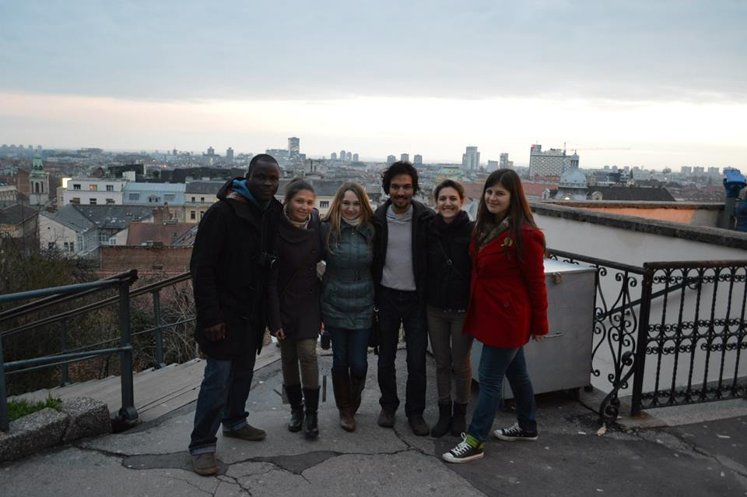
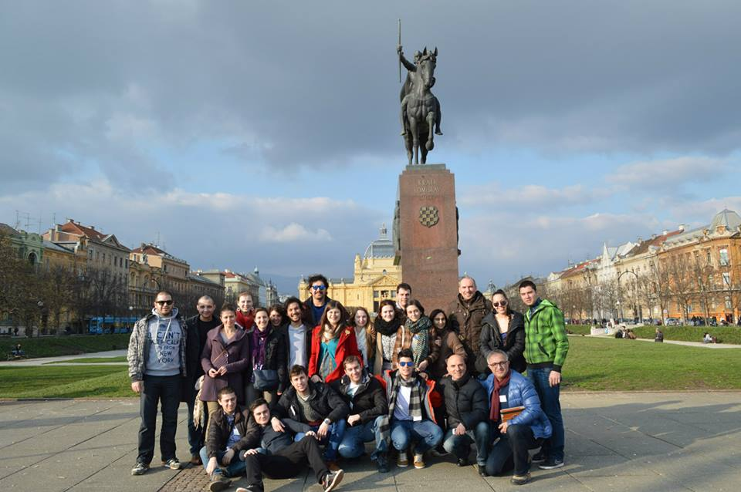

Slide 11
HUM today:
2 years of experience
More than 100 members and growing day after day
On FB group has around 6000 members ( the biggest in Croatia )
Partnership with more than 20 countries ( from South Korea, Georgia to Norway, UK, Portugal, Malta… )
and participated on more than 30 different projects, mainly abroad

Slide 12
Activities to achieve the objectives of the association are:
• To promote the interests and activities of young
• Promotion of tolerance, non-violence and solidarity
• Promote active citizenship of young people, and their European citizenship
• To increase the participation of young people in the civic life of their communities and in the system of representative democracy
• Development of human dignity and respect for different cultures
• Promotion of European cooperation in the youth field
• Integration and cooperation with the European Association for Youth
• Organization of international youth projects
• The organization of lectures, seminars, roundtables, tours and trips for teens
• Stimulate the creativity of children and young people
• Expansion of volunteerism among young people
• Encouraging communication between young people
• Promote awareness of the development of civil society
• Promotion of human rights and gender equality
• Promote awareness of the development of the information society
• Raising environmental awareness
• Encouraging a culture of healthy living
• Associations may establish the book, newspaper or media of any kind aimed at informing the Croatian Youth
• Work with local and regional authorities and the ministries concerning youth Republic of Croatia
• Cooperation with the National Agency for European Educational Projects
• Anything else that will contribute to the active participation and involvement of young people in the Croatian society

Slide 13
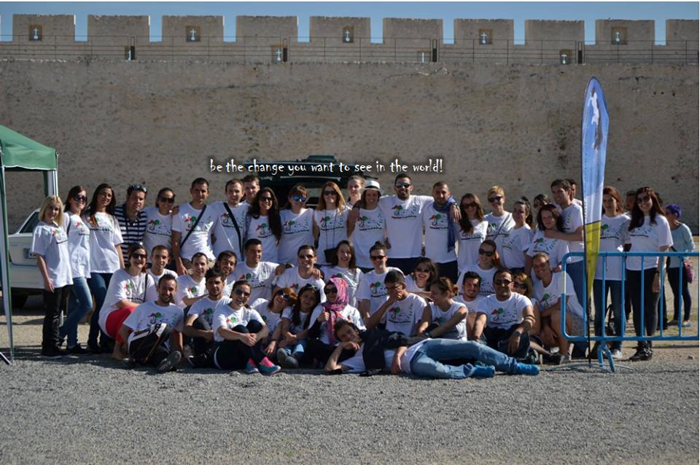
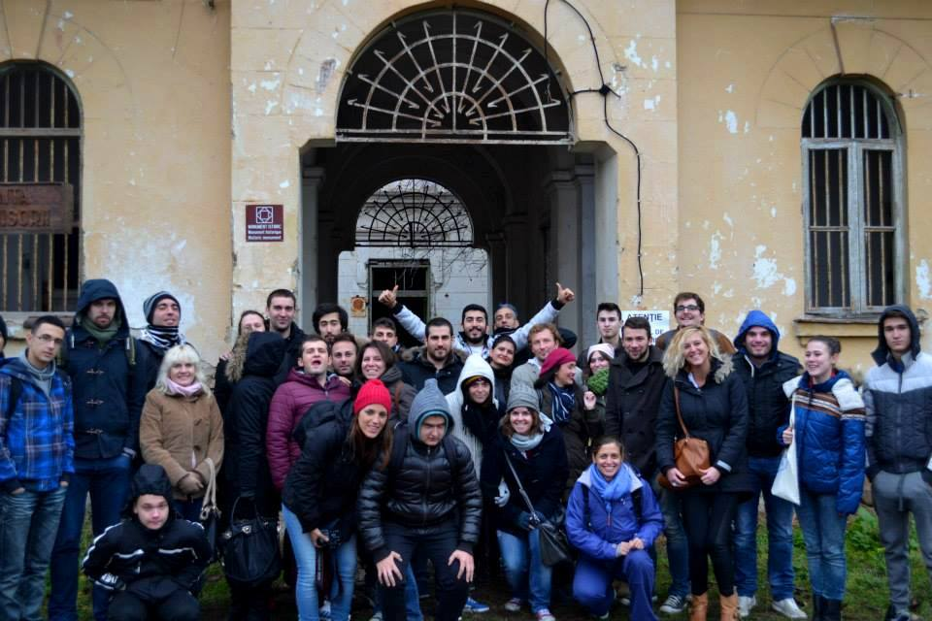
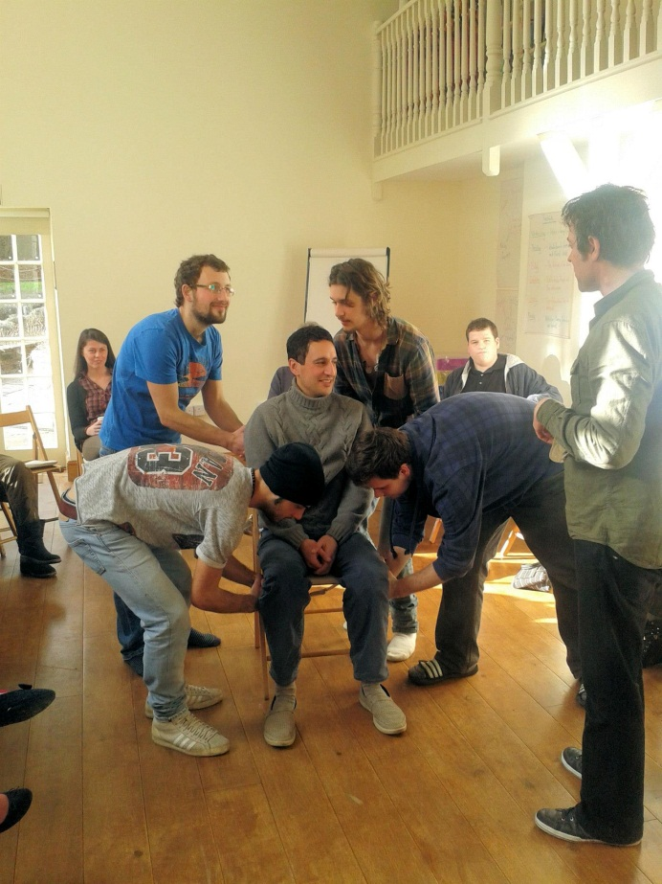
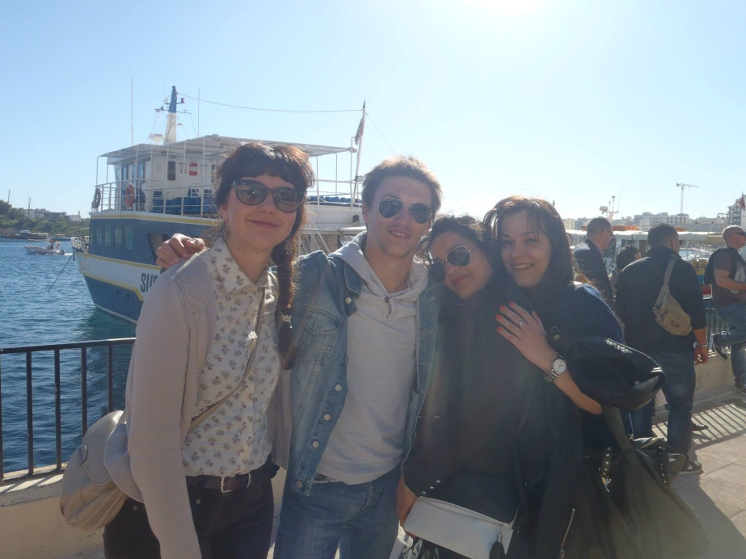

Slide 14
HUM tomorrow:
Continuation of cooperation with current partners
Accreditation for EVS
Sending and hosting volunteers
Applying prepared projects and working on new projects
Strengthening cooperation with educational institutions and public institutions

