Slide 1

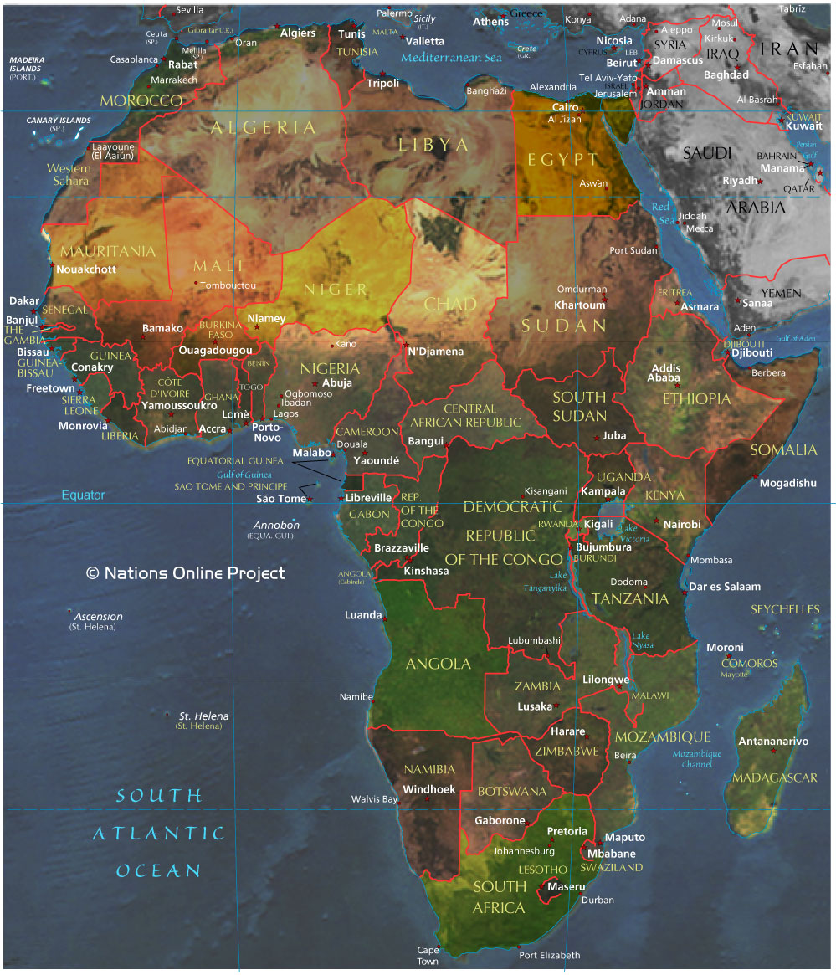

Slide 2
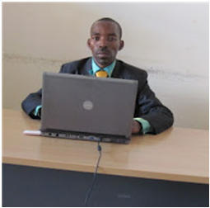
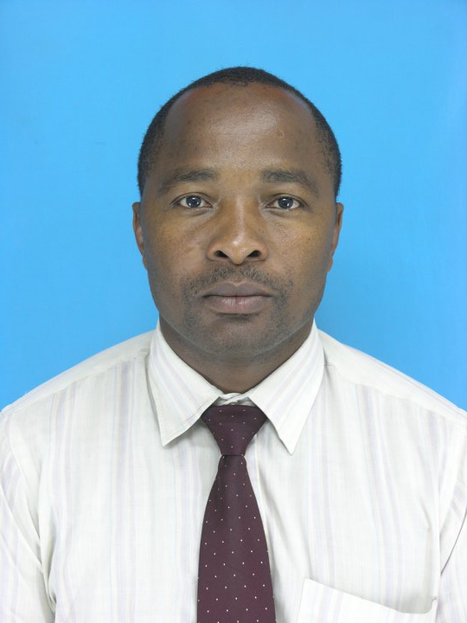
Dream to Child-friendly Community
(Light Dream Organization-LiDO)
Mr. Neatson N. Sunzi
(Chairperson)
Mr. Yusuph DL Mtobela
(Secretary)

Slide 3
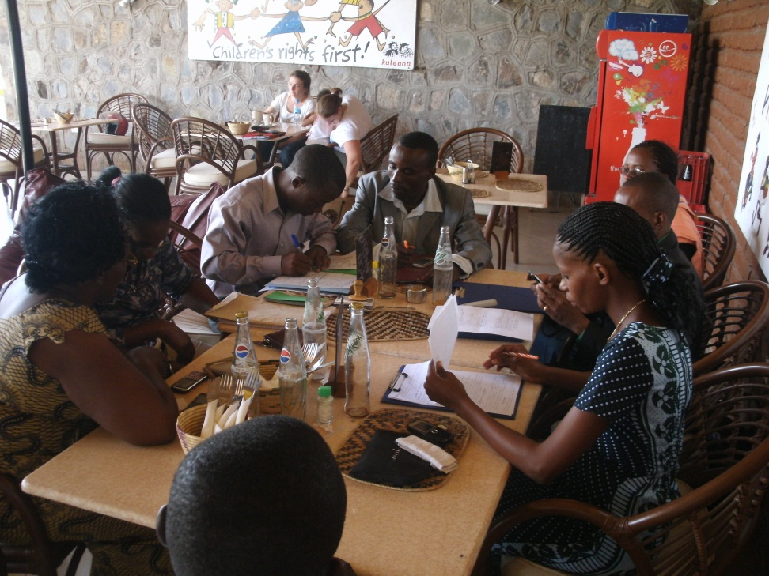
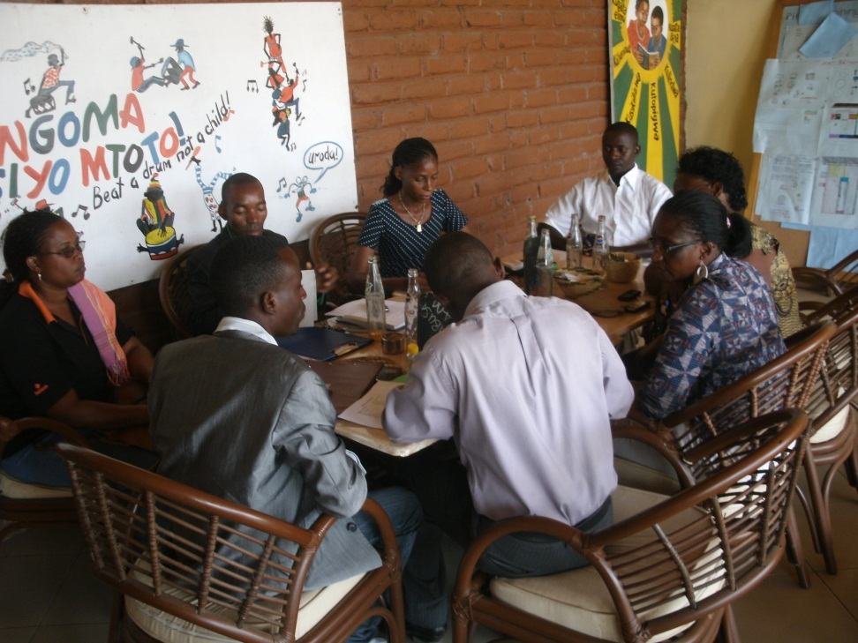
Dream to Child-friendly Community
Members awareness Raising

Slide 4
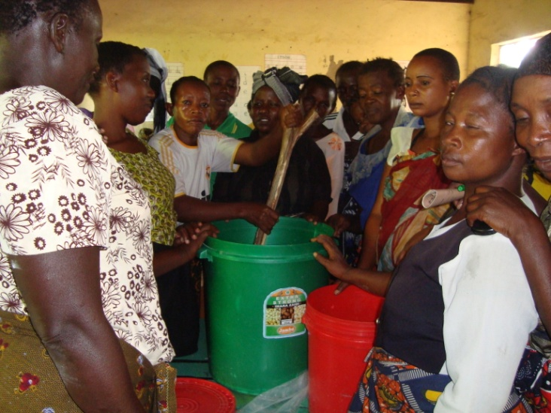
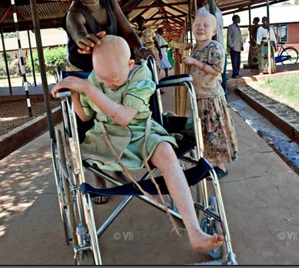


LiDO has 15 founder members geared to serve the following groups:-
Community Groups in
Poverty

Slide 5
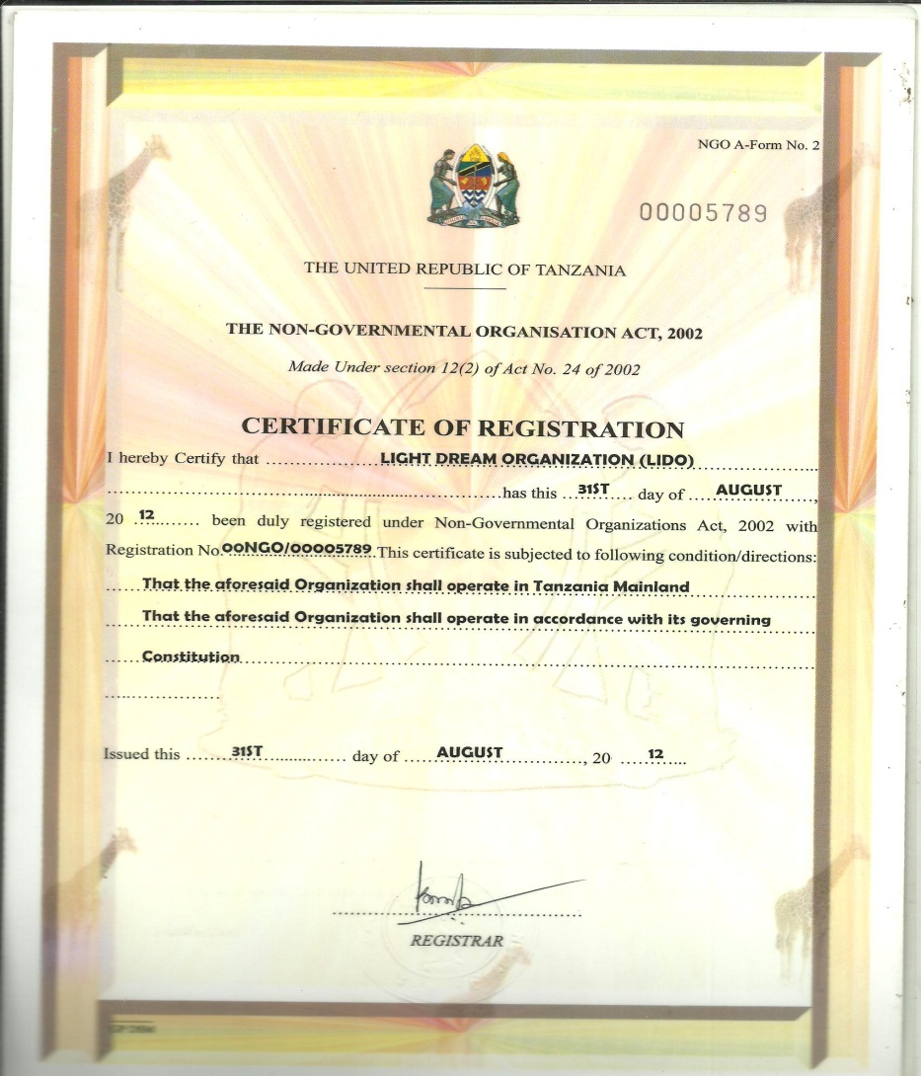
LiDO was Born in August 31, 2012 to fulfill the Dream
Registered to Operate in Tanzania Mainland

Slide 6
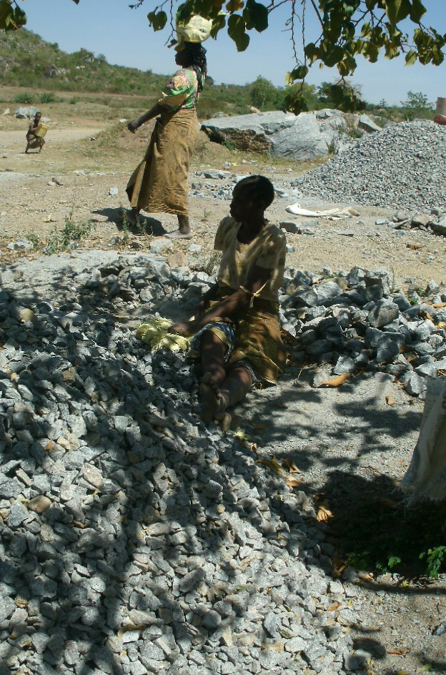
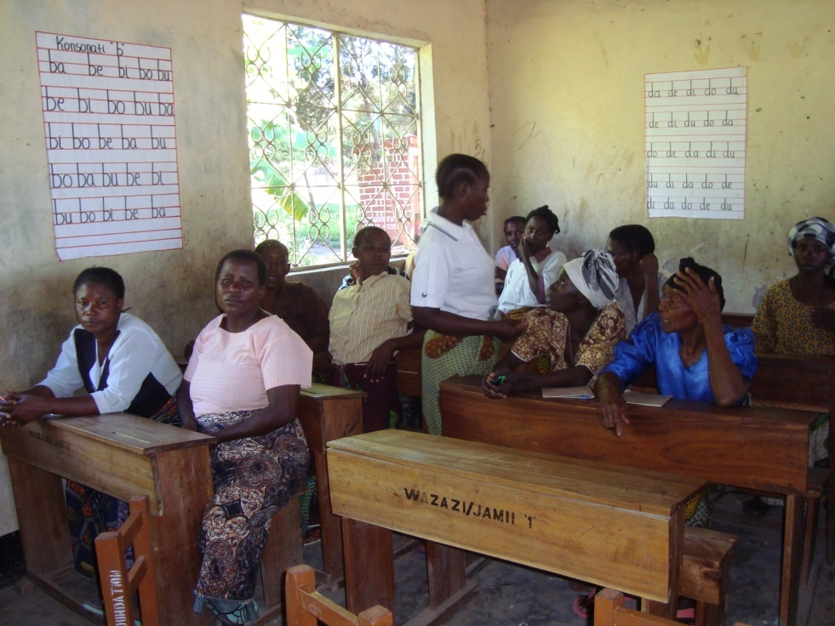
2. Women

Slide 7
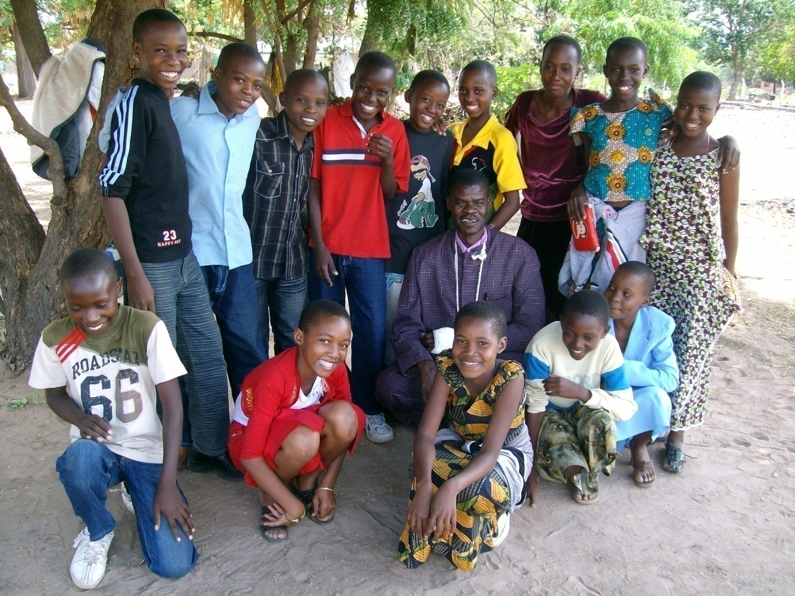
3. Youth

Slide 8
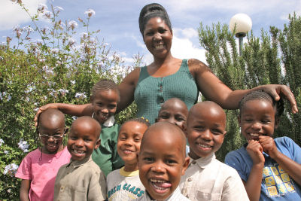
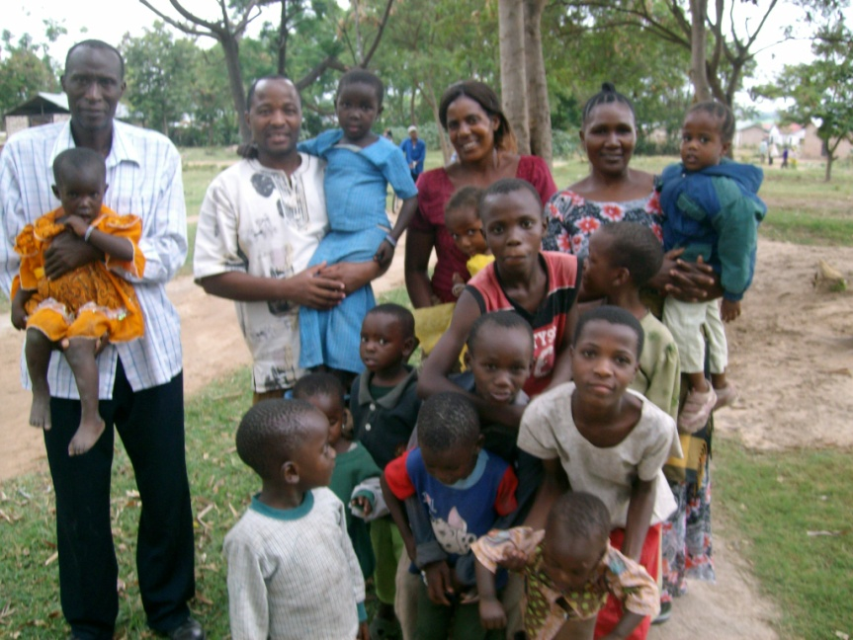
Mothering and fathering play a Golden Role of Unconditional Love and sense of Identity.

Slide 9
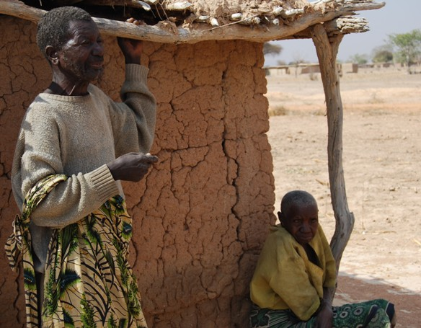
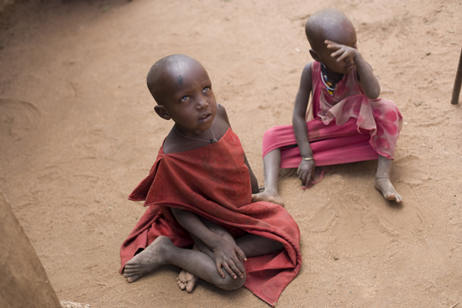
4. Aged (Wazee)

Slide 10
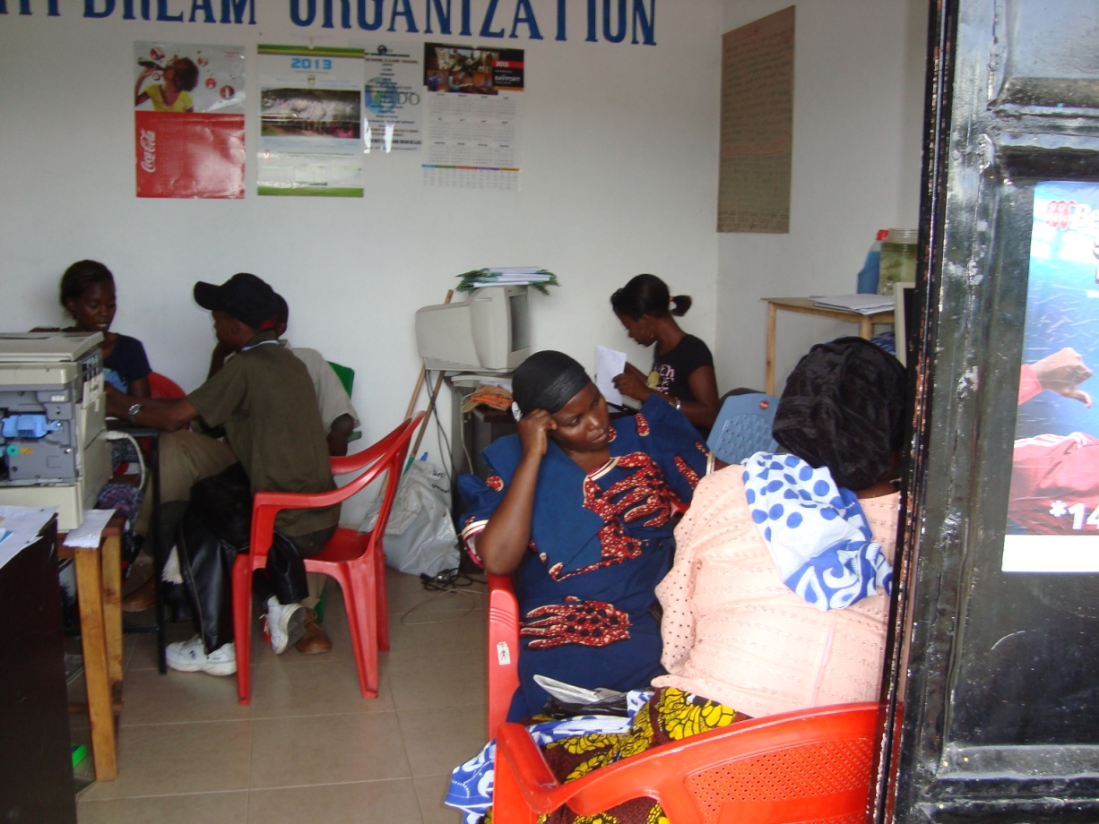
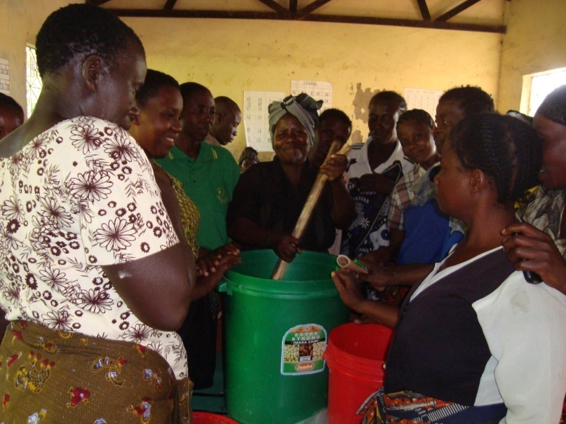
Beneficiaries Registration

Slide 11
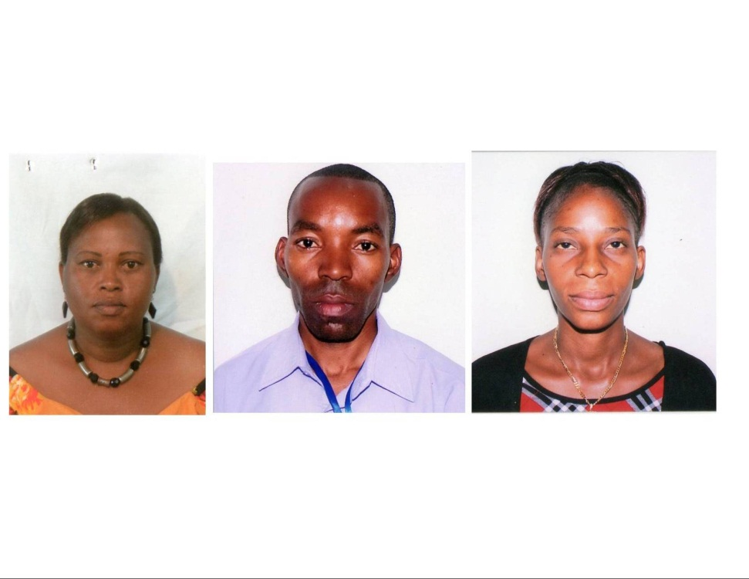
LiDO Bank Account Signatories
Mr. Neatson Sunzi
Mrs. Josephine Lenga
Miss. Sarah Deogratius

Slide 12
For more details contact us:
Light Dream Organization (LiDO)
P O Box 11121 – Pamba Road
MWANZA
Tanzania
E-mail: lightdreamorg2012@gmail.com
    Cell: +255 766 598 408 – Chairperson
    Cell: +255 756 800 008 – Secretary

