Slide 1
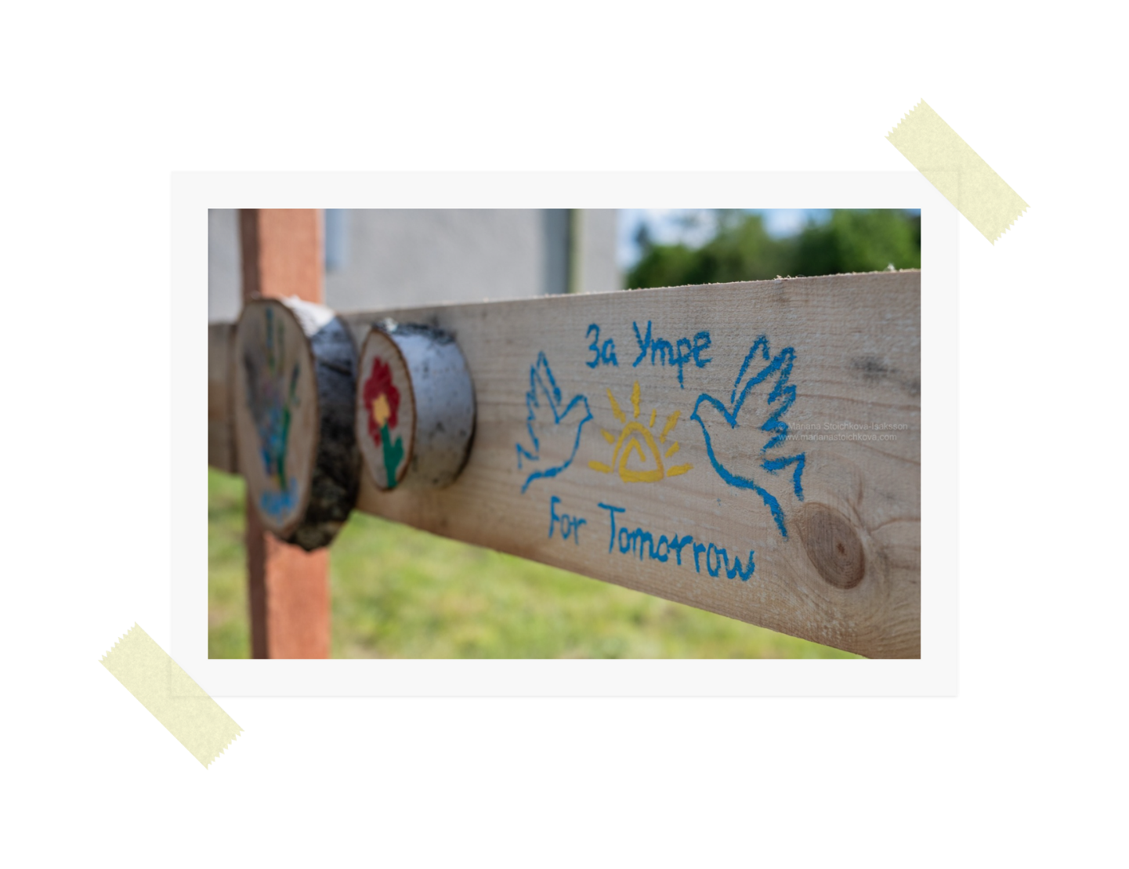

Mindful Sound
TOOLS FOR SELF-DEVELOPMENT AND SOCIAL INCLUSION
ERASMUS+ TRAINING COURSE IN BULGARIA
20.03.2025-31.03.2025

Slide 2

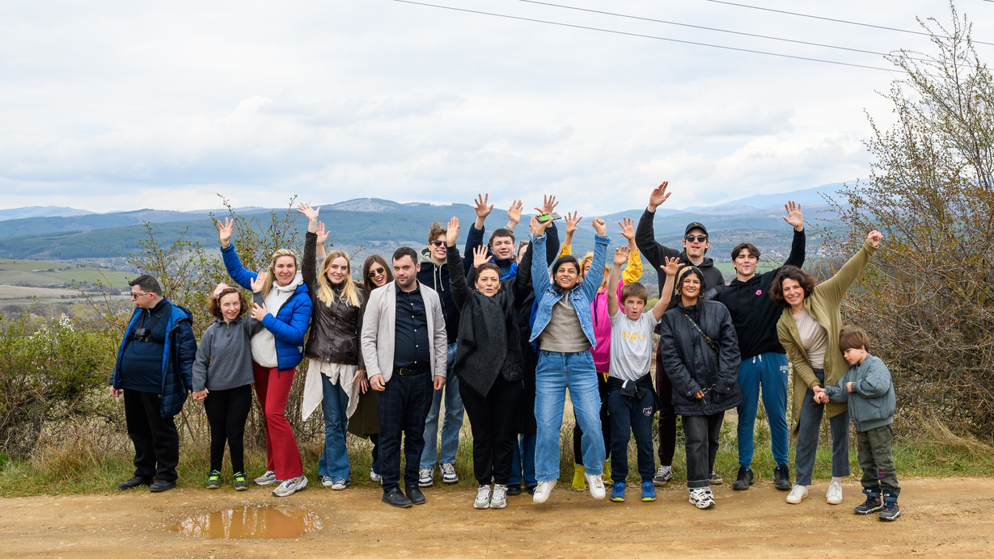
FOUNDATION “FOR TOMORROW” IS A NON-PROFIT ORGANIZATION ESTABLISHED IN 2017 IN BLAGOEVGRAD. ITS MISSION IS TO SUPPORT YOUNG PEOPLE WITH SPECIAL EDUCATIONAL NEEDS (SEN) AND INTELLECTUAL DISABILITIES BY DEVELOPING THEIR ABILITIES AND PROMOTING INCLUSION THROUGH TRAINING, WORKSHOPS, AND SOCIAL INTEGRATION PROGRAMS. THE FOUNDATION AIMS TO IMPROVE THE QUALITY OF LIFE AND SOCIAL PARTICIPATION OF YOUTH WITH SEN OR DEVELOPMENTAL CHALLENGES, ENCOURAGE THE EXCHANGE OF GOOD PRACTICES, AND FOSTER AWARENESS AND EQUALITY.

Slide 3
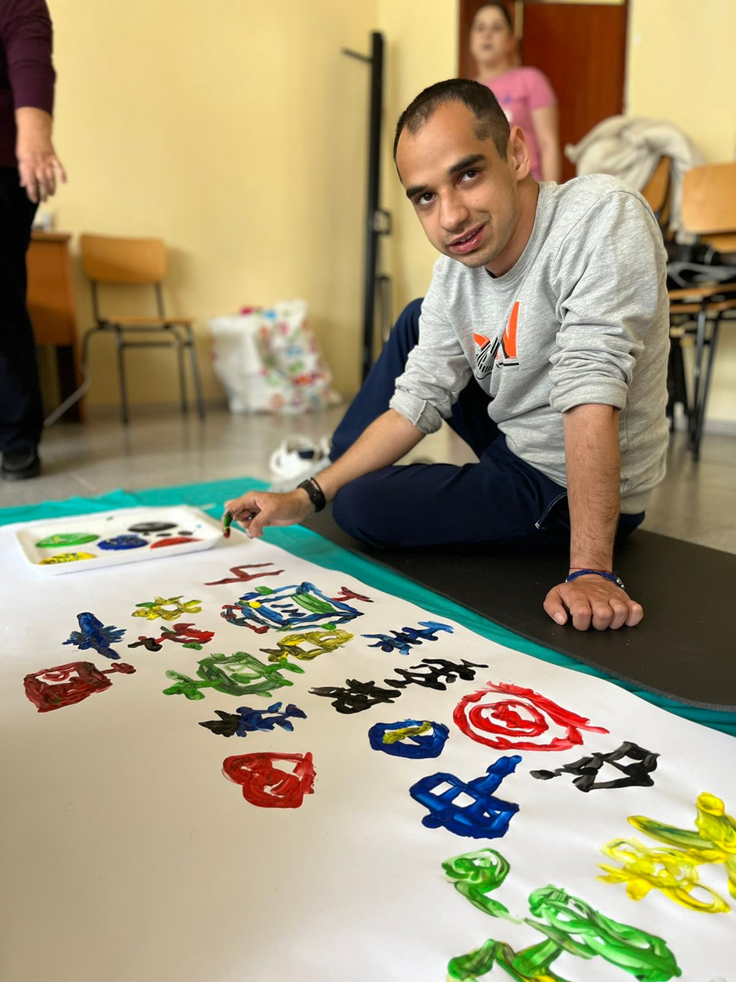
MINDFUL SOUND PROJECT
MINDFUL SOUND IS DESIGNED FOR YOUTH WORKERS WHO HAVE EXPERIENCE OR INTEREST IN ART AND NON-FORMAL EDUCATION, AND IN SUPPORTING THE PERSONAL DEVELOPMENT AND SOCIAL INCLUSION OF YOUNG PEOPLE WITH SPECIAL EDUCATIONAL NEEDS. THROUGH INTERACTIVE AND EXPERIENTIAL ACTIVITIES, PARTICIPANTS WILL ENGAGE IN DEEP SELF-WORK USING SOUND HEALING, ART TOOLS, AND MINDFULNESS. THE TRAINING WILL FIRST FOCUS ON PERSONAL AWARENESS AND SELF-GROWTH, ENABLING PARTICIPANTS TO UNDERSTAND AND EMBODY THE METHODS. AFTERWARDS, WE WILL PRACTICE HOW TO APPLY THESE TOOLS TO SUPPORT INDIVIDUALS WITH SPECIAL NEEDS, HELPING THEM STRENGTHEN THEIR MOTIVATION, CONFIDENCE, AND SENSE OF WELL-BEING. THROUGHOUT THE PROJECT, YOUTH WORKERS WILL HAVE THE OPPORTUNITY TO PRACTICE THE TECHNIQUES WITH DIRECT INDIVIDUAL AND GROUP WORK WITH YOUTHS WITH SPECIAL NEEDS, WHO WILL BE PARTICIPANTS OF THE PROJECT.

Slide 4
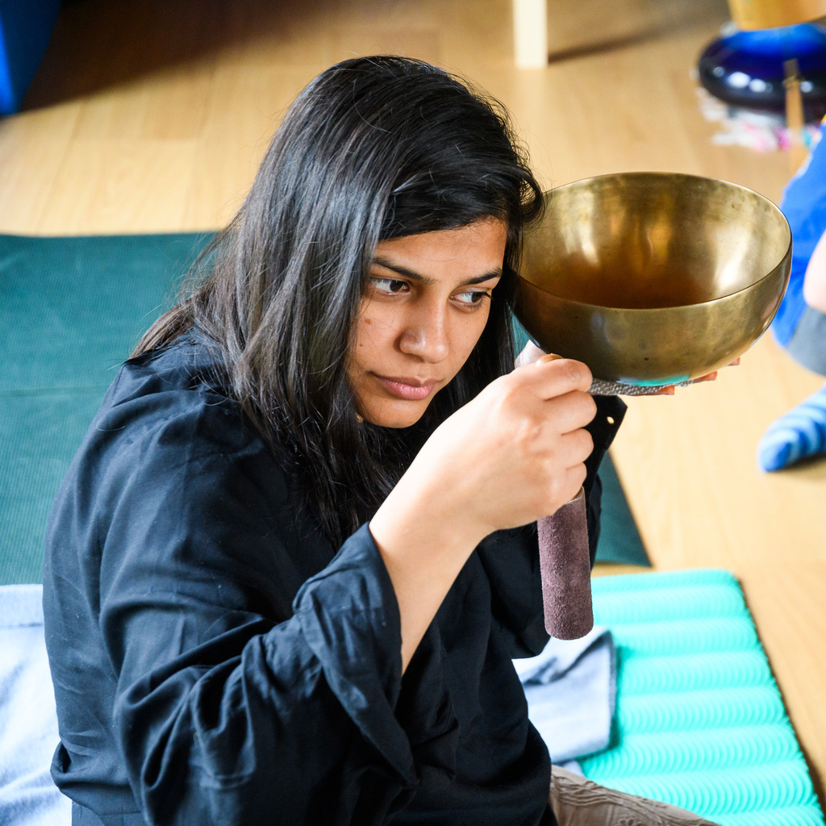
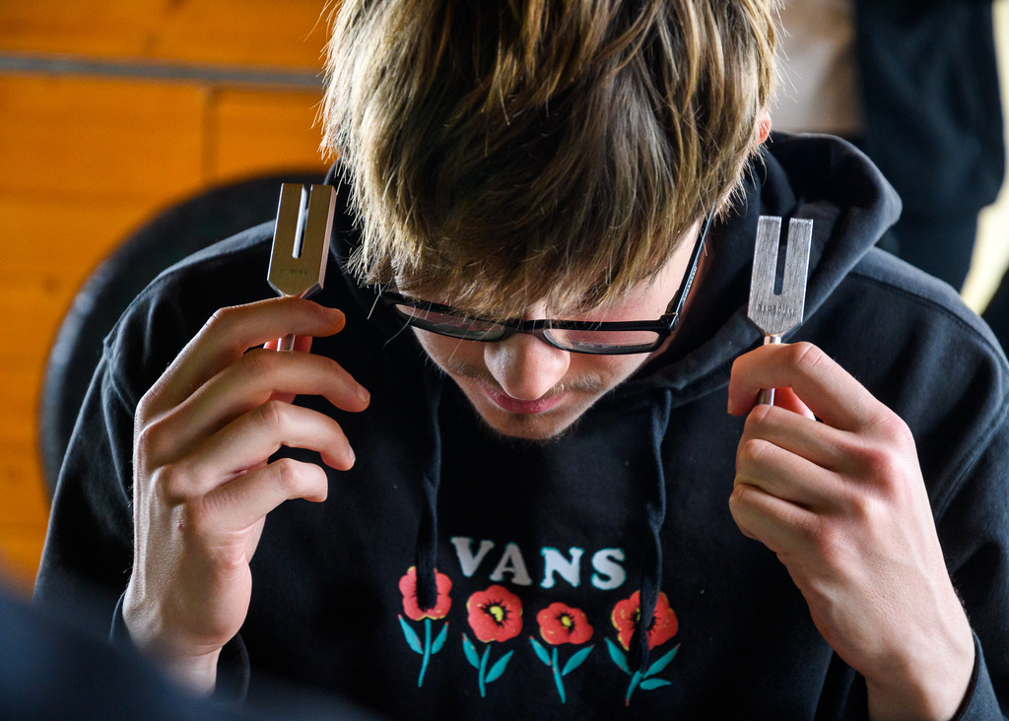
SOUND HEALING IN THE CONTEXT OF SOCIAL WORK
SOUND HEALING CAN BE ESPECIALLY BENEFICIAL FOR PEOPLE WITH SPECIAL NEEDS BECAUSE IT PROMOTES RELAXATION, EMOTIONAL REGULATION, AND SENSORY BALANCE. GENTLE SOUNDS AND VIBRATIONS CAN HELP REDUCE ANXIETY, IMPROVE FOCUS, AND CREATE A SENSE OF SAFETY, WHICH SUPPORTS LEARNING AND COMMUNICATION. FOR INDIVIDUALS WHO EXPERIENCE SENSORY OVERLOAD OR DIFFICULTY EXPRESSING EMOTIONS, SOUND HEALING OFFERS A CALMING, NON-VERBAL WAY TO SUPPORT WELL-BEING AND SELF-AWARENESS.
THE CURRENT PROJECT WILL FOCUS EXACTLY ON THE USE OF DIFFERENT SOUND AND MUSIC FROM NATURE, INSTRUMENTS, ETC. AS TOOLS FOR SELF-DEVELOPMENT AND INNOVATIVE SOCIAL WORK. WE WILL WORK DIRECTLY WITH YOUTH WITH INTELLECTUAL DIFFICULTIES FROM THE LOCAL COMMUNITY, WHO WILL BE INCLUDED AS PARTICIPANTS IN THE PROJECT.

Slide 5
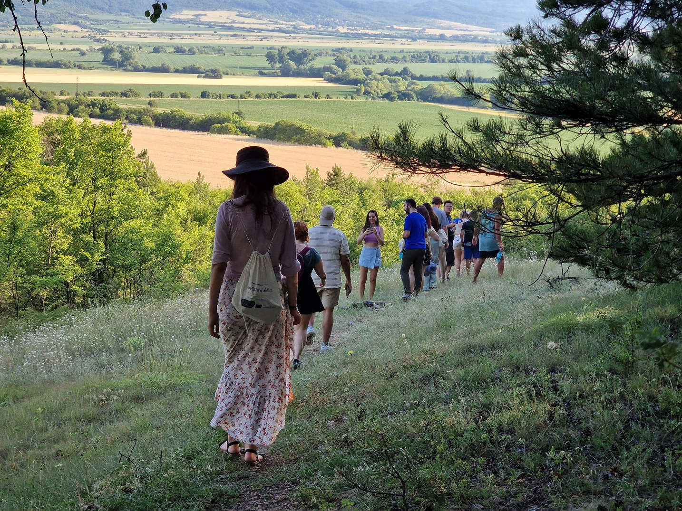
DURING THE PROJECT,
YOUTH WORKERS WILL LEARN:
  HOW TO USE SOUND AND MINDFULNESS FOR PERSONAL SELF-DEVELOPMENT
  HOW TO USE THE NEW TOOLS IN SOCIAL WORK FOR PEOPLE WITH SPECIAL NEEDS
  HOW TO PROMOTE THE OVERALL WELL-BEING OF YOUTH WITH SPECIAL NEEDS THROUGH CREATIVE AND SENSORY-BASED ACTIVITIES
  HOW TO SUPPORT THE AUTONOMY AND INDEPENDENCE OF PEOPLE WITH INTELLECTUAL DIFFICULTIES AND HOW TO HELP THEM EXPRESS THEMSELVES MORE FREELY
  HOW TO USE MINDFULLNESS, SOUND AND ARTISTIC TOOLS TO HELP INDIVIDUALS WITH SPECIAL NEEDS BUILD CONFIDENCE, STRENGTHEN MOTIVATION, AND UNFOLD THEIR FULL POTENTIAL
  HOW TO APPLY THE NEW SKILLS IN THEIR PERSONAL WORK

Slide 6
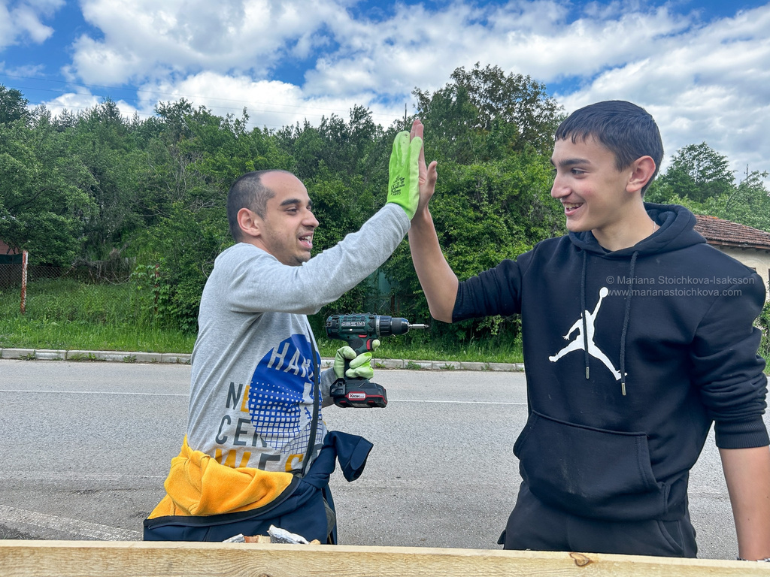
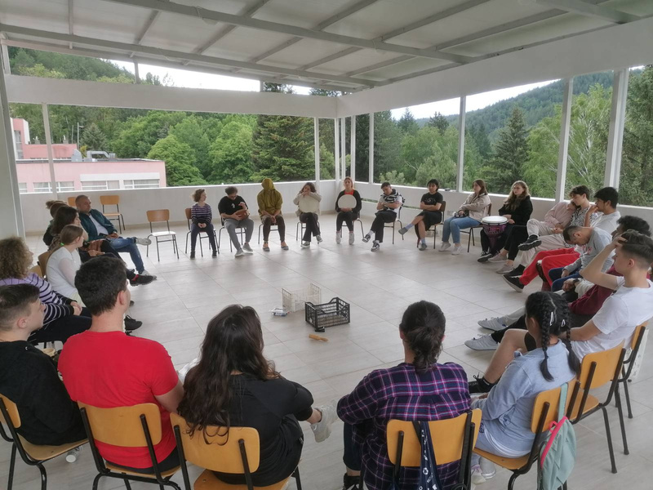
PLANNED ACTIVITIES
  TRAINING SESSIONS AND WORKSHOPS
  NON-FORMAL EDUCATION ACTIVITIES AND GAMES
  CREATIVE WORK FOR EXPLORATION OF THE USE OF DIFFERENT SOUNDS- VOICE, SOUNDS FROM NATURE, INSTRUMENTS
  MINDFUL ACTIVITIES FOR SELF-GROWTH: GROUNDING, FREE WANDERING, DEEP SELF-EXPLORATION, NATURAL SENSATORY EXPERIENCES
  ART ACTIVITIES TO DEVELOP INNER POTENTIAL- IMPROVISED CONCERTS, NATURAL CRAFTING, THEATER
  ON-SITE VISIT OF ORGANIZATIONS WORKING WITH SPECIAL NEEDS PEOPLE
  PRACTICAL WORK WITH YOUTHS WITH SPECIAL NEEDS FROM THE LOCAL COMMUNITY
  CROSS-CULTURAL ACTIVITIES AND CULTURAL EXCHANGE
ALL ACTIVITIES WILL BE LED BY TRAINED ART THERAPISTS AND PSYCHOLOGISTS

Slide 7
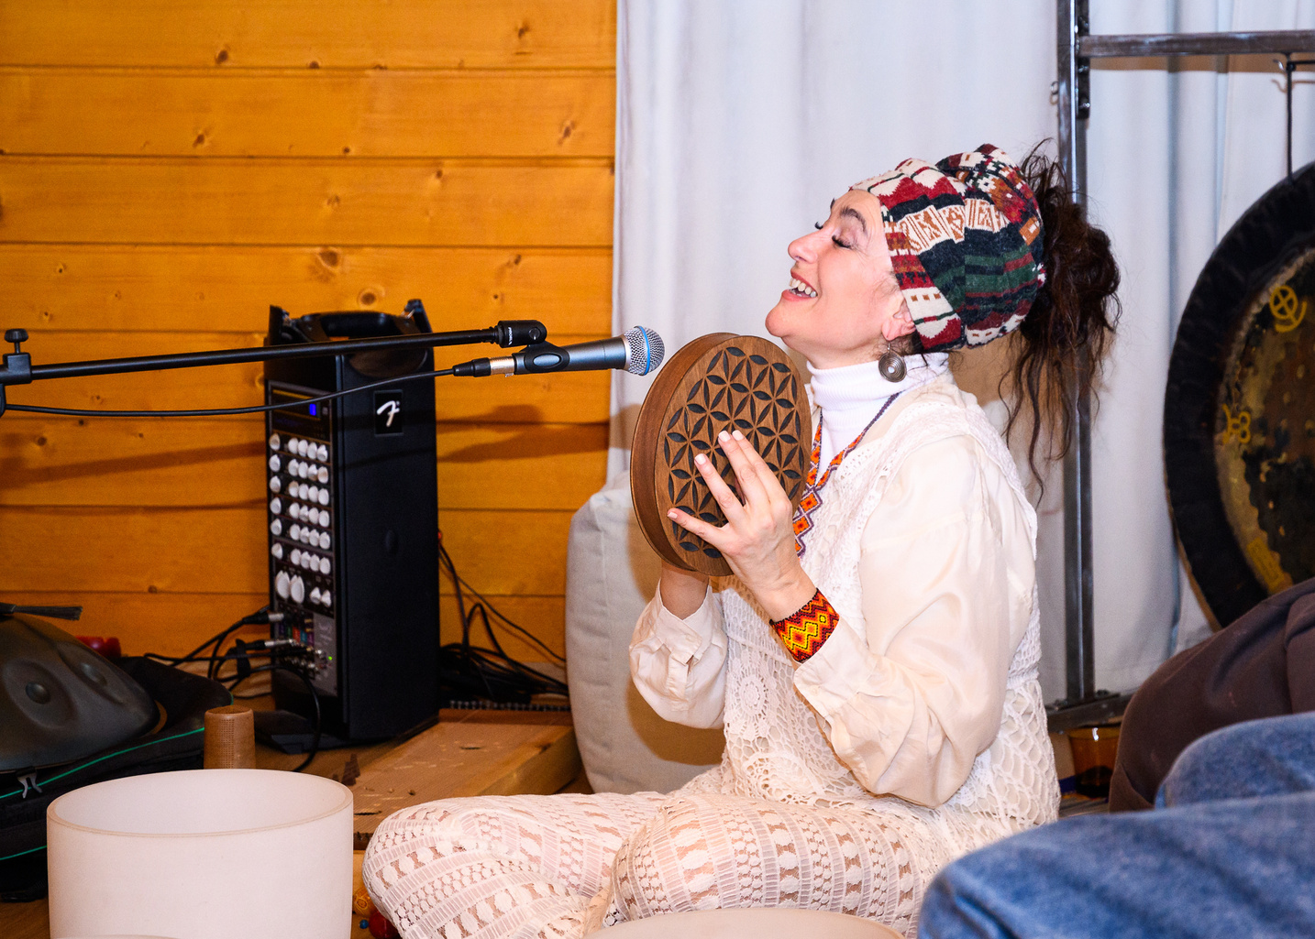
MIHAELLA STOIKOVA A.K.A ORFA IS A MULTI-DISCIPLINARY ARTIST. AS A SPECIALIZED SOUND THERAPIST, SHE WILL BE THE MAIN FACILITATOR IN THIS PROGRAM. SHE HAS A BACKGROUND IN ACTING, SINGING, COMPOSING, AND APPLIED ARTS, AND IS THE CO-FOUNDER OF DANCE THEATER AND ``ORFEA SONICENTER`` FOR HOLISTIC HEALTH AND SELF-AWARENESS THROUGH THE ARTS. PIONEERING SOUND HEALING EDUCATION AND MEDITATIVE CONCERTS IN BULGARIA. MIHAELLA ALSO HAS WIDE EXPERIENCE IN THE FIELD OF YOUTH WORK AS SHE WORKS WITH YOUTHS WITH SPECIAL EDUCATIONAL NEEDS AND ORGANIZES SOUND-RELATED PROJECTS TO PROMOTE THEIR WELL-BEING.

Slide 8
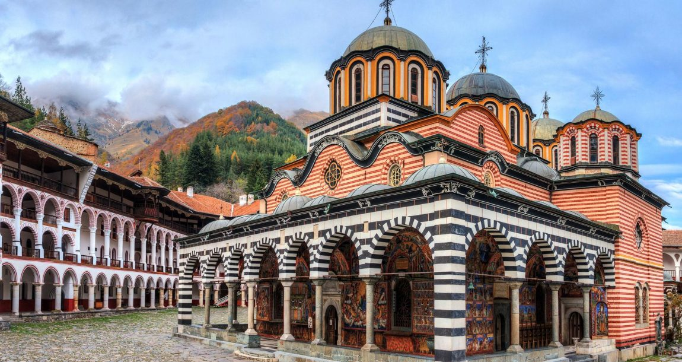
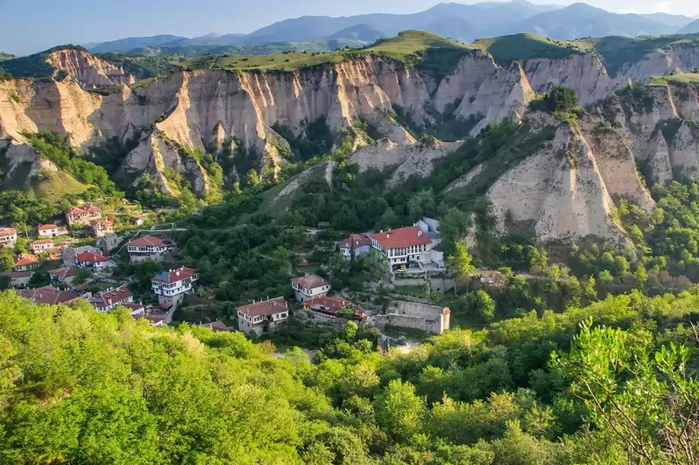
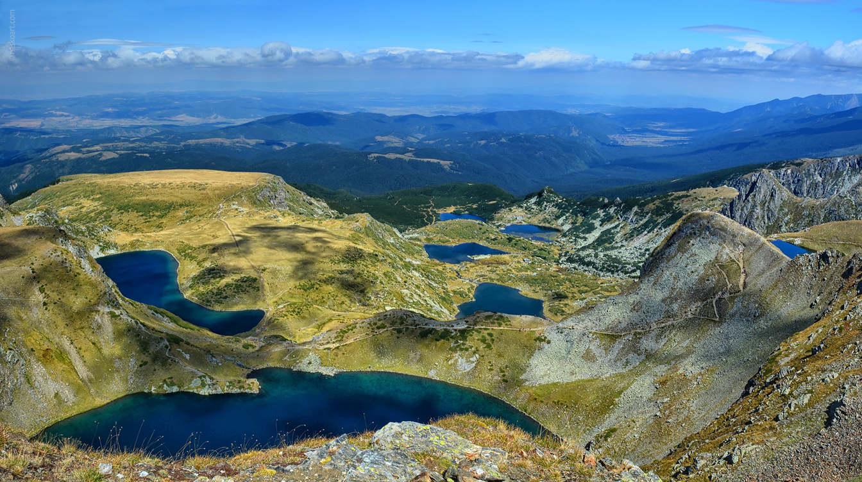
WE WILL INCLUDE IN THE PROGRAM ON-SITE VISITS AND EXCURSIONS FOR SIGHTSEEING TO SOME OF BULGARIA'S MOST BEAUTIFUL LAND MARKS.

Slide 9
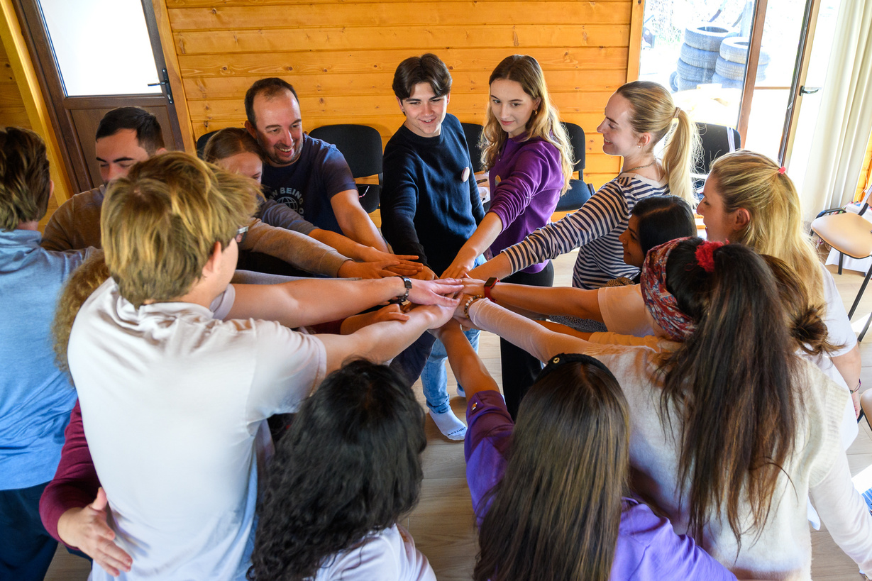
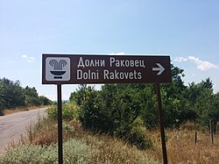
THE PROJECT WILL BE HOSTED IN DOLNI RAKOVETS - A VILLAGE WITH MINERAL SPRINGS, 1 HOUR AWAY FROM THE CAPITAL SOFIA.
PROJECT DURATION: FROM 16.03.2026 TO 27.03.2026 -
10 PROGRAM DAYS AND 2 TRAVEL DAYS

Slide 10
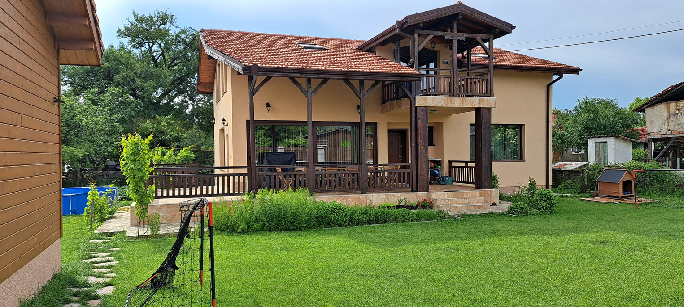
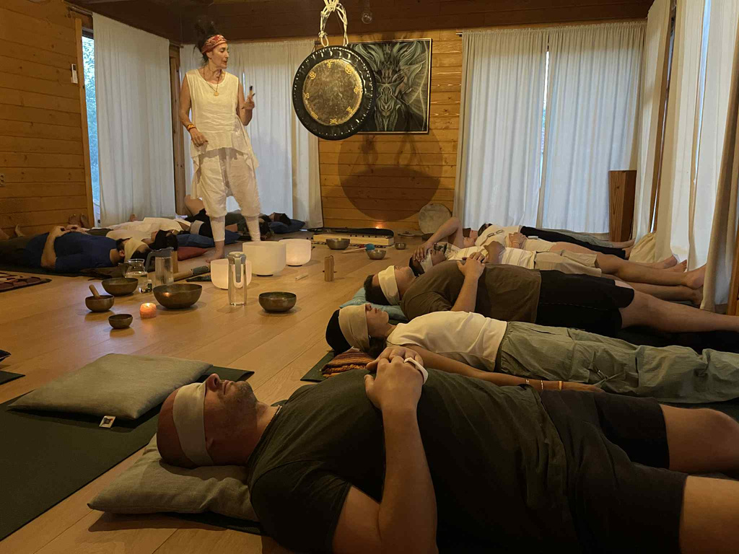
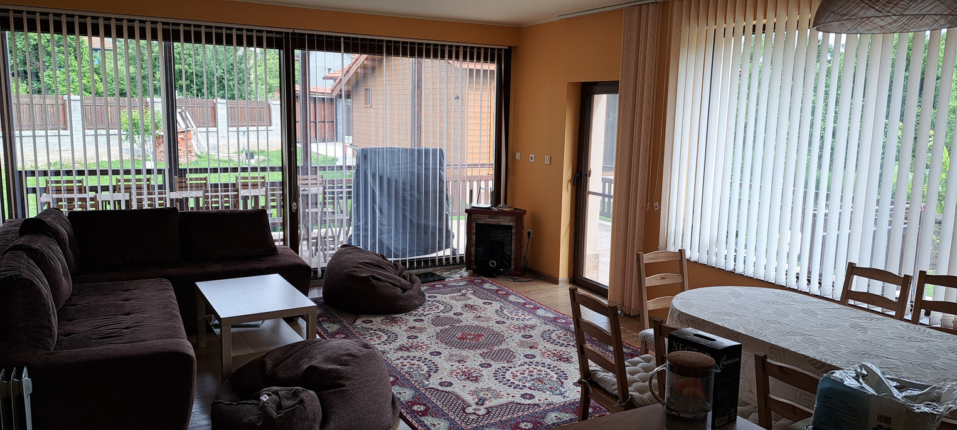
ACCOMODATION
THE PROJECT WILL TAKE PLACE IN HOUSE "OM'' LOCATED IN DOLNI RAKOVETS VILLAGE, 50KM AWAY FROM THE CAPITAL SOFIA. THE HOUSE HAS A BIG YARD, COZY TRAINING HALL, SPACIOUS LIVING ROOM, BEDROOMS FOR 2-3 PEOPLE AND SHARED BATHROOMS. WE WILL HAVE DINNER AT THE HOUSE AND LUNCH AND DINNER IN THE NEAR BY REASTAURANT WHERE FOOD OPTIONS ARE AVALIABLE.

Slide 11
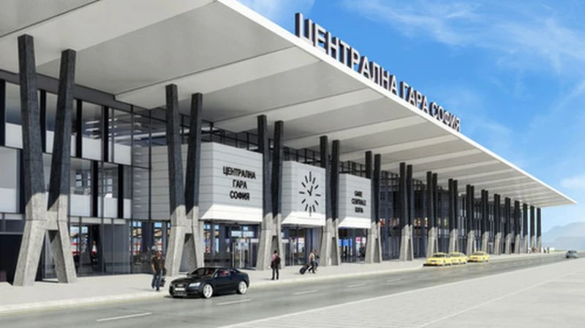
HOW TO GET THERE
THE CLOSEST ARIPORT TO BLAGOEVGRAD IS SOFIA AIRPORT.
FROM THE AIRPORT TAKE METRO TO THE CENTRAL RAILWAY STATION AND FROM THERE TAKE DIRECT TRAIN TO DOLNI RAKOVETS.
WEBSITE FOR TRAIN TICKET:
HTTPS://BILETI.BDZ.BG/
WE WILL PROVIDE TRANSPORT FROM THE TRAIN STATION IN DOLNI RAKOVETS TO THE HOUSE

Slide 12
PROJECT TIMELINE
  PARTICIPANTS GET APPROVAL FROM SENDING ORGANIZATION AND APPLY THROUGH THE APPLICATION FORM UNITL 10.02.2026 - https://forms.gle/fvuUVZcujZxWfAsE9
  POSSIBILITY TO SCHEDULE AN INTERVIEW WITH PARTICIPANTS FOR FINAL SELECTION
  FINAL SELECTION OF 13 PARTICIPANTS UNTIL 20.02.2026
  PARTICIPANTS BUY TICKETS (SAVE ALL RECEIPTS AND BOARDING PASSES FOR REIMBURSEMENT!)- WE ENCOURAGE GREEN TRAVEL AND CAN PROVIDE EXTRA MONEY FOR ACCOMMODATION ON THE WAY WITHIN THE ALLOWE BUDGET
  PREPARATORY ACTIVITES BEFORE THE PROJECT- PRESENTATIONS, WORKSHOPS
  PROJECT ACTIVITIES FROM 20.03.2026 TO 31.03.2026
  DISSEMINATION ACTIVITIES ORGANIZED BY PARTICIPANTS IN THEIR COUNTRIES AND REPORTS

Slide 13
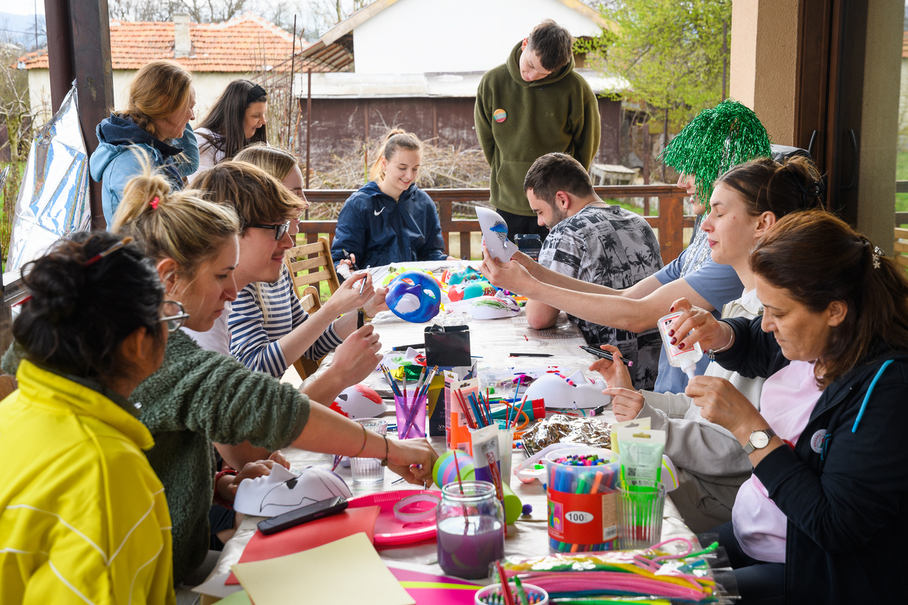
PARTICIPANT PROFILE
  OLDER THAN 21 YEARS WITH NO AGE LIMIT
  RELEVANT EXPERIENCE IN YOUTH WORK, PSYCHOLOGY, EDUCATION OR ART
  MOTIVATED TO COOPERATE WITH PEOPLE WITH SPECIAL NEEDS
  MOTIVATED TO ACTIVELY TAKE PART IN ALL ACTIVITIES
  READY TO CONTRIBUTE TO THE PROGRAM WITH OWN INPUT
  READY TO IMPLEMENT THE LEARNED SKILLS IN THEIR WORK
  PEOPLE WITH SPECIAL NEEDS ARE VERY WELCOME TO APPLY
APPLICATION FORM: https://forms.gle/fvuUVZcujZxWfAsE9

Slide 14
ADDITIONAL INFORMATION
PARTICIPATION IN THIS TRAINING COURSE IS FREE FOR THE PARTICIPANTS AND FULLY COVERED BY THE EU. WE PROVIDE ACCOMMODATION, FOOD, TRAINING MATERIALS AND WORKSHOPS, EXCURSIONS WITHIN THE PROGRAMM AND TRAVEL MONEY WITHIN THE ALLOWED BUDGET (ERASMUS TRAVEL CALCULATOR). ALL PARTICIPANTS WILL RECEIVE A YOUTHPASS AND CERTIFICATE FROM ORPHEA SOUND HEALING CENTER, BULGARIA.
THIS TRAINING COURSE IS OPEN FOR YOUTH WORKERS FROM EU MEMBER STATES AND ASSOCIATED COUNTRIES: BELGIUM, BULGARIA, CZECH REPUBLIC, GREECE, SPAIN, FRANCE, LITHUANIA, LUXEMBOURG, HUNGARY, PORTUGAL, ROMANIA, SLOVENIA, DENMARK, GERMANY, ESTONIA, IRELAND, CROATIA, ITALY, CYPRUS, LATVIA, MALTA, NETHERLANDS, AUSTRIA, POLAND, SLOVAKIA, FINLAND, SWEDEN, NORTH MACEDONIA, SERBIA, ICELAND, LIECHTENSTEIN, NORWAY, TURKEY.

Slide 15
CONTACTS
EMAIL: ZAUTRE.PROJECT@GMAIL.COM
CONTACT PEOPLE:
  BORISLAV SLAVCHOV
  PETYA PETROVA
DEADLINE TO APPLY: 10.02.2026
APPLY HERE: https://forms.gle/fvuUVZcujZxWfAsE9
FUNDED BY THE EUROPEAN UNION. VIEWS AND OPINIONS EXPRESSED ARE HOWEVER THOSE OF THE AUTHOR(S) ONLY AND DO NOT NECESSARILY REFLECT THOSE OF THE EUROPEAN UNION OR THE EUROPEAN EDUCATION AND CULTURE EXECUTIVE AGENCY (EACEA). NEITHER THE EUROPEAN UNION NOR EACEA CAN BE HELD RESPONSIBLE FOR THEM.

Slide 16
