Slide 1

“ Fostering inclusive entrepreneurship for a stronger society and economy”

Slide 2
About TTi
Identity: Established in 2010, as a non-profit organization dedicated to strengthen the entrepreneurship ecosystem.
Mission: Fostering inclusive entrepreneurship for a stronger society and economy.
Final beneficiaries: Aspiring entrepreneurs, particularly youth and women, living in disadvantaged communities.
Impact: Empowering over 12,000 aspiring entrepreneurs since 2010.
Hubs: Three incubation centers in Jordan fostering entrepreneurial and innovation.

Slide 3
Our 3-tier strategy:
MACRO
MESO
Policy Makers
Entrepreneurship Support
Organizations (ESOs)
MICRO
Entrepreneurs

Slide 4
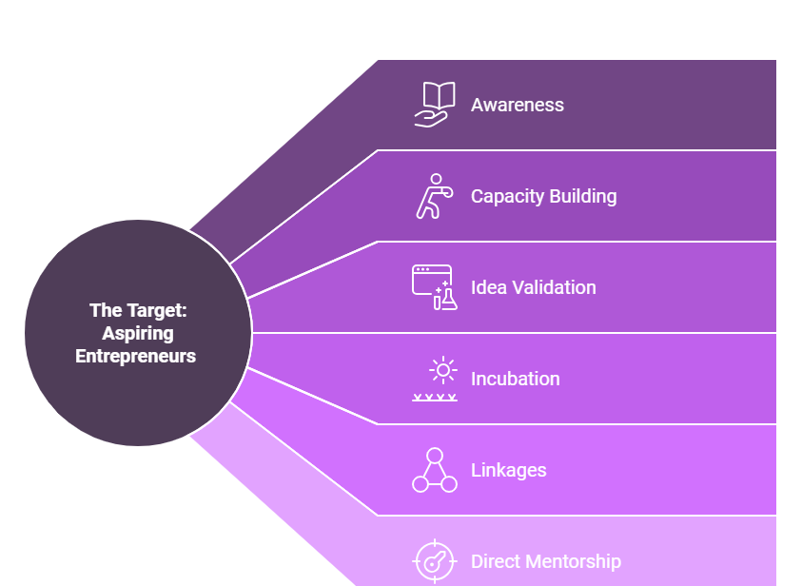
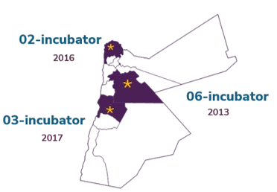
The Micro Level

Slide 5
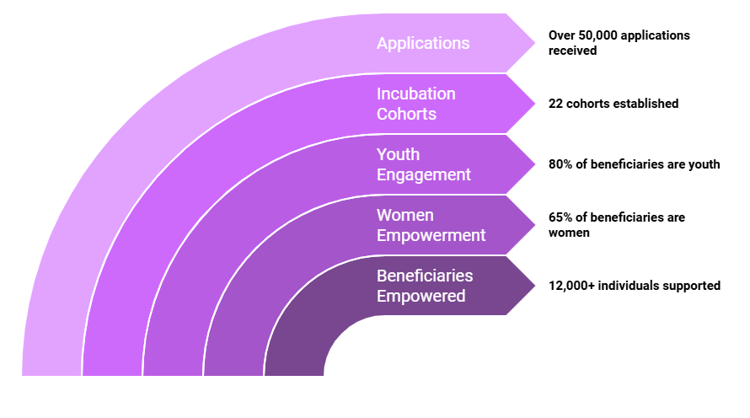
The Micro Level

Slide 6
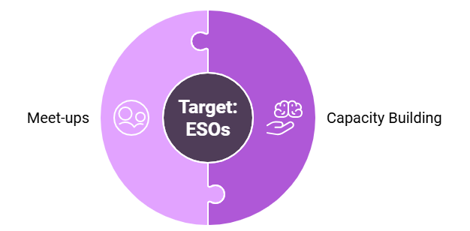
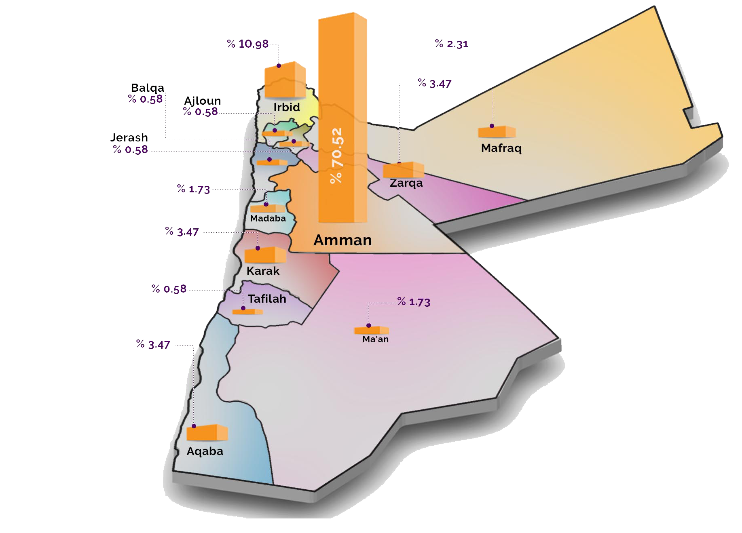
The Meso Level

Slide 7
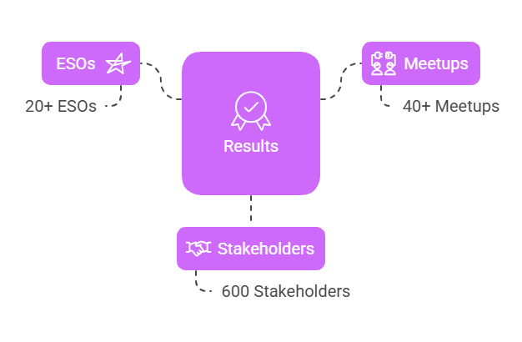
The Meso Level

Slide 8








Sample of Supported ESOs

Slide 9
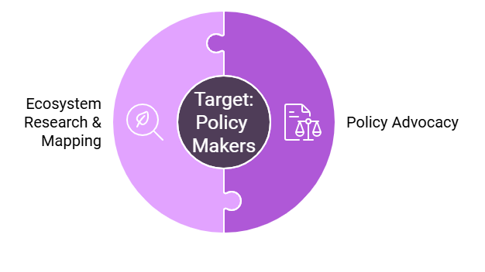
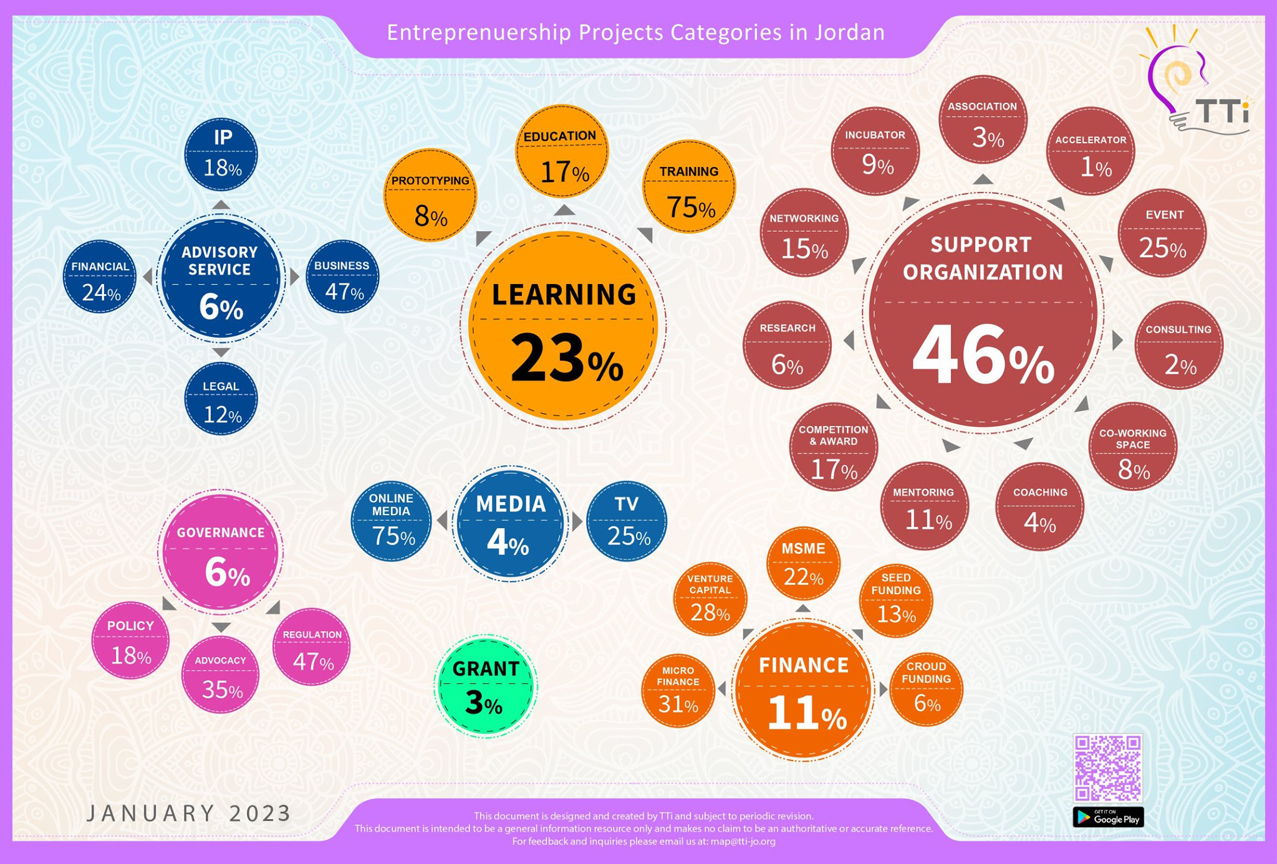
The Macro Level

Slide 10
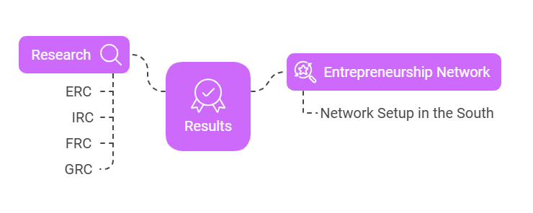
The Macro Level

Slide 11
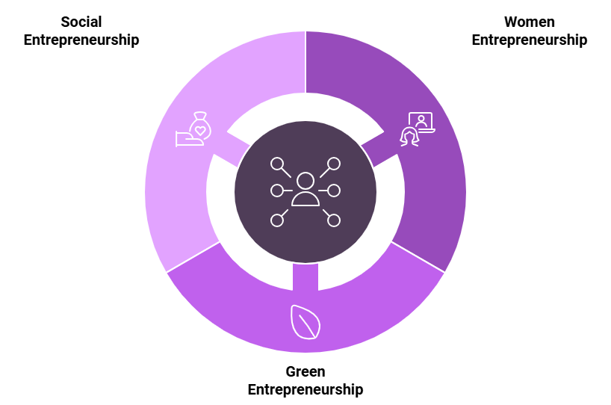
Cross-Cutting Themes

Slide 12












Strategic Partners

Slide 13
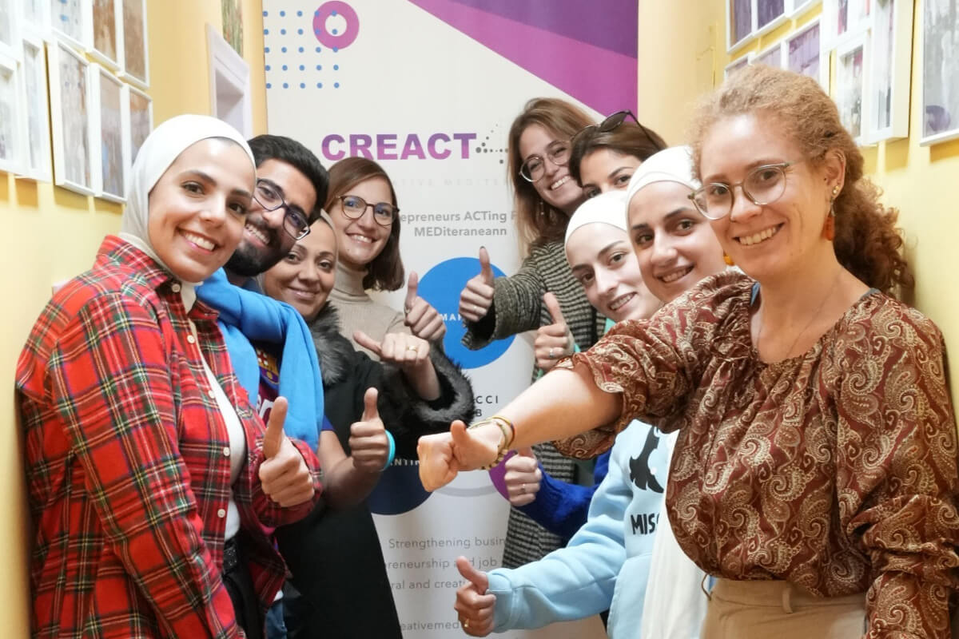
Contact Information
Amman ​
info@tti-jo.org​
Tel: +962786028595 ​
Irbid ​
02incubator@tti-jo.org
Tel: +962786253250​
Karak ​
03incubator@tti-jo.org​
Tel: +962782020213​
Thank You

