Slide 1

DIGIpreneur - Digital Entrepreneurship
KA153 – Training Course

Slide 2
Mission
To equip youth workers with the knowledge, skills, and tools to guide young people in exploring digital entrepreneurship, building a responsible online presence, and using innovative technologies to launch and grow online business ideas.

Slide 3
Project goals
Build youth workers’ capacity to introduce digital entrepreneurship concepts and pathways for starting online businesses.
Strengthen understanding of digital hygiene, online safety, and ethical practices in the context of entrepreneurship.
Develop practical skills in creating and managing online business assets (e.g., websites, portfolios, basic prototypes).
Enable youth workers to design and deliver interactive training sessions that help young people turn business ideas into actionable online projects.

Slide 4
About the project
When? – 2026
The duration will be 6 months
The project will have 1 activity – 8 days long Training Course for Youth Workers in Bulgaria
Who?
The consortium will include 7 Organizations (Applicant + 6 Partners)
Each organization will sent 4 participants to the TC (28 at all)
Digital Entrepreneurship

Slide 5
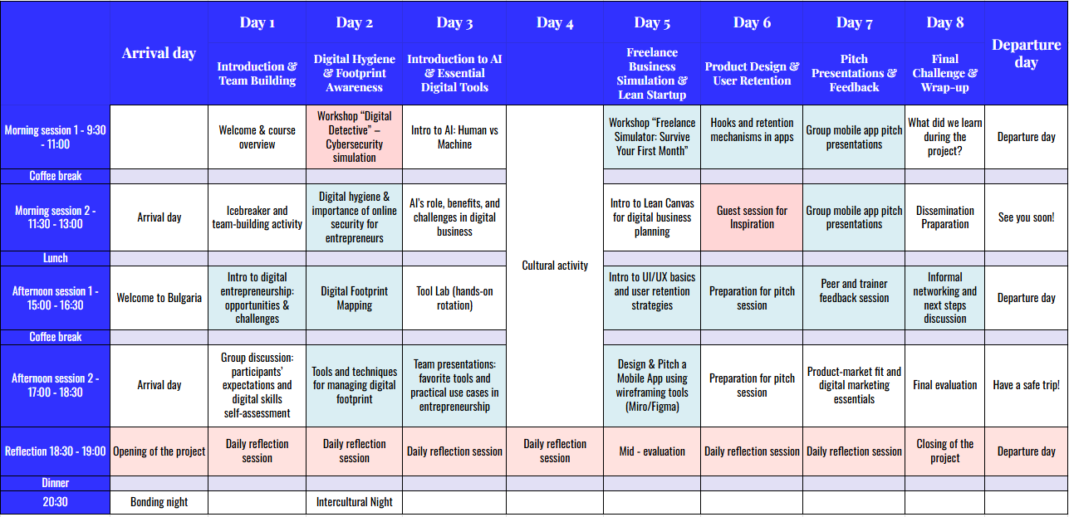
Activity scedule

