Slide 1
«Seminars For Strong Contacts»
ERASMUS+ - KA153
13-21 AUGUST 2022 - Gaziantep, TÜRKİYE

Slide 2
Objective of the Project
The «Seminars For Strong Contacts» project has similar goals (encouraging active participation, intercultural dialogue, social inclusion and solidarity among young people) with the "Erasmus +" program and encourages entrepreneurship as a tool to combat youth unemployment for Organizations.
Youthworkers will gain a better understanding of their role in society and in Europe in the future, as they will learn about the need for business development in order to create new job opportunities and participate at an economic level by designing business plans.
The aim of the project is; to increase the knowledge, skills, and competence levels of 39 youth workers from 9 participating countries or experts working in the field of entrepreneurship.
The goal of the project will be achieved through the following specific objectives:
OS1. To increase the awareness of a total of 39 participants from the European Union, Balkan Peninsula and Africa region in order to encourage and develop entrepreneurship in the current economic environment,
OS2. To raise awareness among young people from 9 organizations about the importance of young entrepreneurs and their role in shaping the future of European society,
OS3. To encourage organizaitons in order expand the entrepreneurship network,
OS4. To establishing an entrepreneurship network in the international level
With this project that we want to realize in Gaziantep province, we aim to establish an international level network, make awarenes about youth employability and youth entrepreneurship etc.
Among the goals; the partner organizaitons will be able to assist young people who could not enter the labor market after the project in guidance and counseling activities. Organizations will encourage young people to establish their own businesses as a result of sharing what they have learned with their environment, inform about existing policies, and grant projects, and instill self-confidence.

Slide 3
Summary of Project ACTIVITIES
3
PREPARATION
IMPLEMENTATION
FOLLOW UP
DISSEMINATION
REPORTING

Slide 4
Programme
4
From | To | 13.08.2022 | 14.08.2022 | 15.08.2022 | 16.08.2022 | 17.08.2022 | 18.08.2022 | 19.08.2022 | 20.08.2022 | 121.08.2022
08:30 | 10:00 | ARRIVAL | Breakfast | Breakfast | Breakfast | Breakfast | Breakfast | Breakfast | Breakfast | Breakfast
10:00 | 12:00 |  | Get to know each other vol.II | Entrepreneurship Ecosystem in Global | Entrepreneurship Interfaces | Incorporation | Network Plan-I | Communication Session | Benchmarking Works | Check-Out
12:00 | 12:30 |  | Tea-Break | Tea-Break | Tea-Break | Tea-Break | Tea-Break | Tea-Break | Tea-Break | DEPARTURE
12:30 | 14:00 |  | Project Briefing | Traditional Entrepreneurship and Innovation | Entrepreneurship Interfaces | Intellectual property rights | Network Plan-II | Network Model Presentation | Visibility-I
14:00 | 15:00 |  | Lunch | Lunch | Lunch | Lunch | Lunch | Lunch | Lunch
15:00 | 16:00 |  | Free Time | Free Time | Free Time | Free Time | Free Time | Free Time | Free Time
16:00 | 17:30 |  | Journey of E+ | Design Thinking-I | Field Visit | Project Management-I | Network Model-I | Network Model Presentation | Visibility-II
17:30 | 18:00 |  | Tea-Break | Tea-Break |  | Tea-Break | Tea-Break | Tea-Break | Tea-Break
18:00 | 19:30 |  | Youthpass | Design Thinking-II |  | Project Management-II | Network Model-II | Benchmarking Works | Final Evaluation
19:30 | 20:00 |  | Reflection | Reflection | Reflection | Reflection | Reflection | Reflection
20:00 | 21:00 | Dinner | Dinner | Dinner | Dinner | Dinner | Dinner | Dinner | Dinner
21:00 | 22:00 | Get to know each other vol.I | Free Time | Free Time | Culture Road Night Watch | Free Time | Free Time | Free Time | Free Time
22:00 | 00:00 |  | Turkish Night | European Night |  | North African Night | Ukrainian Night | Balkan Night | Farewell Night

Slide 5
PARTNERS and Travel Cost Limits
Partner | Country | Travel Limit | Pax
MEDITERRANEAN FORUM FOR SOCIAL DEVELOPMENT | Morocco | 820 EUR | 4 pax
SCAMBIEUROPEI | Italy | 360 EUR | 4 pax
FARHAT HACHED INSTITUTE FOR RESEARCH AND DEMOCRACY | Tunisia | 360 EUR | 4 pax
PHOENIX ASSOCIATION | Ukraine | 275 EUR | 4 pax
UDRUZENJE MLADI VOLONTERI | Bosnia and Herzegovina | 275 EUR | 4 pax
ASOCIATIA INITIATIVE SOCIALE | Romania | 275 EUR | 4 pax
ORGANIZATA JOQEVERITARE THY | Kosovo | 275 EUR | 4 pax
INTERNATIONALE ARBEIDSVERENIGING | Netherlands | 530 EUR | 4 pax

Slide 6
Financial Aspects: Restrictions and Conditions
There is NO participation fee.
All international tickets must be approved by the hosting organization (Hasan kalyoncu University) before buying it
Buying ticket without approval will not be reimbursed
No taxi, no private car, no private shuttle, no personal means of transportation will be reimbursed!
You can only use public transportation.
Participants must bring all financial documents such as invoices, electronic tickets and boarding passes etc. of all relevant travel costs to be reimbursed.

Slide 7
PARTICIPANTS PROFILE
You are engaged in youth work and working actively and closely with young people
You are willing to learn about new methodologies for entrepreneurship education approach in youth work
You have a strong interest in sharing the learning gained during the training course
You are over 18+ years old.
You are motivated to develop your knowledge and skills on training course topic and to share your experiences with other participants
You are committed to attend for the full duration of the course
You are fluent in English, as this will be the working language of the course

Slide 8
Participant Selection Criteria
candidates' profile and match to the topic
participants' experiences on youth work and entrepreneurship education
participants with fewer opportunities
participants' motivation on the topic and sustainable plan for future to use outcomes
potential to deliver gained knowledge with others

Slide 9
International Travel Tickets to GAZİANTEP
Find cheapest travel option for your trip to Gaziantep
Take a screenshot of your desired travel (including route, flight dates, flight times and price)
Send your screenshot to
hku.seminar.project@gmail.com
Get approval from hosting organization!
(HKU)
Buy your ticket ONLY IF YOU GET THE CONFIRMATION of hosting organization!
Send your ticket copy to hosting organization via
hku.seminar.project@gmail.com
DEADLINE:
Participants should be bought travel tickets till
1st July 2022
Remember:
You can stay up to 5 days extra in Türkiye!
Please follow instructions
DO NOT BUY
ANY TICKETS
WITHOUT APPROVAL!

Slide 10
Visa to TÜRKİYE
Turkey is not in the EU yet.
So, please bring along your passport (if you need a passport to travel Turkey).
There is a need for visas for some countries’ citizens.
However, the visa can be obtained online https://www.evisa.gov.tr/en/
Budget for visa cost is 50 EUR per participant.
Do not forget to download your visa and receipt.
But please check your country once again to be sure!
For more information: http://www.mfa.gov.tr/visa-information-for-foreigners.en.mfa

Slide 11
Travel to the venue (13 AUGUST 2022)
Everyone has to be in Gaziantep
before 17:00
On 13 August 2022
When you arrive to Gaziantep Airport, just outside of the terminal you will see HAVAŞ Shuttle Buses.
The shuttle bus will take you to the City Centre Office. The cost is 30 TL and only available to pay in cash.
More information about local transportation will be sent later*

Slide 12
Travel back to the airport (21 AUGUST 2022)
Everyone has self- responsibility to take shuttle bus.
The bus will take everyone from the city centre Office.
You should take the bus
2 hours before your flight.
The shuttle bus will leave you just in front of the Airport Terminal.
Participants can take bus to the GZT airport right after the Project, Or if they prefer, they can stay and enjoy Gaziantep or in other cities!

Slide 13
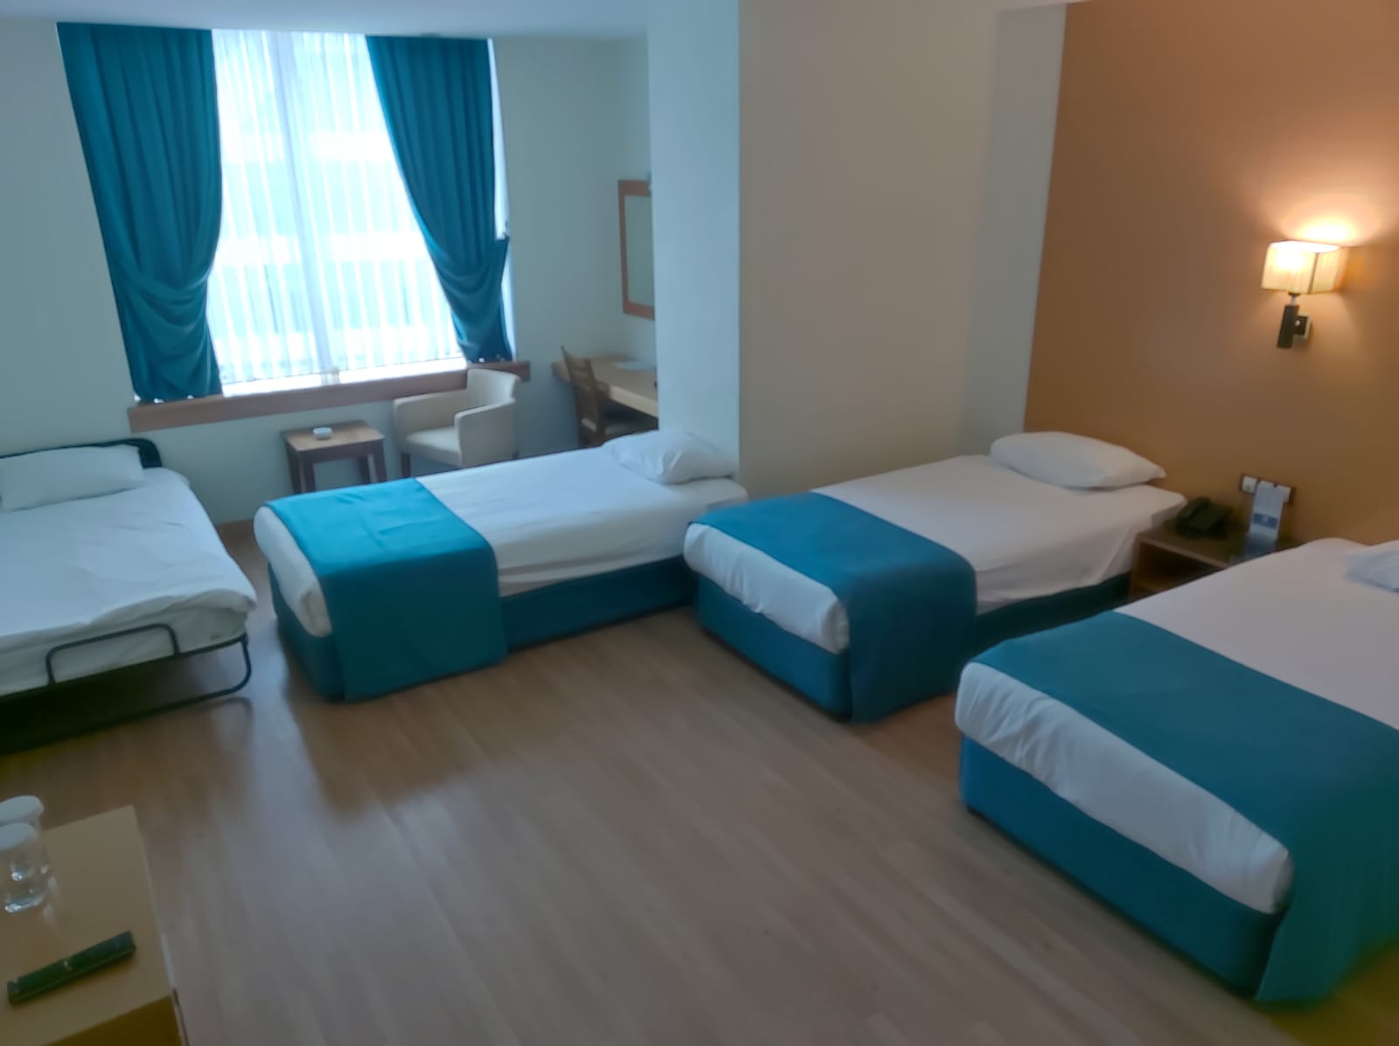
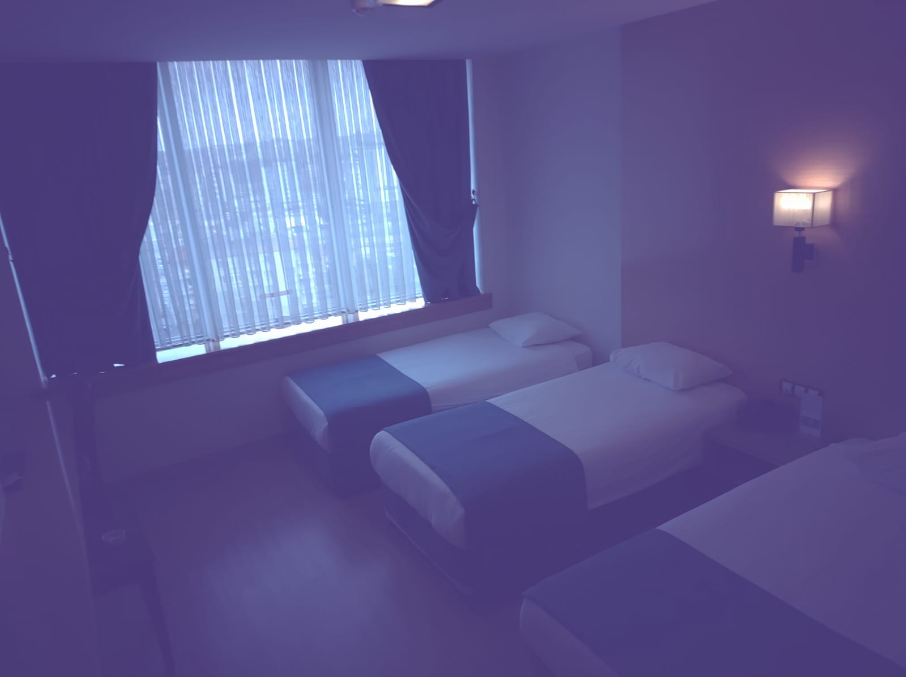
Venue / Hotel
We will stay in the GAZİANTEP PLAZA HOTEL
Rooms are arranged as: 3 people will stay in the same room with same gender
If you want to stay in a single room, you can pay 20 € per day and enjoy single accommodation.
Those who would like to stay alone, should inform us 30 days in advance in order to book the room extra.
There is no laundry service in the hotel and wi-fi is only available in lobby and in training room
Turkey is a country that is not very convenient for those fed vegan. If you are a vegan and decided to come, please be aware that you may have difficulties to find appropriate food for your diet. However, we will do our best to help you with your diet for sure.

Slide 14
Reimbursement Procedures
Find cheapest travel option to Gaziantep
Get approval from Hosting Organization from Turkey
Buy your tickets before 1 JULY 2022
Send your invoice and electronic tickets to hosting organization
Provide all documents in original on spot during the TC in Gaziantep
Get your reimbursement in cash on spot

Slide 15
Warnings!
Participants are responsible for;
buying the wrong ticket
missing the plane/train/bus/shuttle bus etc.
performing travel off the route
extra services bought except ticket during the travel
personal international travel health insurance
taxi, private cars, etc. and undocumented travel expenses
personal expenses, extra days’ costs

Slide 16
COVID-19 ARRANGEMENTS
NO QUARANTINE REQUIRED
NO VACCINATION REQUIRED
NO COVID-19 TEST REQUIRED
NO FORMS TO BE COMPLETED
Please review Country-specific Entry Restrictions page for more details.

Slide 17
The Team
General Coordinator: Cengiz HELVACIKARA
Project Coordinator: Şevket YILMAZ
Logistics Coordinator: Gizem ARIK
Trainer: Mehmet ÇETİNKAYA

Slide 18
See you in Gaziantep!
Webpage
Facebook
LinkedIn
Twitter
Instagram
Project Mail Address
Project’ Facebook Group

Slide 19
Thanks!
ANY QUESTIONS?
You can find us at hku.seminar.project@gmail.com
https://kalitto.hku.edu.tr/

