Slide 1
INFOPACK
Training Course Moldova
11 – 19 June 2022, Chisinau
A PROJECT COORDINATED BY D.G.T. Moldova ASSOCIATION
CO-FUNDED THROUGH ERASMUS+ PROGRAMME

Slide 2
A PROJECT COORDINATED BY DGTASSOCIATION
CO-FUNDED THROUGH ERASMUS+ PROGRAMME
SUMMARY OF
THE PROJECT
The project “Start Up and Pass On” is a project initiated by 6 European non-profit organisations (3 from European Union member state and 3 from the Eastern vicinity) to encourage the cooperation between European NGOs and skill up human capital from NGOs (youth workers) by providing quality entrepreneurial education instruments, supports the employability of NEETs and enhance the international dimension of youth activities.
During the project we will facilitate the exchange of knowledge and best practices between youth workers who works in different entrepreneurial ecosystems, create training curricula in entrepreneurship education for young people, discover how to facilitate the youth transition from school to work and adult life.
In the same time, youth workers can help young people to make informed decisions, after they see the big picture: the advantages and drawback of entrepreneurship.
We will stimulate the international exchange of good practices and relevant experiences to develop modern tools for entrepreneurial education of professional people from NGOs.

Slide 3
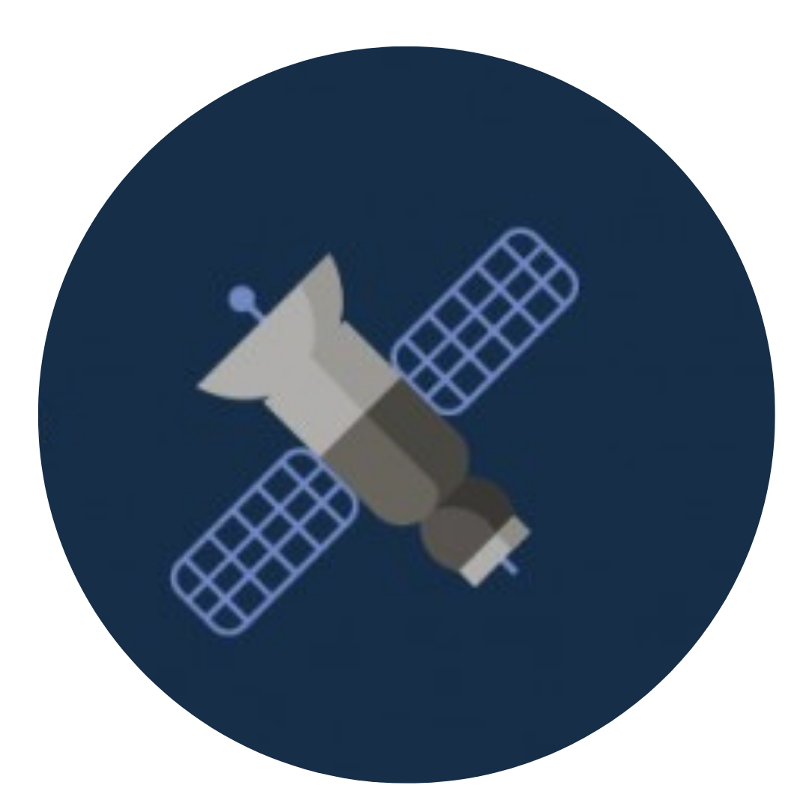
A PROJECT COORDINATED BY DGTASSOCIATION
CO-FUNDED THROUGH ERASMUS+ PROGRAMME
OBJECTIVES
In order to reach our aim, the project will have the following specific objectives:
O1: To create a network of 34 international youth workers and prepare them to become multipliers of entrepreneurial education through 3 mobility and capacity building activities (Romania, Moldova and Georgia)
O2: To foster the inclusion and employability of 590 NEET youth from 6 countries organizing local workshops and using tools based on learning through games and non-formal education developed by the 34 youth workers
O3: Raise awareness regarding the importance of entrepreneurial education in formal and non-formal educational environments and promote developing and learning opportunities for NEET in the field of entrepreneurship

Slide 4
A PROJECT COORDINATED BY DGTASSOCIATION
CO-FUNDED THROUGH ERASMUS+ PROGRAMME
Participant profile:
Above 18 without upper age limit;
At least medium English level is required;
Working with young peope at local/international level;
Connection with the sending organization.
The national teams of the training course will be, as following:
Georgia – 5 participants
Belarus – 5 participants
Moldova – 7 participants
Poland – 5 participants
Italy – 5 participants
Romania – 7 participants

Slide 5
A PROJECT COORDINATED BY DGTASSOCIATION
CO-FUNDED THROUGH ERASMUS+ PROGRAMME
PROJECT FLOW
The NGOs involved in the project will develop a new tool for experiential education in the field of entrepreneurship with a 4 steps cycle project:
1 – design a non-formal education curricula focused on 21st Century skills, to be tested in an intensive training course (Romania – February 2022);
2 – organize a capacity building workshop to simulate an incubator for social start-ups (Moldova – June 2022);
3 – based on the processes and know-how gathered in 1st and 2nd step, the youth workers, with the guidance of a game designer will create an interactive board game to be used by youth workers to explain the start-up process from idea to implementation to young people through an workshop (Georgia – September 2022);
4 – organize demo-workshop to test the board game with new youth workers, non-formal education trainers, teachers and young people.

Slide 6
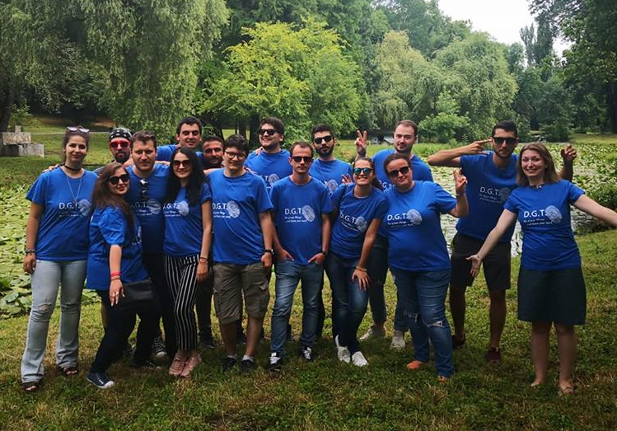
A PROJECT COORDINATED BY DGTASSOCIATION
CO-FUNDED THROUGH ERASMUS+ PROGRAMME
ABOUT
D.G.T. Association is Romanian non-profit organization launched in 2011, with branches in Moldova (2014), Spain (2016), Latvia (2019), Netherlands (2020). Our aim is to create a network between youngsters, students and researchers of different backgrounds and nationalities to encourage the exchange of learning opportunities and development of soft and professional skills.
WEBSITE
FACEBOOK PAGE
Project coordinator: Andrei Daicer
d.g.t.andrei@gmail.com
0040737074831

Slide 7
A PROJECT COORDINATED BY DGTASSOCIATION
CO-FUNDED THROUGH ERASMUS+ PROGRAMME
PARTICIPANTS RESPONSIBILITIES FOR THE MOBILITY IN MOLDOVA
1. Create a series of 3 interviews/by country with young entrepreneurs (under 35 years old). Format of the interviews – written, audio and/or video
The interviews shall be sent via email by national groups at emilie.radu@gmail.com before the arrival in Moldova.
2.Identify 2-3 succesful social entrepreneurship projects/start-ups initiated by nonprofits or by a group of people from your country and understand how these works, what makes them unique. You will have to share their stories when we meet, so if you want to save few paragraphs about them in a word document, it would be great.

Slide 8
LEARNING CYCLE - A3 – MOLDOVA
11 – 19 JUNE 2022
Day 1 -
Reconnecting. Intro in social entrepreneurship – what it is, what are the different forms of social entrepreneurship
Gallery of social entrepreneurship projects from your country
Day 2-6
Introduction to Play Incubate methodology – a 6 days marathon to create social start-ups
4 phases:
Phase 1: You. The Road of Trials
Phase 2: Idea. Creative Islands
Phase 3: Project. The social start-up
Phase 4: Grow. Magic Flight
Visits to local young entrepreneurs/HUBs
Day 7
Introduction in board game design. Preparing for Georgia. Evaluation.

Slide 9
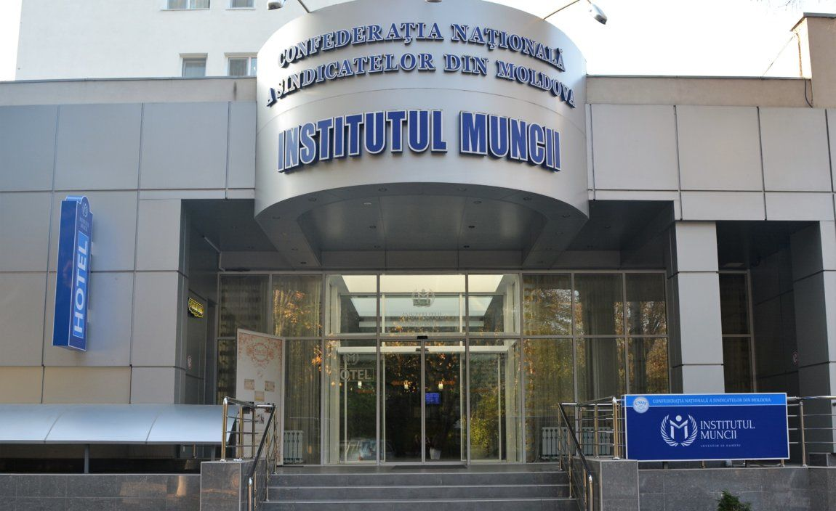
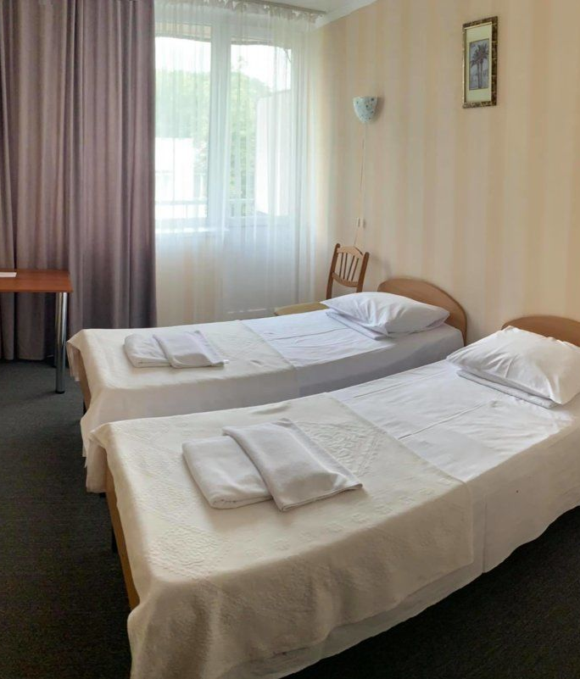
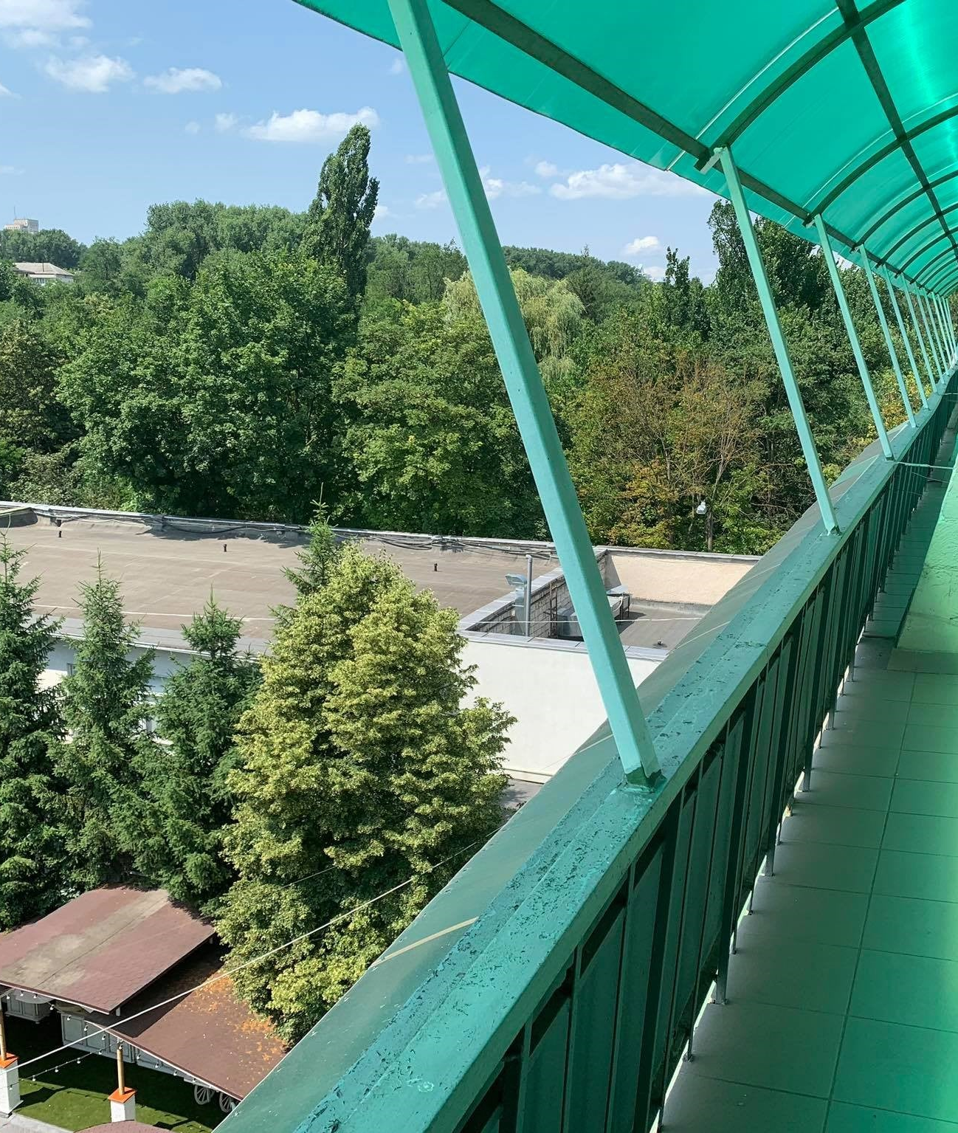
A PROJECT COORDINATED BY DGTASSOCIATION
CO-FUNDED THROUGH ERASMUS+ PROGRAMME
ACCOMMODATION - TO ADD
Venue: We chose for project “Start Up and Pass On” a Labor Institute (Insitutul Muncii) Hotel. Labor Institute (http://institutulmuncii.md/) is the educational center of The National Confederation of Trade Unions from Moldova and records a history of over 50 years. The core spheres of activity of the Institute of Labor include the following types of services: educational, research, hotel, feeding, and organization of different events. Addres: Republic of Moldova, Chisinau, Zimbrului 10 street.
Rooms Participants will share rooms of 2 roommates of the same gender. There is shower in each room. Bed linen is provided. However, we advise you to bring your own towels.
Food There will be provided three meals per day. If you have allergies or special diets, please inform the organizers through the application forms.
Wi-Fi internet connection will be provided Hotel.

Slide 10
Travel to Moldova
A PROJECT COORDINATED BY DGTASSOCIATION
CO-FUNDED THROUGH ERASMUS+ PROGRAMME
TO CHISINAU You will arrive in Chisinau at the Chisinau International Airport (KIV). It is the only airport in Chisinau: http://www.airport.md/
The other closest airport option that we can recommend is Iasi International Airport (Romania). From Iasi to Chisinau you can easily arrive by minibus/ bus. Other option would be flights to Bucharest (Romania) and from there bus/ train to Chisinau.
TO THE VENUE Trip from Chisinau airport to the venue takes about 40-60 min. It will cost about 10 lei by public transport (0.5 euro) or 150 lei by taxi (about 7 euro).
BUS/TROLEYBUS: From airport you need to take BUS No 33 or TROLEYBUS No 30 till the City Center and after you can take another MINIBUS No ( 186, 184, 138) or TROLEYBUS No 7 or 24 , after 10-20 minutes walk. Some possibilities you can find on this link https://www.eway.md/md/cities/chisinau/compile/392/47.035434:28.869989/46.935279:28.934957/1
TAXI: There is a more comfortable option to take a taxi from airport to Hotel and it costs about 150 lei (7€ for a group). If you choose to take a taxi, it will be your own expense because taxi fares are not refunded according to the Erasmus+ framework.
Chișinău is the capital and largest city of the Republic of Moldova. The city is Moldova's main industrial and commercial center, and is located in the middle of the country, on the river Bâc, a tributary of the Dniester. According to the results of the 2014 census, the city proper had a population of 532,513, while the population of the Municipality of Chișinău (which includes the city itself and other nearby communities) was 700,000. Chișinău is the most economically prosperous locality in Moldova and its largest transportation hub. Nearly a third of Moldova's population lives in the metro area.

Slide 11
Travel conditions
A PROJECT COORDINATED BY DGTASSOCIATION
CO-FUNDED THROUGH ERASMUS+ PROGRAMME
Reimbursements of travel costs up to:
Romania – 180 EUR
Poland – 275 EUR
Italy – 275 EUR
Belarus – 275 EUR
Poland – 275 EUR
Reimbursements will be managed via bank transfer after the completion of the mobility and the tasks related to the follow-up period, as decided during the mobility.

Slide 12
About Moldova
https://www.britannica.com/place/Moldova
https://www.thecrazytourist.com/15-best-places-visit-moldova/
https://en.wikipedia.org/wiki/Moldova

