Slide 1
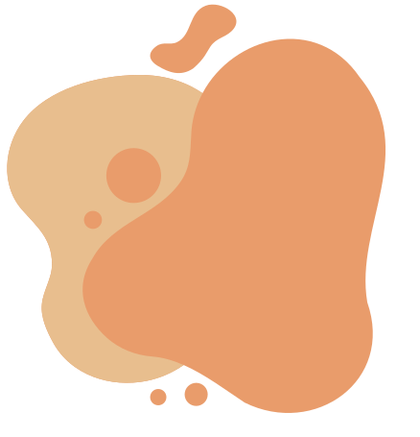

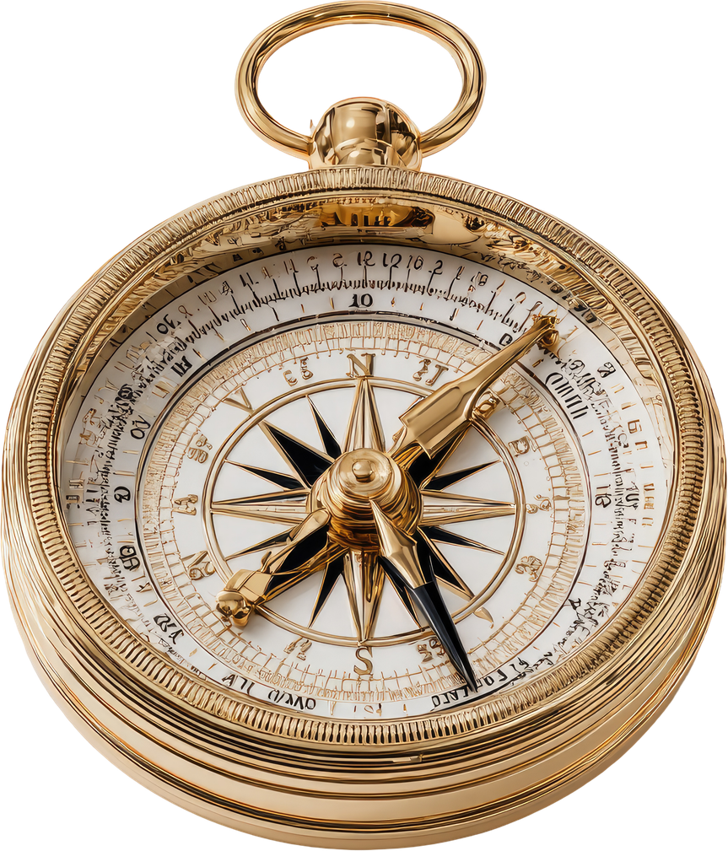




LIFE COMPASS
Training Course
6-12 August (travel excl.)
Talsi, Latvia
for 24 youth workers from Greece, France, Latvia, the Netherlands, Poland and Romania

Slide 2
About the project
The main goal is to strengthen youth workers’ personal and professional well-being and resilience.
Participants will explore 8 key life areas.
The programme will include interactive workshops, reflection sessions, embodiment practices, and peer-to-peer learning.
Together, participants will co-create practical methods and contribute to a digital “Life Compass” handbook.
After the project, you will apply and share the gained tools in your organisations and local communities, ensuring long-term impact.

Slide 3
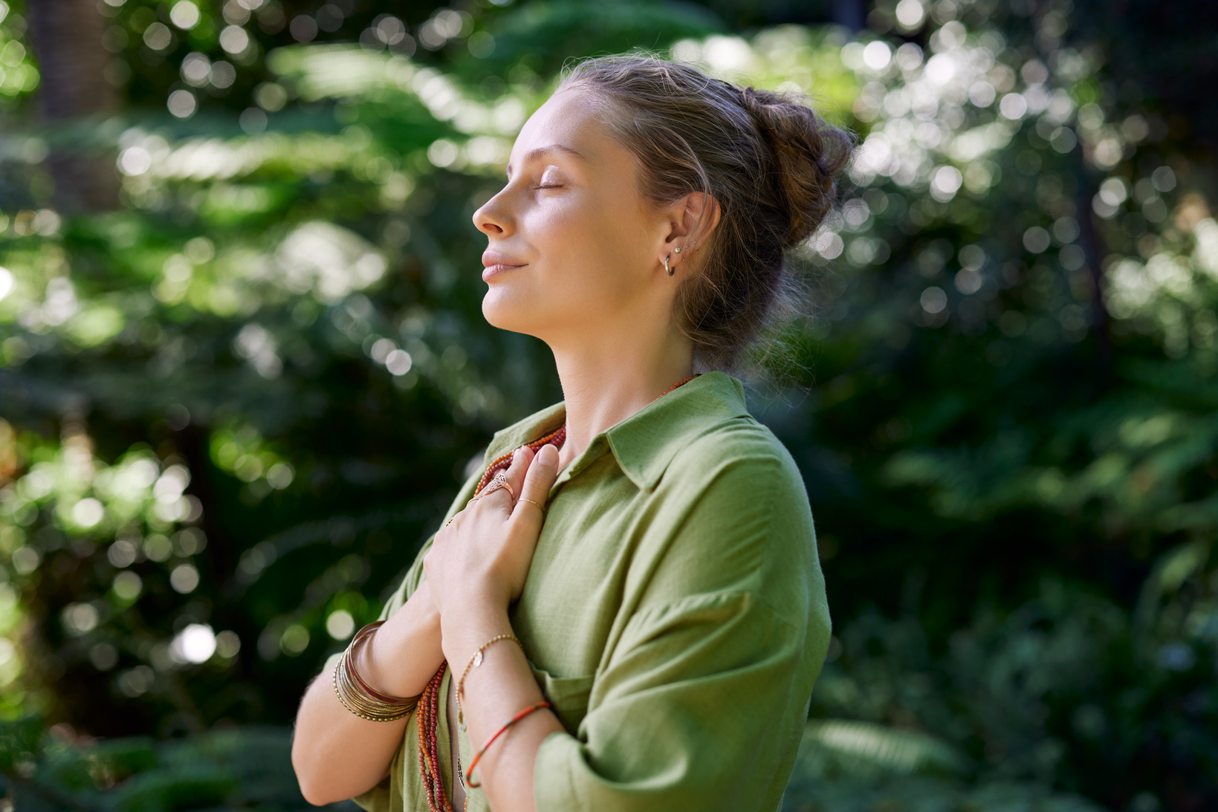


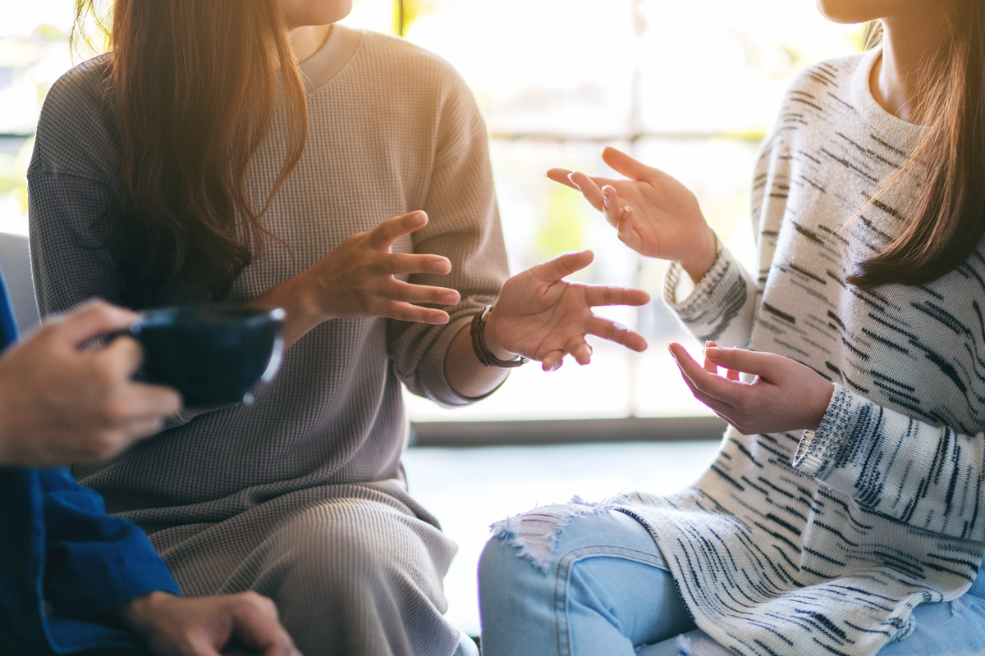
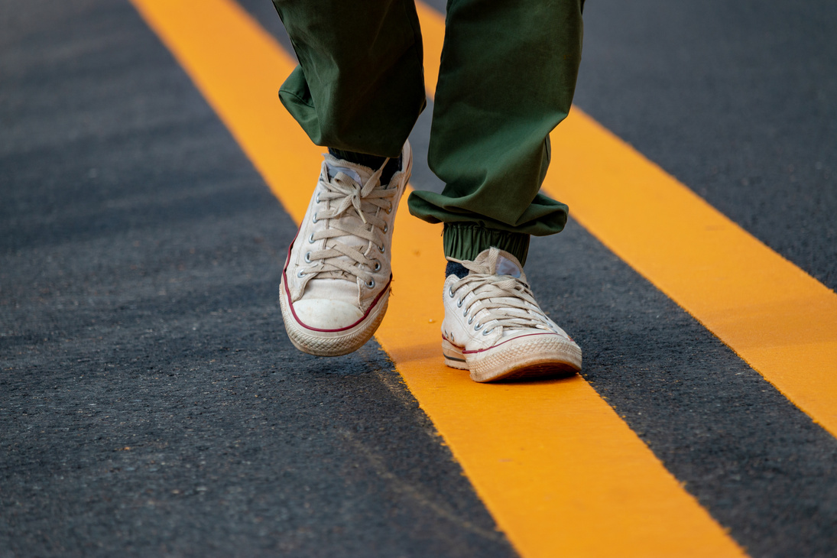


We will explore
8 key areas:
Health
Emotions
Relationships
Social Life
Work & Career
Financial Life
Personality & Inner Resources
Life Vision

Slide 4
Objectives
Strengthen youth workers’ resilience, growth mindset, and personal well-being.
Equip participants with practical tools to balance the eight key life areas and prevent burnout.
Improve competences in supporting young people’s self-awareness, emotional well-being, and goal-setting.
Co-create and transfer the “Life Compass” methodology for long-term use in youth work across partner organisations.

Slide 5
Profile of participants
• youth workers from Greece, France, Latvia, Poland, Romania and the Netherlands
(4 per country, 24 in total)
• professionals working with young people in NGOs, schools, youth centres, coaching a.o.
• actively supporting young people’s personal development, well-being, and participation
• motivated to strengthen their resilience and improve the quality of youth work
• fully committed to participate in all phases of the project (preparation, training course and organisation of a follow-up activity)
• at least 22 years old and able to communicate and work in English
• committed to applying and sharing the LIFE COMPASS tools in their organisations and local communities.

Slide 6
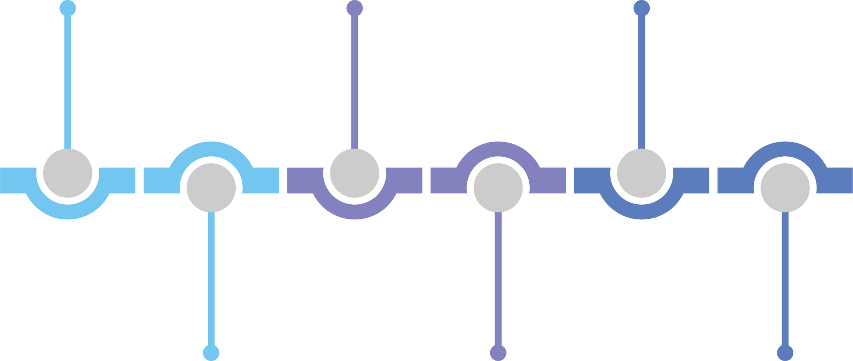
Timeline
PREPARATION PHASE
15 June - 4 August
ARRIVAL DAY
5 August before 7PM
DEPARTURE DAY
13 August before 10AM
ONLINE MEETING
End of July
TRAINING COURSE
6-12 August
FOLLOW-UP
until 20 September

Slide 7
Daily schedule
🟢 Day 1 – Opening
Introduction to LIFE COMPASS and objectives.
Getting to know each other & group-building activities.
Group agreements, reflection groups, Youthpass.
LIFE COMPASS framework.
1st area - My Health & Fitness
🟠 Day 3 – Social & Professional Balance
Deep dive into key life areas:
4th - My Social Life
5th - My Work & Career
Breathwork, embodiment and guided reflection.
🟢 Day 6 – Study Visit & Open Workshops
Study visit to Tukums Youth Centre.
Participant-led workshops (parallel sessions).
Open workshops with invited local youth workers.
Peer feedback and facilitation practice.
🔵 Day 4 – Personal & Financial Balance
6th area - My Personality
7th area - My Financial Life
Group exercises and practical tools development.
🔴 Day 2 – Emotional & Relationship Balance
Deep dive into key life areas:
2nd - My emotions
3rd - My relationships.
Reflection exercises.
🔴 Day 7 – Reflection & Future Steps
LIFE COMPASS handbook completion and personal action planning.
Youthpass reflection and self-assessment.
Follow-up activity planning.
Final evaluation.
Project closing ceremony.
🟡 Day 5 – From Learning to Practice
8th area - My Life Vision
Participants prepare and design their own workshops.
Method development in small groups.
Integration.

Slide 8
Follow-up
after the project
After returning home (within 6 weeks), each participant will apply the experience locally by organising a follow-up activity (e.g. workshop, school session, or activity with colleagues), ensuring the methods reach young people, educators, and the wider community.
Completion of the follow-up activity is part of your commitment and is linked to travel
reimbursement.
Participants will share their experience within their networks and online, supporting wider impact. Dissemination will take place both during the project activities and after the project, ensuring long-term benefits for youth work practice.

Slide 9
Financial and logistics
🟡 Travels
Travel limits
⚠️ Do not book your tickets before receiving approval from the hosting organisation.
Only previously approved travel costs will be reimbursed.
Participants must keep all original tickets, boarding passes, invoices and receipts. We encourage Green Travel options (train, bus, carpooling) for Poland.
Country | Regular travel (flight) | Green travel (bus, train etc.)
Greece | 395 EUR | --
The Netherlands, Romania, France | 309 EUR | --
Poland | 309 EUR | 417 EUR
Latvia | -- | 28 EUR
🔵 Reimbursement
Participants will receive reimbursement after:
Submitting all travel documents (tickets, boarding passes, invoices)
Completing the EU online evaluation form
Organising and reporting on a local follow-up activity
⚠️ Reimbursement is possible only if the participant attended the full duration of the training.

Slide 10
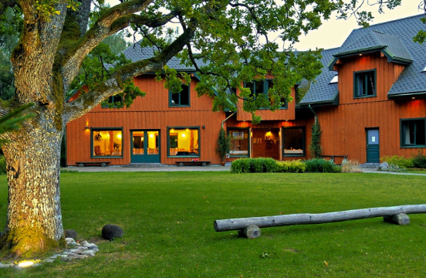
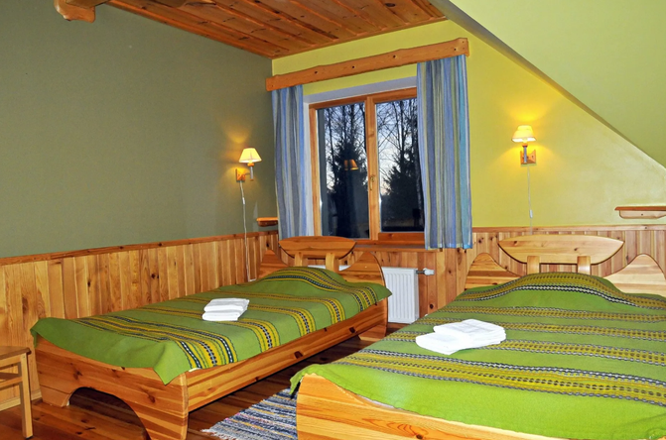
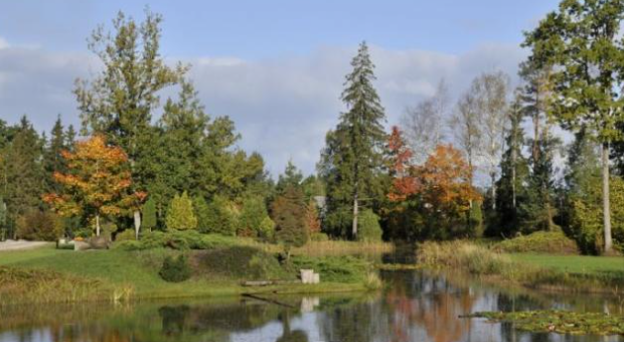
The Venue
The training will take place at Laumas Nature Park , a unique location in Latvia known for its forest trails, meadows, bird-watching trails, and well-equipped workshop spaces. The environment offers a special combination of indoor learning and outdoor activities.
This peaceful and inspiring setting will support mindfulness practices, movement exercises, and reflective learning.
Laumas Nature Park is located near Talsi (120km from Riga). It takes approximately 2,5h to reach it from Riga by public transport.
There will be shared rooms for 2–4 people. Some rooms have a private bathroom, while others have a shared bathroom.
The venue will be our home throughout the programme, so we will all share responsibility for taking care of the space, including keeping common areas clean and tidy.
Meals- we will enjoy mostly vegetarian meals. Meat will be served 2-3 times per week.

Slide 11
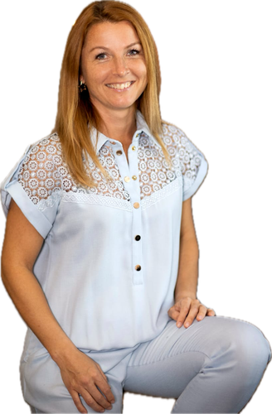
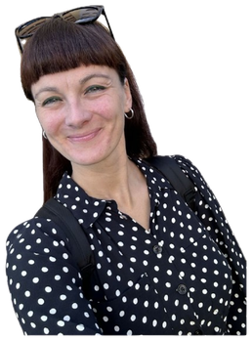
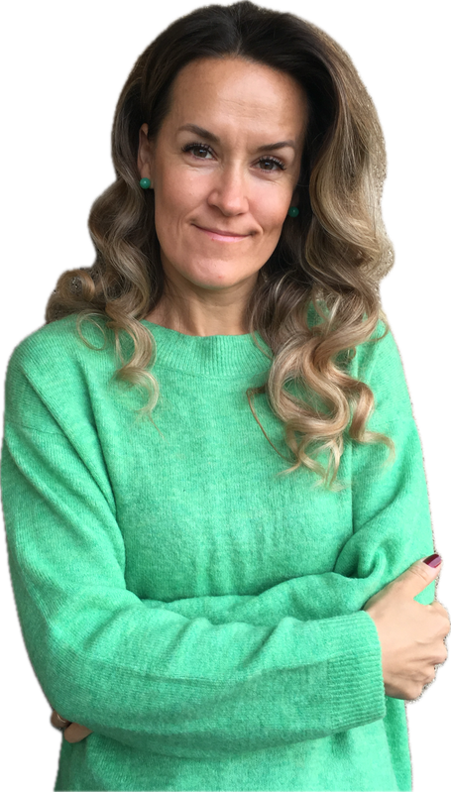
Trainers
Laura Freimane brings a warm, creative, and embodied approach to the LIFE COMPASS training. Drawing from her experience in embodiment, improvisation, theatre, Playfight, and breathwork, she creates spaces where participants can explore personal development not only through reflection, but also through movement, play, and direct experience.
Her strength lies in helping people feel safe to express themselves and connect with different aspects of their lives. Laura combines sensitivity with structure, supporting participants in turning insights into awareness, connection, and practical tools they can apply in their youth work.
Liene Linde is responsible for communication in the LIFE COMPASS training course. With a long experience in the private sector as a coordinator, she ensures smooth internal and external communication, partner coordination, and visibility of the project.
She combines strong organisational skills with a passion for non-formal education and plays a key role in dissemination, documentation, and overall project management.
Laura Šuspāne brings a calm, attentive, and deeply human presence to the LIFE COMPASS training. With her background in human behaviour, counselling in education, and group facilitation, she supports participants in exploring inner processes, self-awareness, and personal growth across different life areas.
What makes Laura especially valuable in this course is her ability to combine knowledge, sensitivity, and practical guidance, creating a safe and reflective space where participants can explore, learn, and grow with depth and curiosity.

Slide 12

Apply HERE
The application deadline is 20 May.
All applicants will be notified of the selection results
on 25 May.
Selected participants will receive a confirmation email with important information about the next steps.

Slide 13
Design Yourself
Small Steps for Lasting Change
Design Yourself is the space where we return to what is alive in us -
to breath, movement, presence, creativity, and connection.
We create
learning experiences that invite young people and youth workers to
grow not only through knowledge, but through feeling, exploring, and
daring to meet themselves more honestly.
For us, it is about shaping a more conscious way of being in the world and bringing that aliveness
back into our communities.

