Slide 1
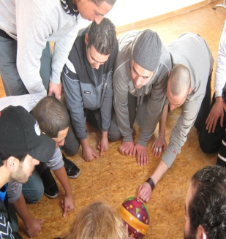
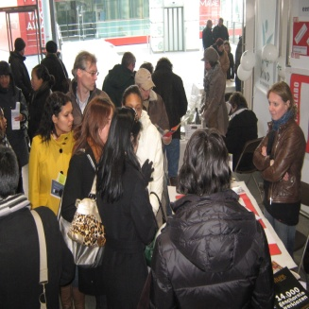
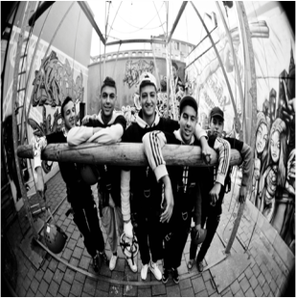
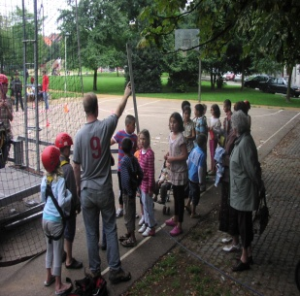
A global presentation of the Youth competence centers in Antwerp

Slide 2
JES NGO
A non-profit organization that, as a metropolitan laboratory, continuously initiates new projects that aim at increasing opportunities for young people in the cities of Antwerp, Brussels and Ghent to benefit from creative and meaningful free time activities, employment and training, participation in society, and policy making. Its main activities include training for metropolitan youth work, labour market counselling, outreach work, organisation of adventurous city tours and activities and organisation of cultural projects.

Slide 3
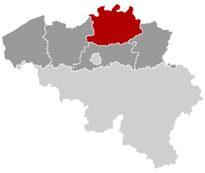
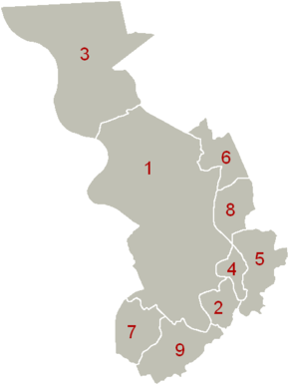
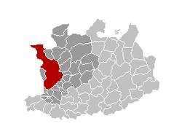
Belgium – province Antwerp – city of Antwerp

Slide 4
Global objectives in Antwerp
City of Antwerp:
Youngsters in Antwerp | 29% of the entire population of Antwerp is -25 years
Births in a socio-economic vulnerable situation | 21.7% ← → in Flanders: 5.9%
School drop-out or delay 01/01/2010 | 47%
Unemployment -25 years February 2011 | 24,7% : 5862 (- 635 in 2010)

Slide 5
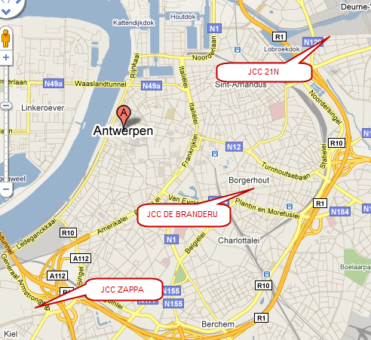
3 Youth Competence Centres

Slide 6
definition
The Antwerp Youth Competence Centres are accessible centres for young people that provide integrated activities regarding leisure time, competencies and work. The YCC’s are explicit learning and development spaces that empower young people with a view to personal development and increased social orientation and participation. The lifestyle and needs of young people are central in the activities of the YCC’s.

Slide 7
mission
The city of Antwerp has three Youth Competence Centres (YCCs). These YCCs work on the intersection between free time, work and competence development. They are accessible centres where youngsters, as human capital for the further development of the city of Antwerp, get maximum opportunities and customized counselling for their development towards adulthood.
The YCCs are open to all youngsters, but the priority target group of YCCs is 16 to 25 year old young people in a vulnerable socio-cultural or socio-economic situation. The lifestyle and needs of young people are the central focus in the activities of the centres. They are characterized by an integrated approach between the crucial fields in the development of young adults: free time, employment and education. Starting from this multidisciplinary setting, YCCs respond to the needs of the youngsters. A close cooperation was established with the counsellors from the Flemish Employment Service (VDAB) and the Study Choice counsellors (Studiewijzer).
Competences are the core of YCCs: youngsters gain awareness on their competences (competence identification), further develop these competences (competence development) and get (formal) recognition of their competences (recognition, validation or accreditation of acquired competences or prior learning). The objective is to improve the youngster’s self-esteem, stimulate personal development and increase social orientation and participation. This also contributes to strengthening their labour market position. In this process, the WAC (work-related acquired competences) and RAC (recognized acquired competences) counsellors play a crucial role (see below).

Slide 8
Working with Competences = Empowerment
Perspective of Strenghts
- individual level
- collective level
- political – social level
Relational perspective
- shared responsability
- active citizenship
Participation as engine
- condition and outcome
- proces

Slide 9
Premises
Belief in strenght and talent of young people
Accessible youthwork:
  Psychological en physical
  Affordable
  On pace and customized
  Low treshold
3. Voluntarily
4. Youngsters are the inspirers, direction givers and director of their route
5. Lifelong learning: youthwork as an explicit learning environment
6. Compatible with competencroutes in formal time (education, school,…)
7. Responding to assets in metropolitan context
8. In group or inidividual
9. Holistic approach
10. Phased proces (participationladder)

Slide 10
The RAC and the WAC…
What’s in a name?
R → recognition
A→ acquired
C → competences
The RAC-counsellor meets youngsters in their leisure time: youthwork, cultural activities, sports, events and parties, volunteerwork, …
The RAC-guidance can be individual or group-based
W → Work (related)
A → Acquired
C → Competences
The WAC-counsellor meets younsters in the youthcenters, streets and squares, teahouses, leisure time activities,…
The WAC-guidance can be individual or group-based (trainings)
The RAC and WAC – counsellors work in a close team in each youth competence center

Slide 11
Leisure time, work and competences
Youth work
Training for youth work volunteers
Cultural youth work activities
RAC
3. work
2. Competences
1. Leisure time
WAC
meets young people where they are
Networking

Slide 12
In practice… a summary
YCC De Branderij Borgerhout | Volunteerwork Vertical and divers youth work Youthcultural work Empowerment Program by initiative of the youngsters co-owners → community co-owners Territorial | 1 RAC (JES) 100 youngsters 1WAC (JES) 40 youngsters Coöperation with F.E.S Youthwork and youthcultural work by JES (FES = Flemish employment service)
YCC Zappa Kiel | Accents on events Infrastructural management Experiments with YAA New building Volunteerwork events | 1 RAC (ZAPPA) 80 youngsters 1 WAC (JES) 40 youngsters Coöperation with F.E.S and Werkhaven, de 8,… Events and youthcultural work by ZAPPA
YCC 21N Deurne noord | Professional youthworkers Horizontal youth work Program made by the youthworkers. New building, new facts, new contacts with the neighbourhood. territorial | 1 RAC (JES) 50 youngsters 1 WAC (JES) 40 youngsters Coöperation with F.E.S and Levanto Youthwork by KIDS

Slide 13
RAC and WAC
 | RAC | WAC
Priority target group | Youngsters from 12 – 25 years In a vulnerable situation volunteerwork as (first) work expierience | Youngsters from 16 – 25 years In a vulnerable situation low educated Unemployed school-drop-outs
Meeting points | Volunteerwork youth-cultural activities youthwork and sports events and parties non-formal education Schools | Streets and squares Youthwork youthcultural work social meeting points: teahouses, football,…
Targets: | volunteerwork as first work expierience oriëntation in leisure time activities Competence awareness competence development by leisure time activities enlarge chances. | School oriëntation guidance to FES trainings support (admninistration, …) active help by finding a job. enlarge chances Competence awareness Competence development.
How? | Empowerment Positive Active Holistic Competence development | Empowerment Positive Active Holistic Competence development

Slide 14
Introduction to competences in our youthwork activities
Different roles of a youth worker:
Guide → to be able to take the lead, to have didactic capacities, to guide a group
Referee → to make and defend rules, to give clear instructions
Clown → to be able to motivate, to take initiative, to be funny
Construction worker → to be able to organize, to cooperate, to work independently
Friend → to be able to listen, to have empathy
Inventor → to be creative, to experiment, to be flexible

Slide 15






6 roles illustrated

Slide 16
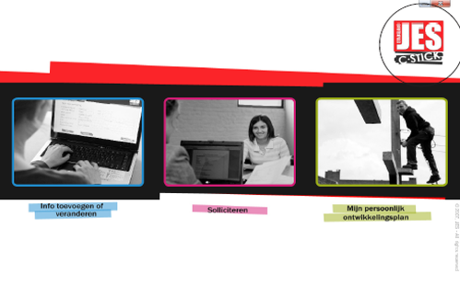
Digital portfolio: C-Stick

Slide 17

Cooperation VDAB (Flemish employment service)
Strategic:
  Transition and career development
Content:
  Implementation of the competences used by VDAB
  Use of a common framework to assess competences
Technical:
  Data transfer between C-Stick and e-Portfolio of VDAB (‘My Career’)
ESF: Bijdragen tot de ontwikkeling van de werkgelegenheid door het bevorderen van inzetbaarheid, ondernemerschap, aanpasbaarheid en gelijke kansen, en door het investeren in menselijke hulpbronnen

