Slide 1
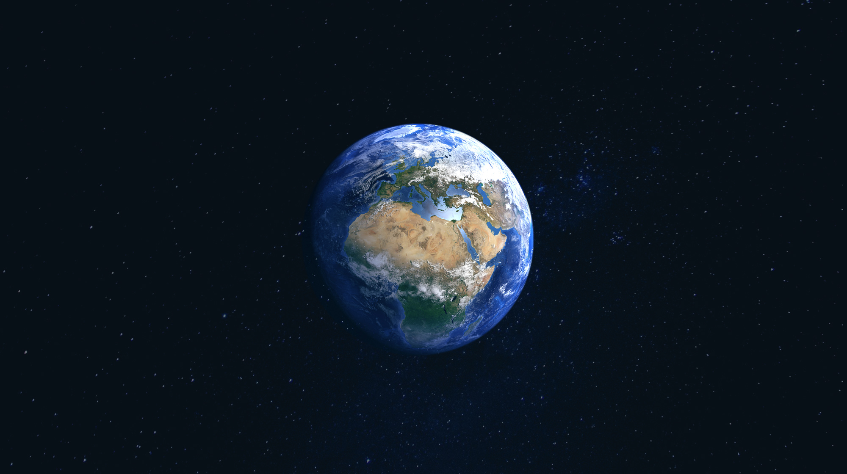
Ecosystems
European Youth for Environment
Sietse van der Ree

Slide 2
Ecosystems
What is an ecosystem?
A biological community of interacting organisms and their physical environment.

Slide 3
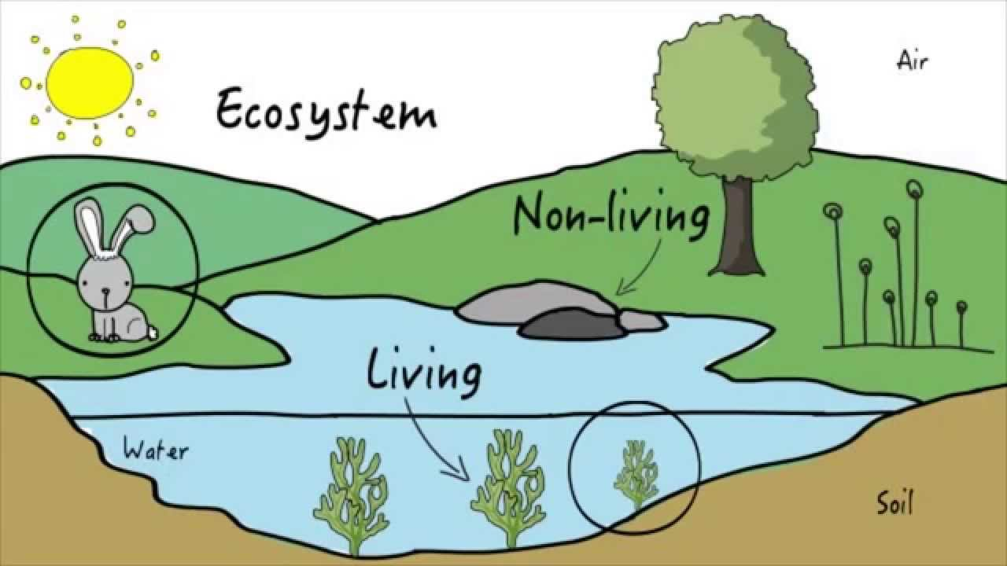

Slide 4
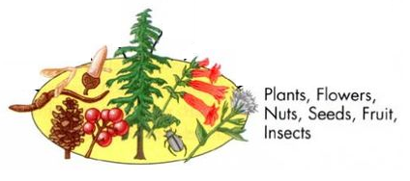
Ecosystems

Slide 5
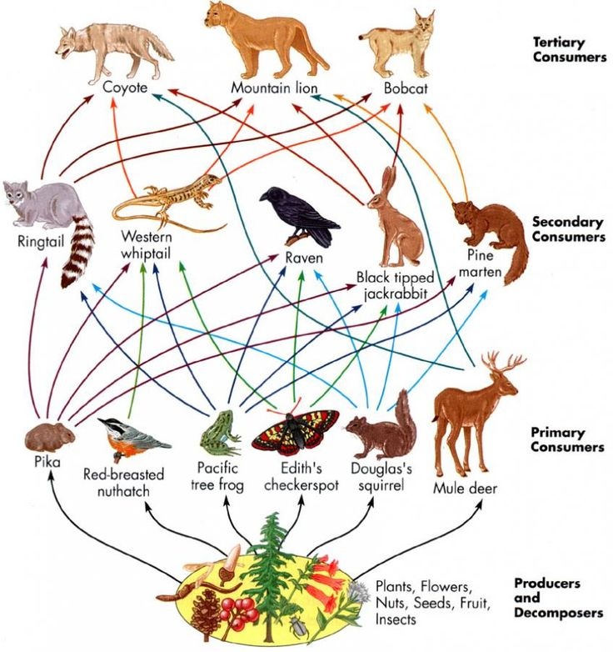
ecosystems

Slide 6
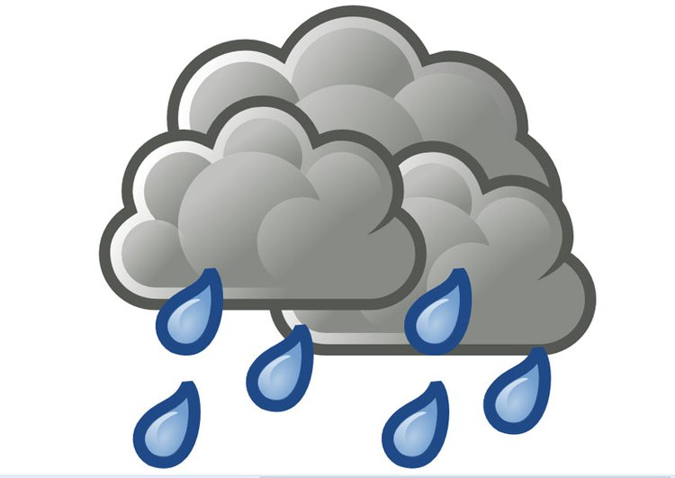
Ecosystems

Slide 7
Ecosystems
N2
Nitrogen
CO2
Carbon dioxide

Slide 8
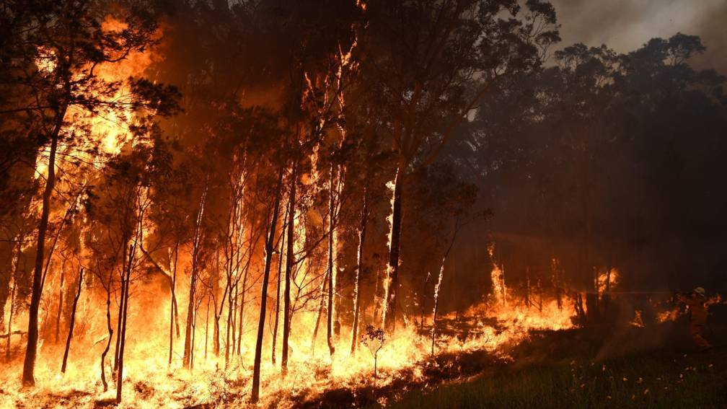

Slide 9
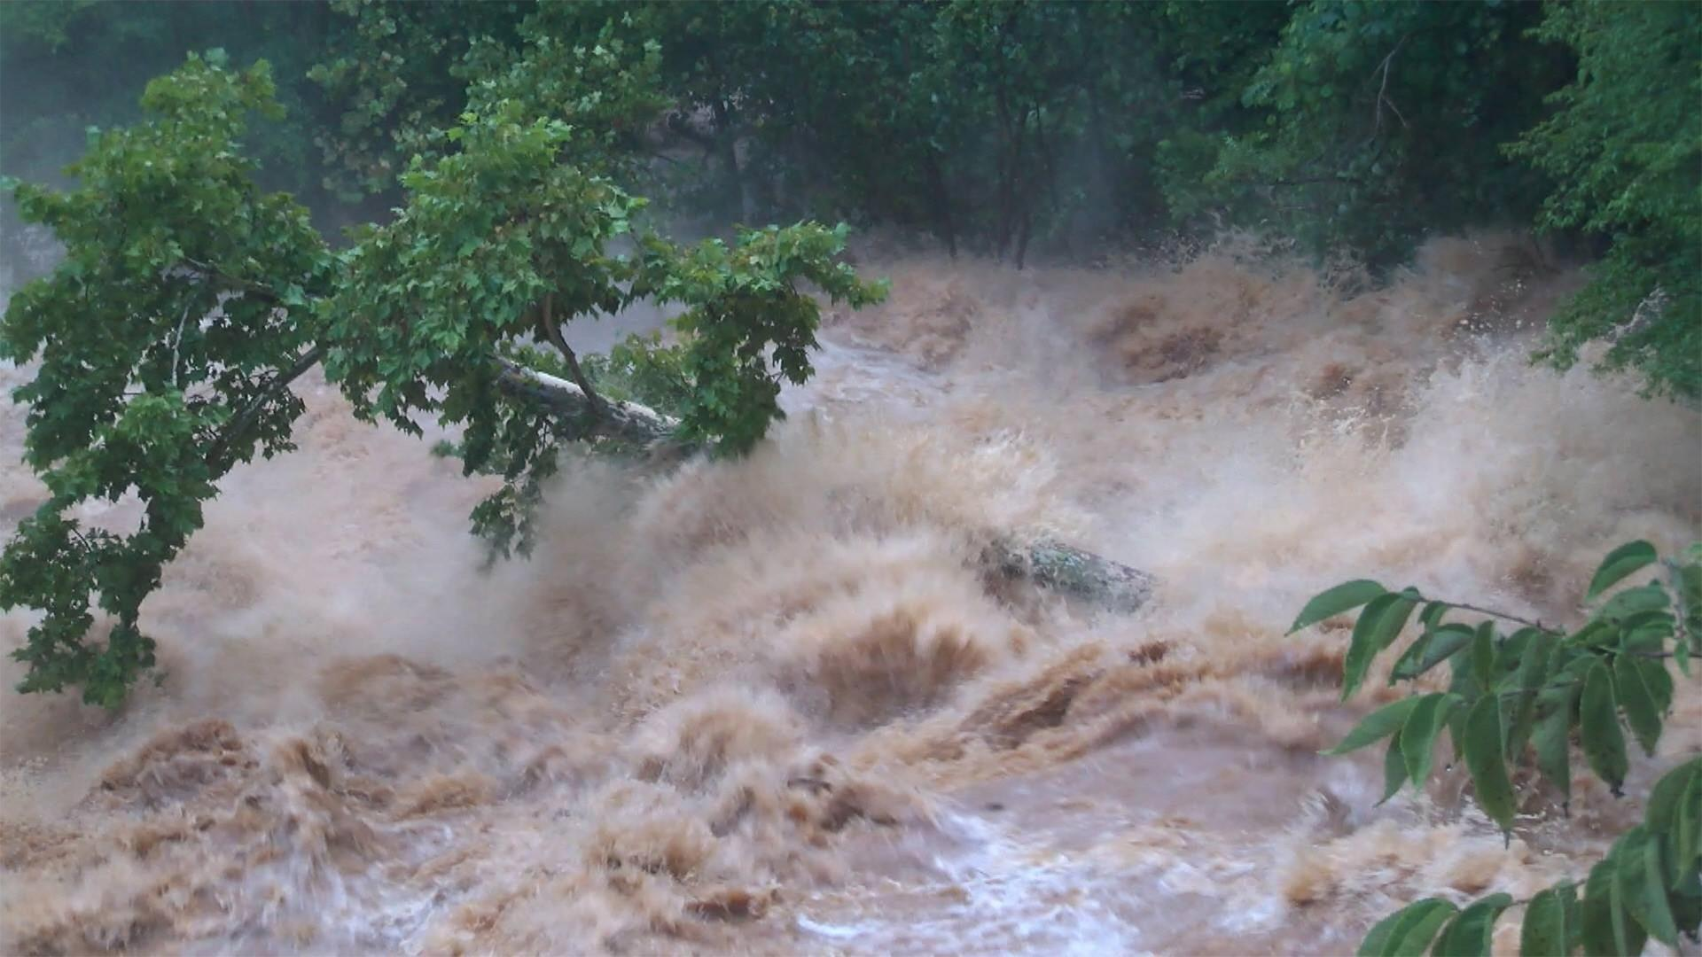

Slide 10
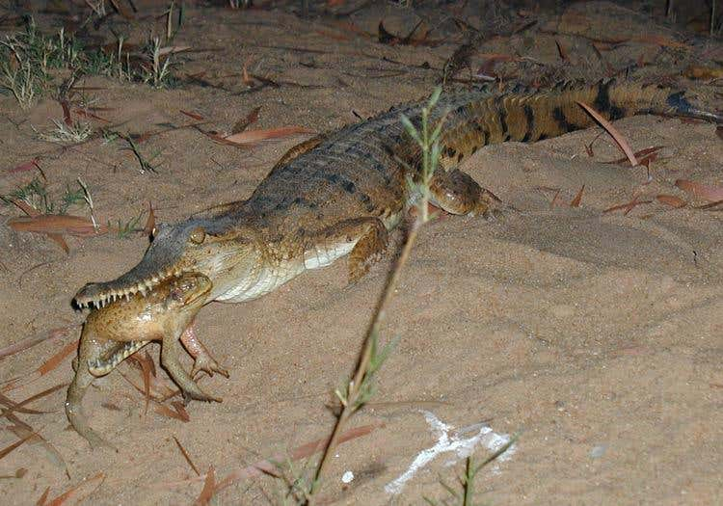

Slide 11
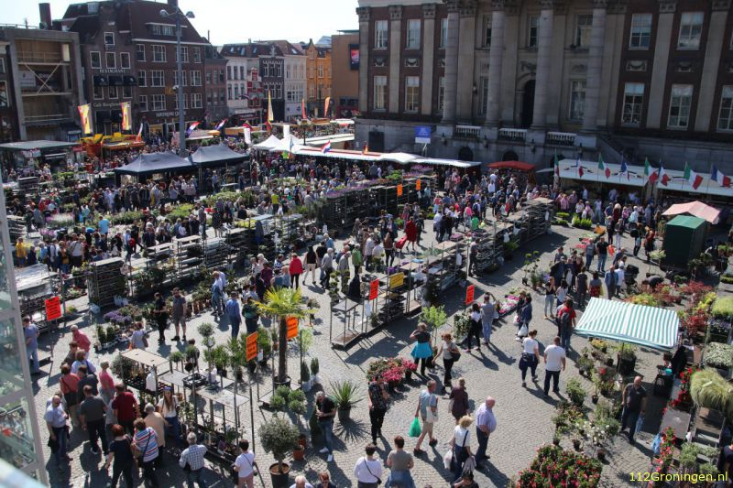
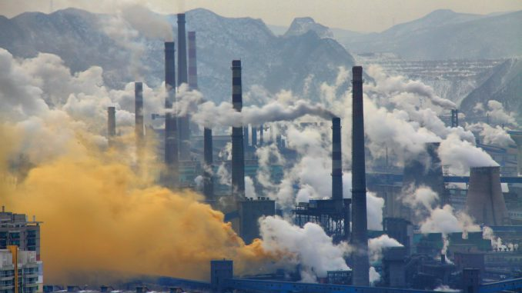
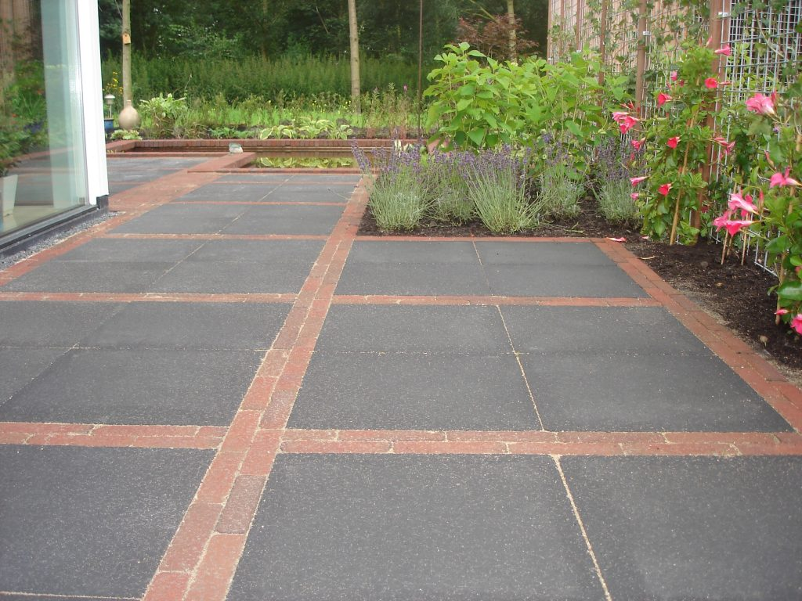
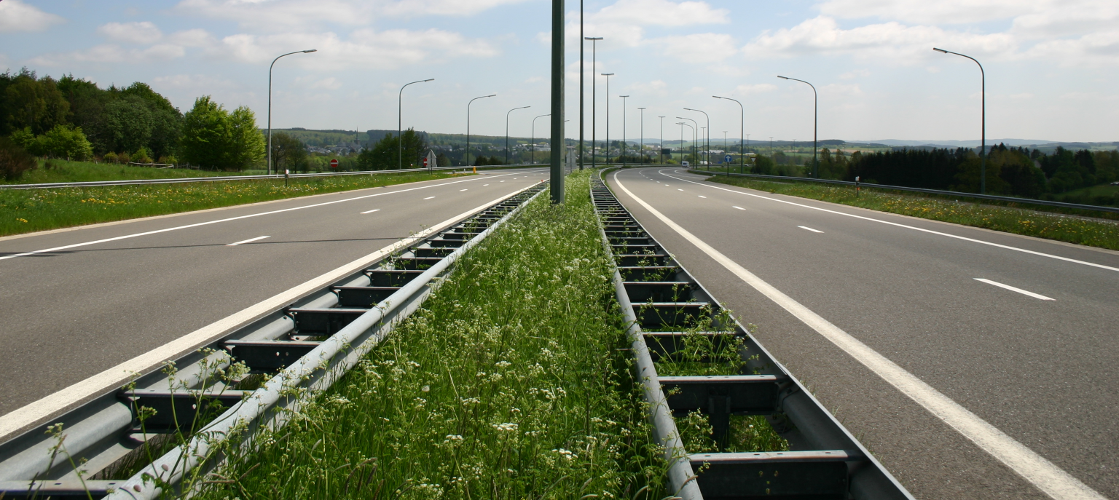

Slide 12
Ecosystems
N2
Nitrogen
CO2
Carbon dioxide
And much more…
Bushfires
Floods
Exotic species
Humanity

Slide 13
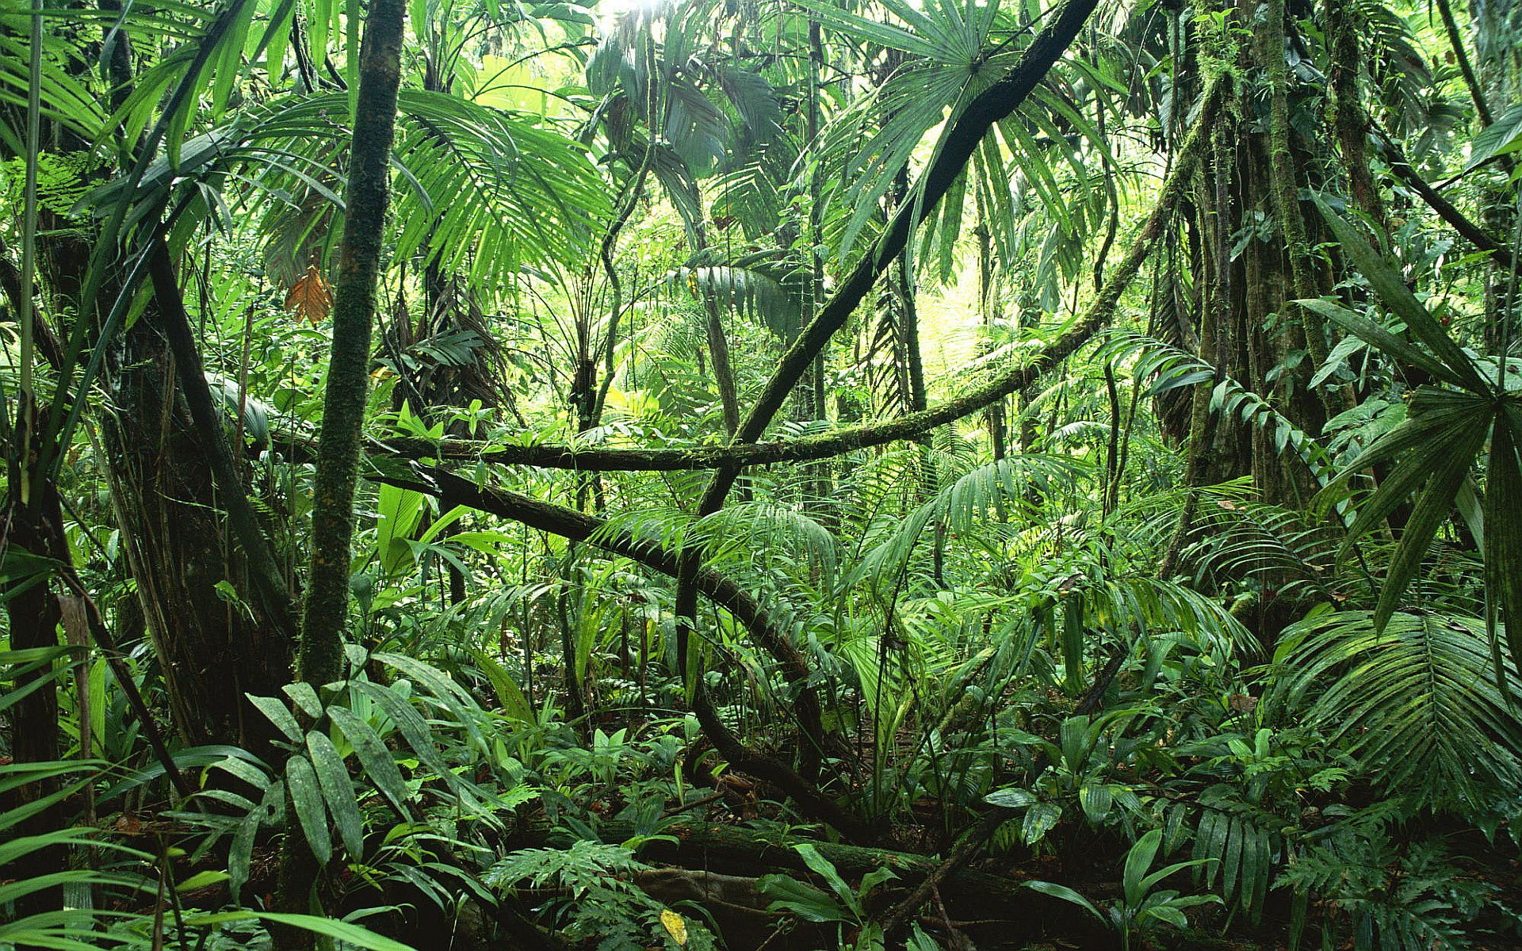
Ecosystems

Slide 14
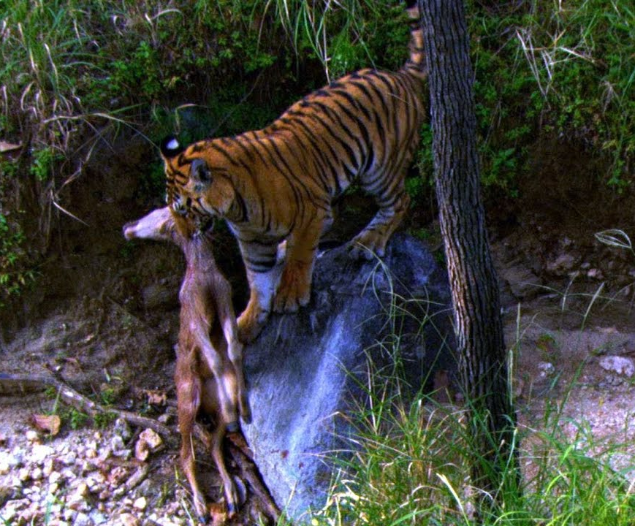
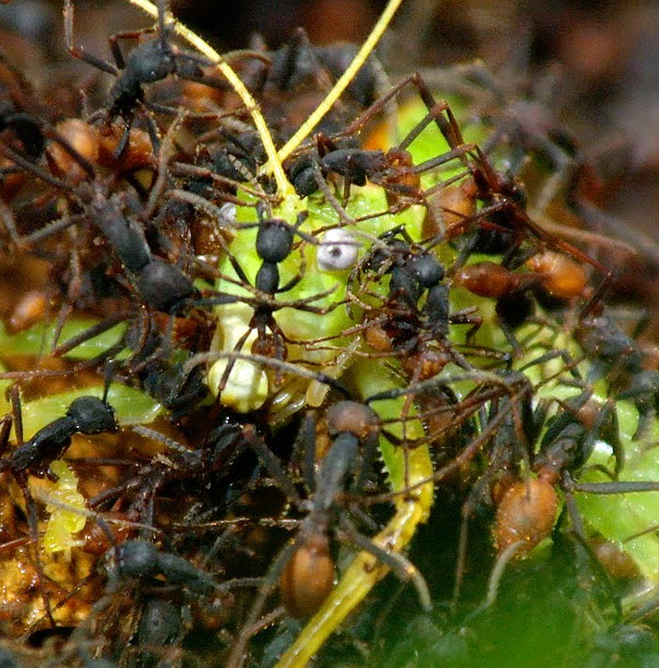
Ecosystems

Slide 15
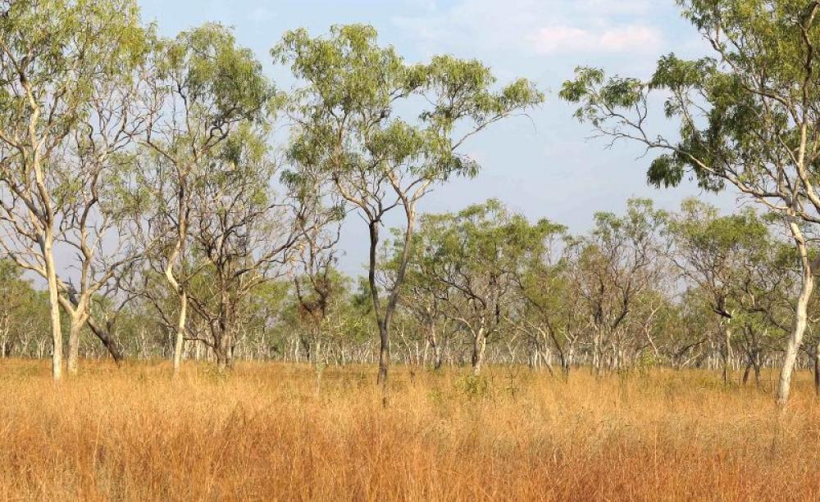
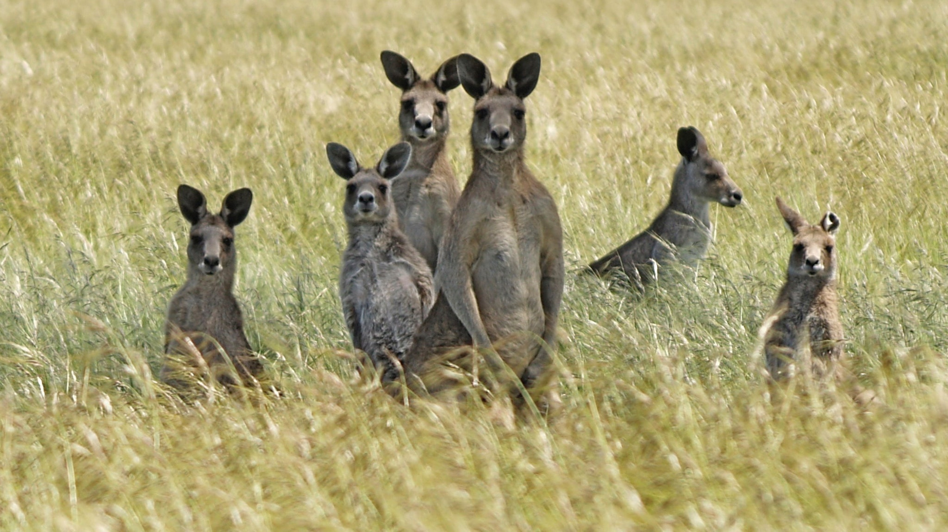
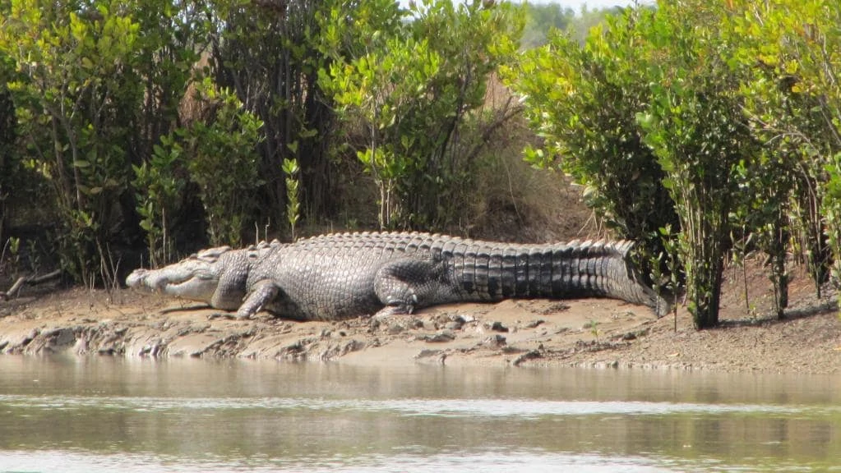
Ecosystems

Slide 16
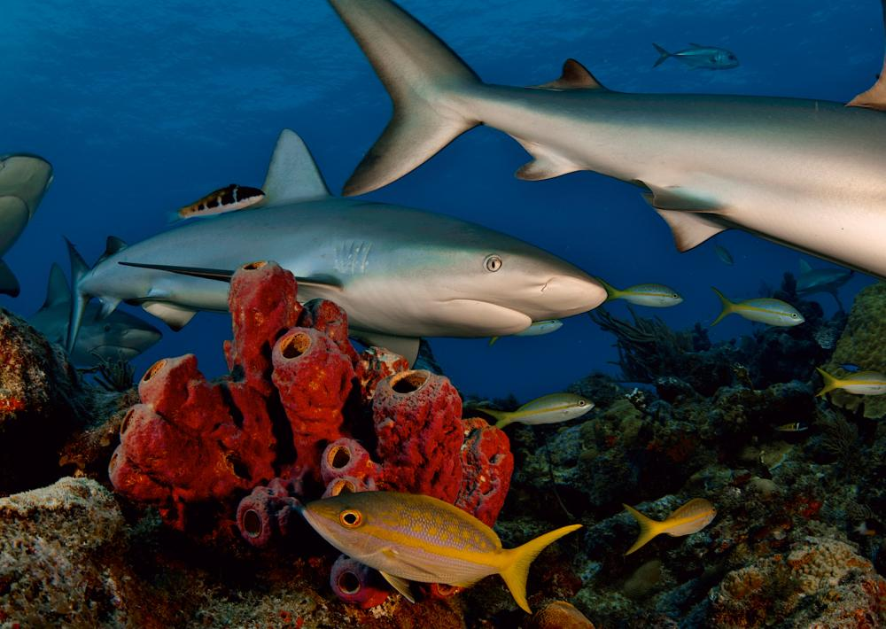

Slide 17
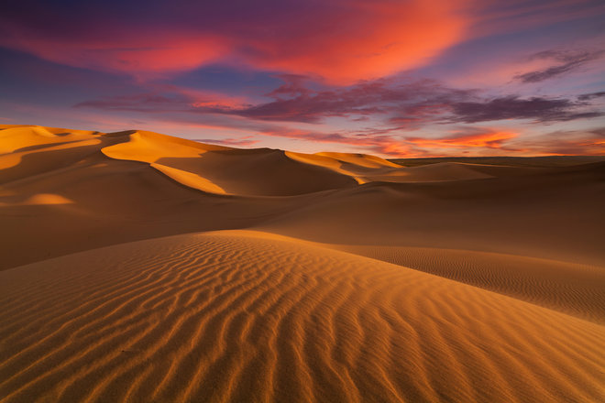
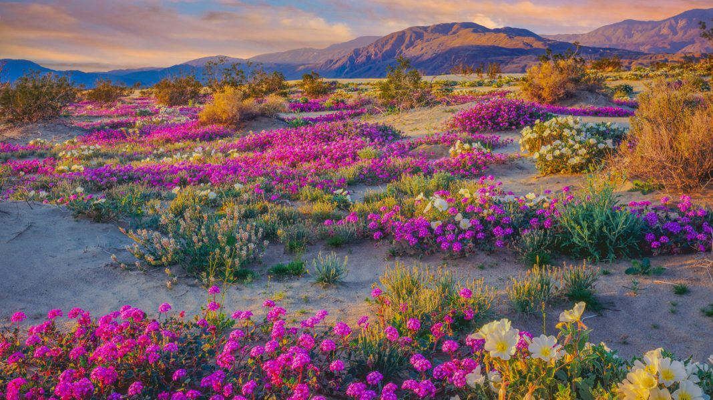
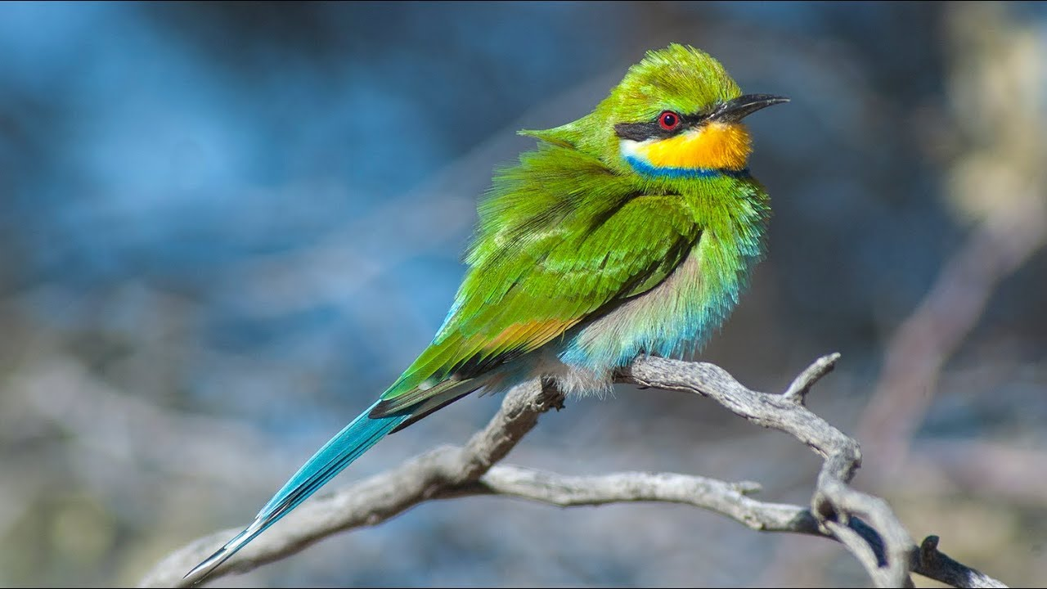
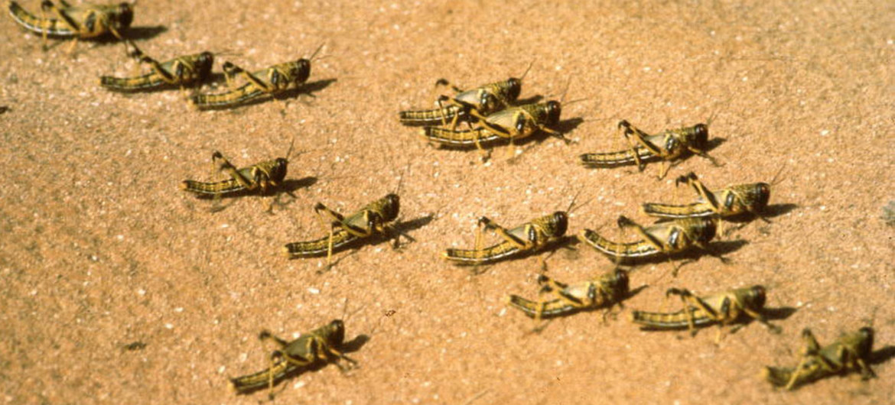
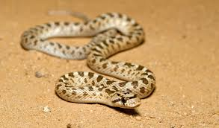
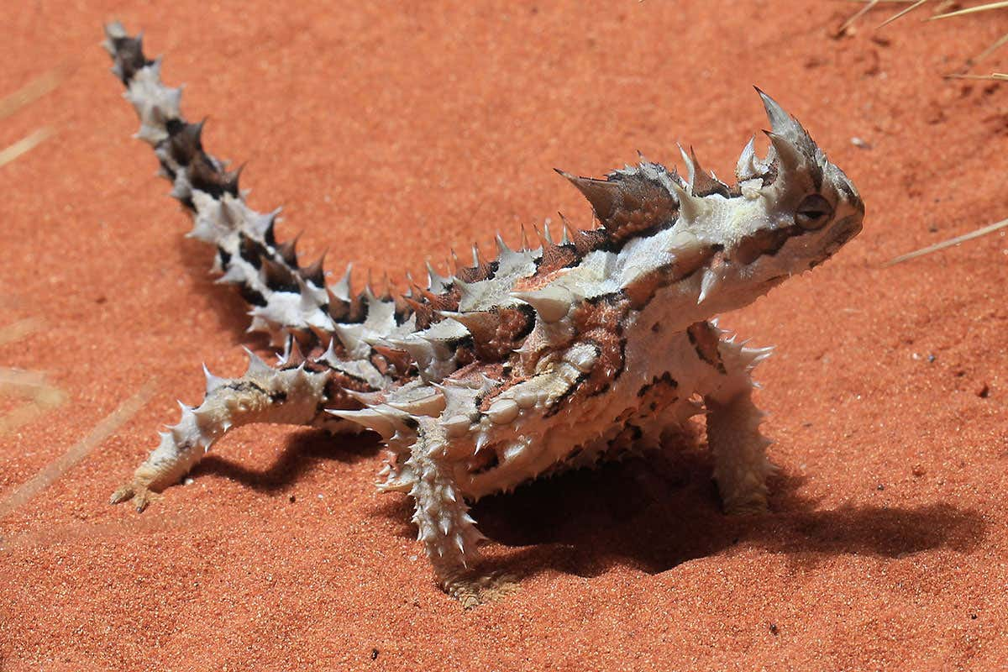

Slide 18
Ecosystems
https://www.youtube.com/watch?v=ysa5OBhXz-Q

Slide 19
Ecosystems
Assignment:
Build your own ecosystem!

Slide 20
Ecosystems
5 groups
Green A2-paper
Pictures of:
Predators (carnivores)
Prey (Herbivores)
Plants
Insects
Oxygen (O2)
Nitrogen (N2)
Carbon dioxide (CO2)
Rules:
Green is the basis
Grey is rock
Blue is water
Min. 15 pictures of animals and plants per ecosystem!
Max. 25 pictures of animals and plants per ecosystem!
1 predator picture is 5 predators.
1 prey picture is 10 prey animals.
For bacteria, O2, N2 & CO2 one picture is enough.
Tip! Generally: more diverse means more stable!
Fun! Give your ecosystem a name!
Make a balanced ecosystem!
Schedule:
Before lunchbreak: The making of your ecosystem
After Lunchbreak: - Finish Ecosystem & Prepare presentation
- Next assignment!

Slide 22
Ecosystems
Next assignment:
Disasters!
Pay close attention:
Each group will explain the effects of several disasters on their ecosystem!

Slide 23
Ecosystems
Disaster 1

Slide 24
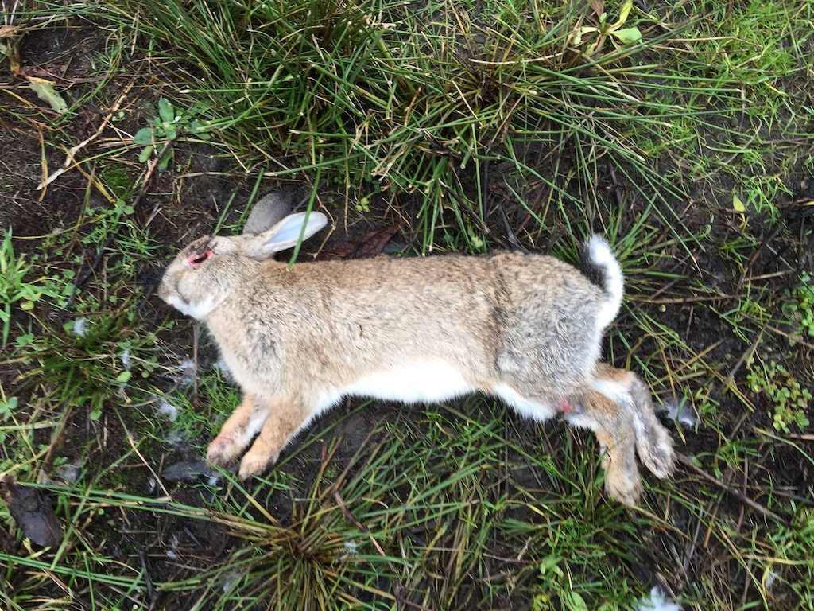
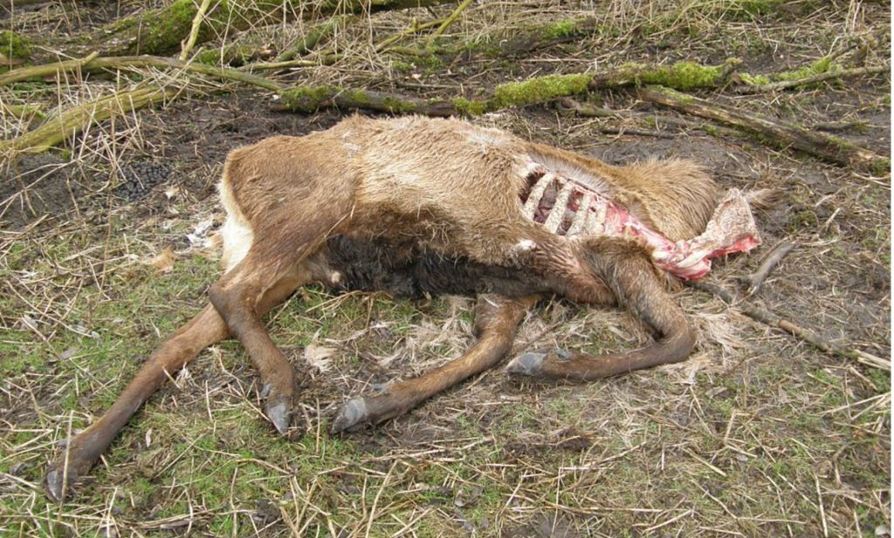
Ecosystems
Disaster 2
Virus that kills all the prey animals (herbivores)

Slide 25
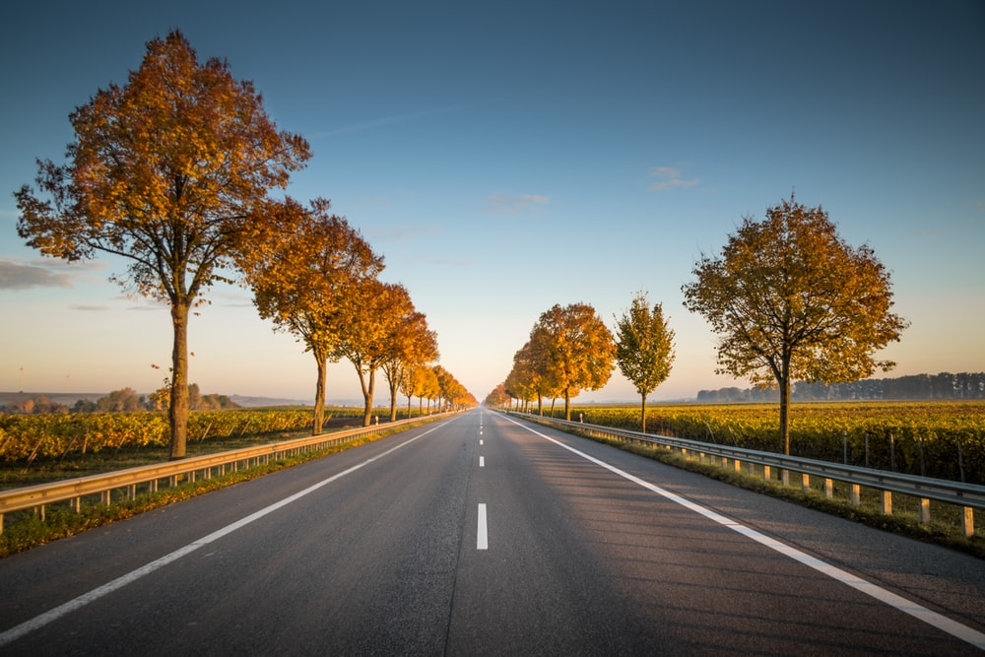
Ecosystems
Disaster 3
A road through the middle of your ecosystem
- Animals cannot cross this road!
Your ecosystem:
Road

Slide 26
Ecosystems
Disaster 4

Slide 27
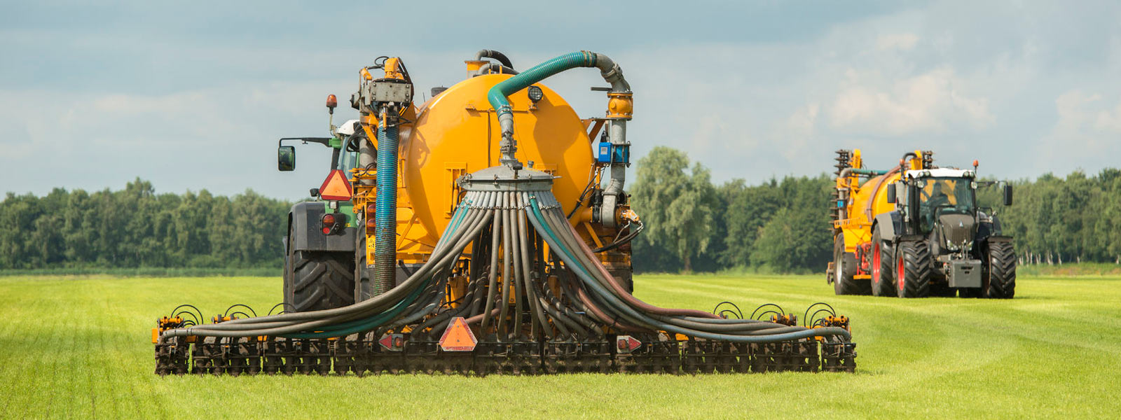
Ecosystems
Disaster 5
Nitrification:
Nitrogen levels increase dramatically!

Slide 28
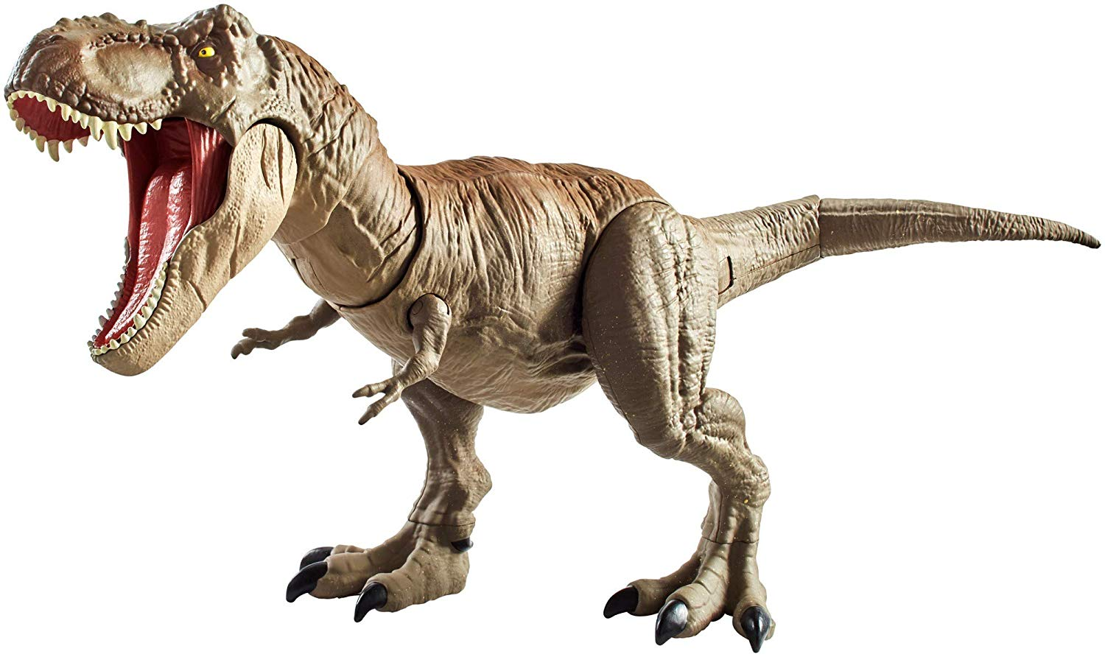
Ecosystems
Disaster 6
Add one species of animals that will disturb your ecosystem

Slide 29
Ecosystems
Disaster 7
A city will be build in the right upper corner of your ecosystem
Your ecosystem:
City

Slide 30
Ecosystems
Conclusion:
It is important to learn about these ecosystems, because these systems make the world we live in.
We influence these systems
But it influences us as well in our daily lives.
(Food, energy, pets, safety)
What needs to be done is the opposite of the disasters we looked at
Connect ecosystems
Avoid nitrification, which leads to higher nitrogen levels.
Don’t add exotic species
Green energy

Slide 31
