Slide 1
Introduction to Research
RJaafar

Slide 2
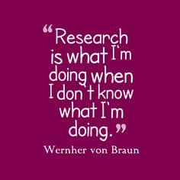
RJaafar

Slide 3
RJaafar

Slide 4
To define what we mean by ‘research’ and describe the stages and concepts behind the research process.
To explore how data, information, knowledge, and decision-making relate to the role of research.
Focus group and questionaire basics
RJaafar

Slide 5
RESEARCH
“Research is creating new knowledge.” -Neil Armstrong
“Research itself provides an important long-run perspective on the issues that we face on a day-to-day basis. ” -Ben Bernanke
RJaafar

Slide 6
Good Research
a question with a clear hypothesis, examined using a rigorous method, undertaken under the supervision of an experienced supervisor with adequate infrastructure and an enthusiastic and dedicated researcher
RJaafar

Slide 7
Undertaking a successful research
Developing a research idea
Expectations
Realistic targets
Data collection
Outreach / publications
RJaafar

Slide 8
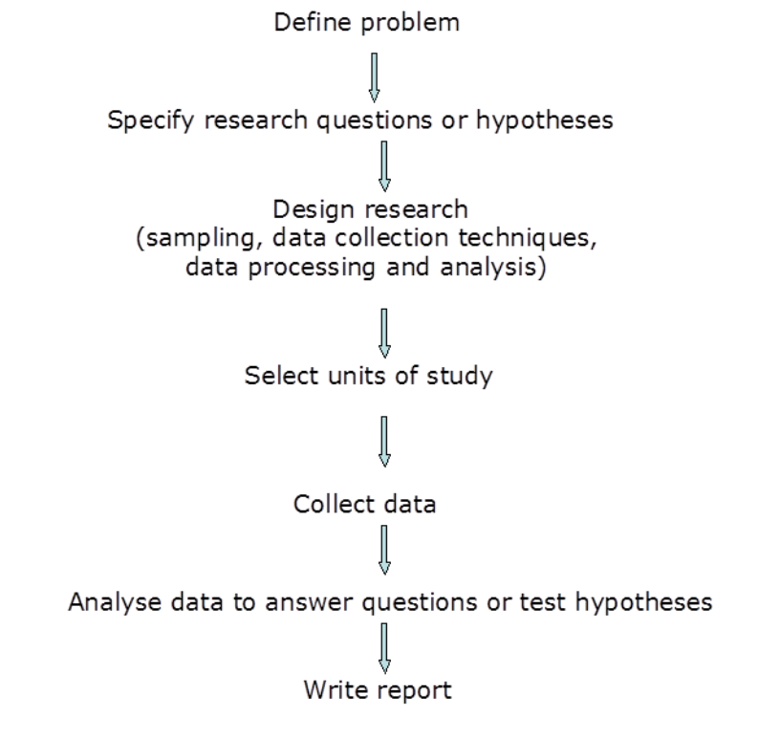
Research process
RJaafar

Slide 9
Research process
RJaafar

Slide 10
Good research questions
RJaafar

Slide 11
Research Considerations
The conceptual approach – the philosophical underpinnings of research
Research design – how data collection is organized
Data collection techniques – how data are collected Sampling – from whom data are collected
The types of information outputs required – who needs the information and for what purposes
research resources – time, funds, facilities, staff, and access
ethical considerations
for example, within the research plan is it possible to obtain informed consent from all participants, does the plan involve any risks to the safety of the researcher, can the researchers assure the confidentiality of all information given?
RJaafar

Slide 12
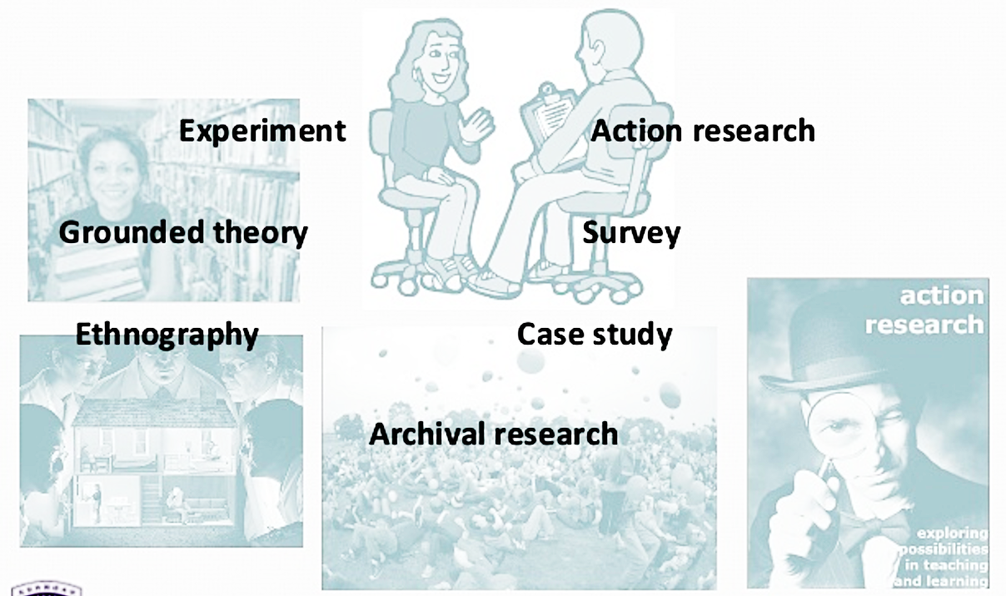
RESEARCH TYPES
RJaafar

Slide 13
RJaafar

Slide 14
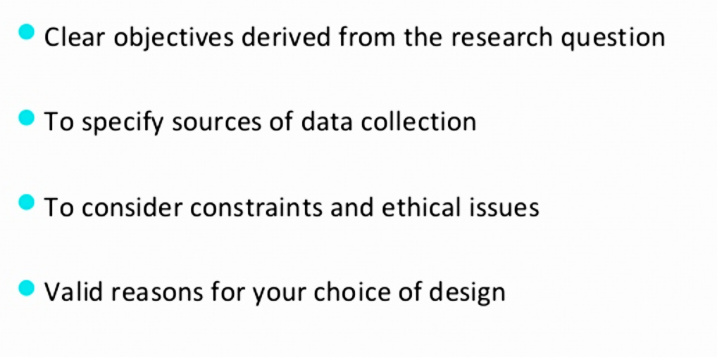
Not to forget…
RJaafar

Slide 15
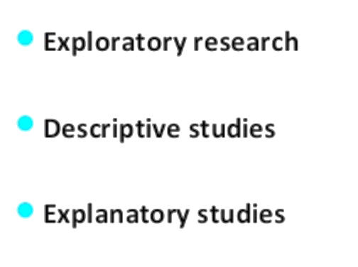
Research Description

Slide 16
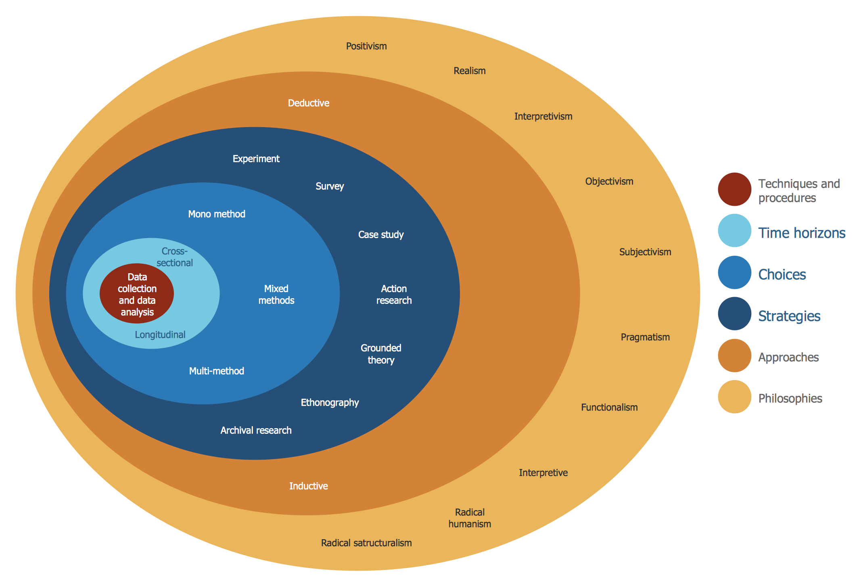
Research Types
RJaafar

Slide 17
RJaafar

Slide 18
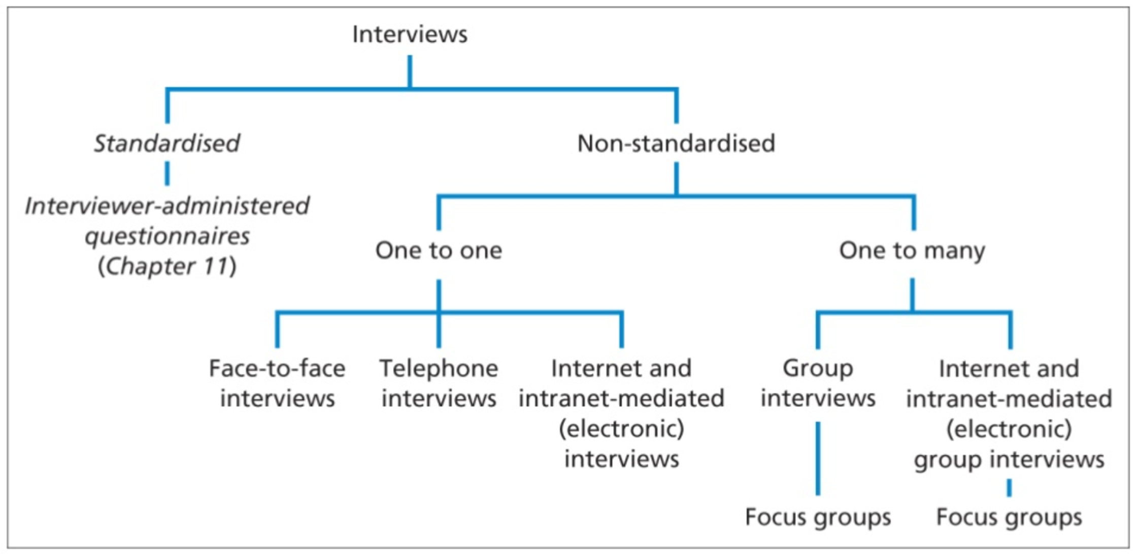
Interviews/Questionnaires
RJaafar

Slide 19
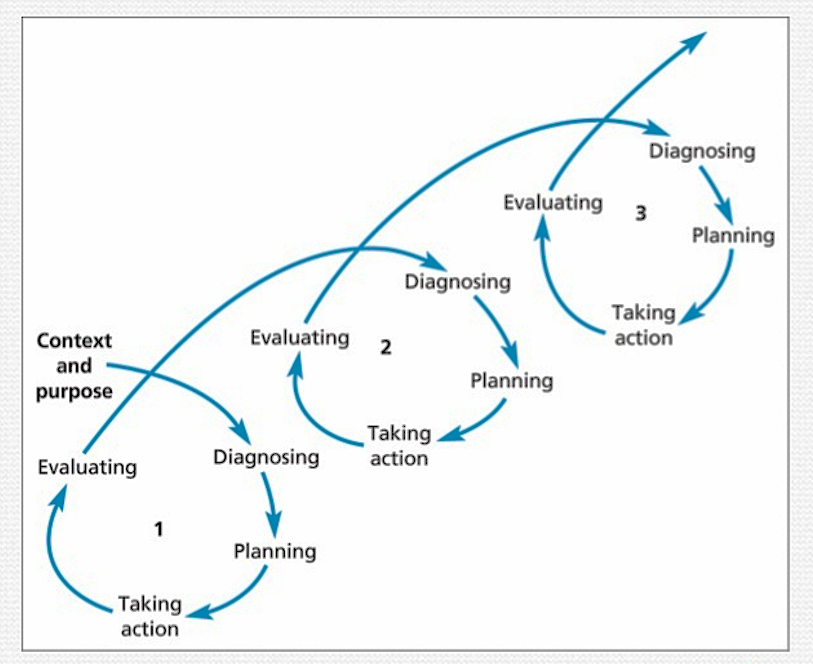
RJaafar

Slide 20
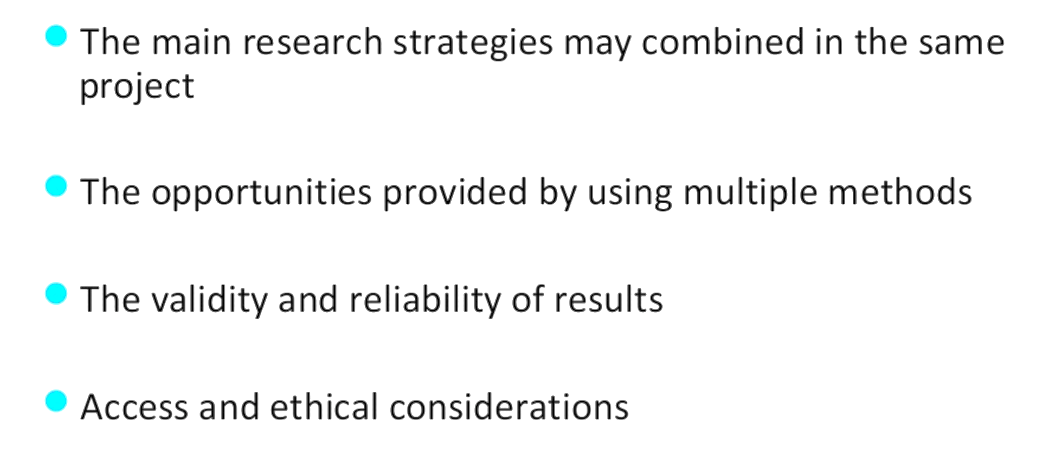
Important!!!
RJaafar

Slide 21
RJaafar

