Slide 1



Training course
“Stay Tuned Online”
Djakovo, Croatia
12-19 of September 2015
#StayTunedOnline
www.cetstaytuned.wordpress.com

Slide 2
Where can you always find a group of young people?
• hanging out together
• chatting about everyday life, and about issues that matter to them
• planning an upcoming adventure
• reflecting upon the activities they have recently been involved in
• sharing jokes
• having a heart to heart discussion with their peers
• and just generally being young people?
Stay Tuned Online
Djakovo, Croatia, 12-19.09.2015
#StayTunedOnline

Slide 3
Ten years ago the youth club or ‘the street corner’ or ‘the park’ might have been the answer. Today it is just as likely to be ONLINE!
Digital technology has created some golden opportunities for youth work practitioners:
to promote specific events, training and volunteering opportunities and activities for young people
to drive up attendance and attract new members
to engage with young people who may or may not already access youth provision
to create an identity for your organisation online
greater visibility, through videos and photos of what actually happens in your organisation
Stay Tuned Online
Djakovo, Croatia, 12-19.09.2015
#StayTunedOnline

Slide 4
opportunities for young people to pass on information to their friends easily
if you have an existing website, social media will enable you to raise its profile through web links
by establishing online discussions you can consult on developments to your organisation, allowing young people to give feedback in their own time
by checking out other sites you can see who is talking about positive activities for young people in your area and what they are really saying.
it offers you the opportunity to harness and build on the skills and talents of young people, allowing them to play a key role in creating and maintaining an online community for your organisation.
and to generally deliver high quality youth work
Stay Tuned Online
Djakovo, Croatia, 12-19.09.2015
#StayTunedOnline

Slide 5
WHAT ARE SOCIAL MEDIA?
Social media is a dynamic online medium that has changed the way we work. Similar to traditional media, social media offers opportunities to collect and share news, communicate with audiences and advocate for change. However, unlike traditional media, social media allows for this to happen on the Web in real-time through highly interactive global or regional social networks.
It is important to remember that traditional media ethics rules apply to social media. Nothing said or done on social media is truly private. Anything you post is a direct reflection of you or the organization you represent.
Stay Tuned Online
Djakovo, Croatia, 12-19.09.2015
#StayTunedOnline

Slide 6

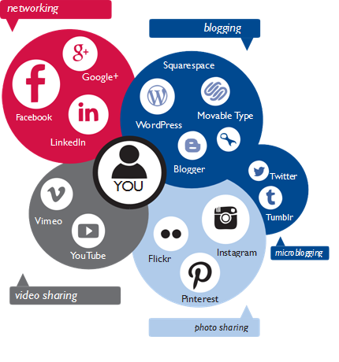
There are over 2 billion social media users worldwide!
There are a wide range of social media platforms, from social networking sites designed to link people with common interests through an online community to sites designed purely for photo and video sharing. These platforms are constantly evolving and new platforms are emerging daily. There are a variety of options available to suit a range of individual needs.
Stay Tuned Online
Djakovo, Croatia, 12-19.09.2015
#StayTunedOnline

Slide 7
SOCIAL NETWORKING SITES
A social networking site is an online community that allows users to create a profile and cultivate a social network of friends and followers. Users may communicate with others in the network by sharing ideas, activities and events through updates and photos.
With over one billion active users, Facebook is the most popular social networking site globally, but there are also many other sites that cater to regional or personal interests.
In China, for example, Tenecent Qzone is a widely popular social networking site while in Latin America, Orkut is among the most popular social networking sites. VKontakte is very popular among Russian speaking countries with over 300 million users.
Twitter and Tumblr are other social networking sites with global popularity, otherwise known as microblogging sites.
Stay Tuned Online
Djakovo, Croatia, 12-19.09.2015
#StayTunedOnline

Slide 8
SOCIAL NETWORKING SITES
LinkedIn is an online social network for business professionals. It’s different than other social networking sites because it’s designed specifically for professional networking -- finding a job, discovering sales leads, connecting with potential business partners -- rather than simply making friends or sharing media like photos, videos and music.
Tumblr is a microblogging platform and a social networking website. This service allows users to post different thing in a form of a short blog. There are no length limitations on Tumblr posts, but the culture of this site it is based on short updates and many users stick to this format.
Pinterest is all about collecting and sharing different things we find on the internet. It is a kind of digital bulletin board or a scrapbook. Pinterest helps you to organize and save easily whatever you discover online.
Stay Tuned Online
Djakovo, Croatia, 12-19.09.2015
#StayTunedOnline

Slide 9
BLOG
A blog, short for Web log, is an online communication platform through which a blogger (the person who submits content to a blog), can regularly share stories, photos, videos or links according to the subject matter of the particular blog. It is often likened to a journal, because most blogs are written in first person and offer a more personal narrative compared to content traditionally found on a website.
Blogs are a valuable tool for development because they allow organizations to easily expand beyond their traditional communications mediums and social networks, and curate a content rich platform for their followers. Organizations can share meaningful stories from the field through the personal voice of staff members, volunteers or partners. They are also a great venue to share other news or information, relevant to the organization and its partners or stakeholders.
Stay Tuned Online
Djakovo, Croatia, 12-19.09.2015
#StayTunedOnline

Slide 10

BLOG
As with other forms of social media, readers can interact with bloggers by commenting on blog posts. They can also subscribe to a blog to receive notifications as soon as new posts are published. Blog posts appear in reverse chronological order, with older posts archived for reference. Blogs facilitate easy updates, which encourages organizations to frequently generate fresh content.
Some of the popular blogging platforms include: WordPress, Movable Type, Blogger, Tumblr, Squarespace and Typepad.
Stay Tuned Online
Djakovo, Croatia, 12-19.09.2015
#StayTunedOnline

Slide 11

WIKI
A wiki is a special web application that allows open content editing by users, thus encouraging the democratic use of the Web. Users can add, modify or delete content in a collaborative environment. The owner of a wiki can choose to allow open editing or limit editing to only those who have an account or special permissions.
Wikipedia, an online encyclopedia produced collaboratively by volunteers around the world, is the most popular wiki.
Many companies and organizations have launched wikis to compile documents and information into a unified whole, allowing staff and stakeholders to edit and contribute to the knowledge base.
Stay Tuned Online
Djakovo, Croatia, 12-19.09.2015
#StayTunedOnline

Slide 12



PHOTO AND VIDEO SHARING SITES
Photo and video sharing sites have become increasingly popular with the proliferation of smartphones.
The sites host user-generated photos and videos that users can upload to their profiles. The most popular video sharing site is YouTube, which requires a user account to upload videos. Though, anyone can view videos posted on YouTube.
Vimeo is another platform to upload and share videos. Popular photo sharing sites include Flickr, Instagram, Vine, Snapchat and Pinterest, each catering to a different niche. Some photo sharing sites also allow users to post videos.
Stay Tuned Online
Djakovo, Croatia, 12-19.09.2015
#StayTunedOnline

Slide 13
PHOTO AND VIDEO SHARING SITES
Instagram is an online mobile photo-video sharing social networking service which enables its users to take pictures, videos and to share them online with the others. Instagram is considered as vintage photography smartphone app.
Snapchat is video messaging application which allow users to take photos, record videos, add text and drawings, and send them to a controlled list of recipients. These sent photographs and videos are known as "Snaps". Users set a time limit for how long recipients can view their Snaps (as of September 2015, the range is from 1 to 10 seconds), after which they are deleted from Snapchat's servers.
Vine is a short form of video sharing service. The service allows its users to share seven second video clips and share them with the others.
Flickr is a photo and video positing website. The site allows its users to share and search photos. The service is widely used by photo researchers and bloggers.
Stay Tuned Online
Djakovo, Croatia, 12-19.09.2015
#StayTunedOnline

Slide 14


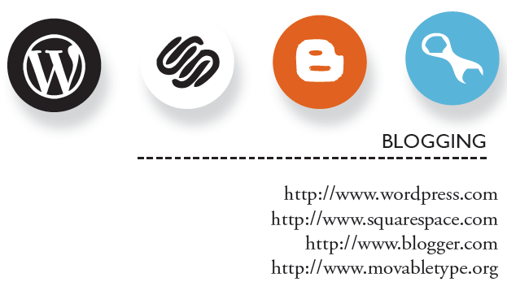

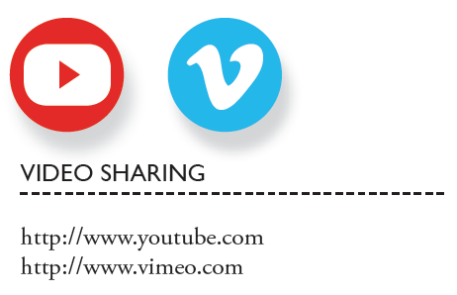


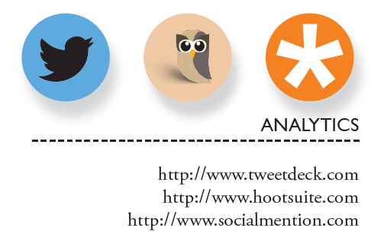
POPULAR SOCIAL MEDIA PLATFORMS
Stay Tuned Online
Djakovo, Croatia, 12-19.09.2015
#StayTunedOnline

Slide 15

www.facebook.com
Facebook is the world’s largest social networking site. It allows users to engage with people and brands through a very interactive experience. Individuals can create a personal profile Page, while public figures and entities can create public pages. Both options allow users to share photos and videos, plan and promote events, post news or information through status updates, and like or comment on posts. Each time a user engages in these activities, it becomes visible in their friends’ or followers’ news feed.
Organizations can promote their cause and build a community of advocates through Facebook’s open and dynamic interface. They can use high quality photos or visuals to brand their Page and add customized apps to drive followers to their blog, website or other online networks. Organizations can also choose to create a Group in addition to a Page, where they can foster dialogue on a specific topic and have more flexibility with privacy settings.
1.49 billion monthly active users!
!
Correct usage:
Profile – for real person
Page – for organisation / company
Group – for people with common interests
Stay Tuned Online
Djakovo, Croatia, 12-19.09.2015
#StayTunedOnline

Slide 16

www.facebook.com
1. Create a Facebook Page for your organization
2. Maintain a timeline of activities, events and milestones
3. Actively engage fans with status updates, photos, polls and videos
4. Build a community of fans and advocates, and foster meaningful conversations
5. Drive fans to strategic virtual destinations by offering links to your organization’s website, online resources, surveys or blogs
6. Follow other organization’s Pages whose missions align with yours
Stay Tuned Online
Djakovo, Croatia, 12-19.09.2015
#StayTunedOnline

Slide 17
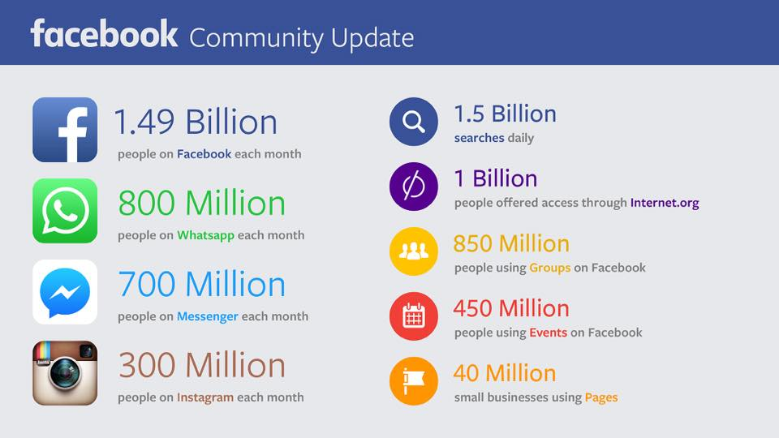
Stay Tuned Online
Djakovo, Croatia, 12-19.09.2015
#StayTunedOnline

Slide 18
When using Facebook:
As an organization, you should have a page not a profile. Profiles are for individuals.
Update your Facebook page as often as you can, with the latest news and issues that you would like to share with your community.
Keep Facebook posts rather short and conversational, and if possible include an image
Encourage the dialogue and discussion through wall posts, status updates and news feeds.
Post stories about issues that concern you
Share photos, videos, links that could be interesting to your community
Create Facebook events to advertise meetings, events, campaigns that you are organising, invite as many friends as possible
Stay Tuned Online
Djakovo, Croatia, 12-19.09.2015
#StayTunedOnline

Slide 19

www.twitter.com
Twitter is a social networking and microblogging site that offers a very simple interface to quickly share and discover information. Twitter has over 500 million users.
Users can create a profile, gain followers and follow others. Twitter posts are called Tweets and are restricted to 140 characters. Within the 140 character limit users can share text, links, images or hashtags (#) for categorizing content.
They can also favorite, retweet, or reply to a tweet. Popular users gain millions of followers.
Stay Tuned Online
Djakovo, Croatia, 12-19.09.2015
#StayTunedOnline

Slide 20
www.twitter.com
1. Create a Page for your organization
2. Regularly share relevant updates or photos
3. Drive followers to strategic virtual destinations by offering links to your organization’s website, online resources, surveys or blogs
4. Engage in direct conversation with followers by replying to their Tweets
5. Follow trending topics with hashtags relevant to your organization’s interests
6. Provide your followers a real-time sense of what is going on by sharing timely Tweets
Stay Tuned Online
Djakovo, Croatia, 12-19.09.2015
#StayTunedOnline

Slide 21
When using Twitter:
Share short posts on Twitter, up to 140 characters, but don’t use all 140 characters – leave some space for others in case they want to re-tweet it and add something
Encourage followers to take specific actions related to your NGO’s goals which should be clear and simple
Tweet directly to local organizations that you would like to collaborate and be partner of your initiative
Engage in discussions with others
Be active and creative while posting - this way you will draw attention of more people
Reply to Tweets addressed to you
Use special websites (tinyurl.com) to cut your link – this will save a lot of space out of your 140 characters
Use hashtags! (not more than 3) #StayTunedOnline
Stay Tuned Online
Djakovo, Croatia, 12-19.09.2015
#StayTunedOnline

Slide 22

www.youtube.com
Sometimes, even more important than telling an audience the impact of a special program, is showing them through video. YouTube is the leading video sharing site in the world. It offers visitors an opportunity to discover videos on virtually any topic, produced both by amateurs and professionals alike.
Organizations can create channels, much like profile pages on other social networks, to curate their own videos and subscribe to and follow other channels. Videos can be uploaded easily, with an option to take advantage of video editing tools already built into the system. With appropriate titles and keyword tags, searching for videos is made very easy. Once a video is on YouTube, it can be embedded onto other online platforms such as websites or blogs, making it even easier to share.
Stay Tuned Online
Djakovo, Croatia, 12-19.09.2015
#StayTunedOnline

Slide 23
www.youtube.com
1. Create a YouTube channel for your organization
2. Share promotional videos, mini-documentaries and emotional appeals for support
3. Build a base of subscribers with whom your organization can engage
4. Promote special events and drive visitors to online destinations
5. Subscribe to other channels and search for videos that align with your organization’s objectives
Stay Tuned Online
Djakovo, Croatia, 12-19.09.2015
#StayTunedOnline

Slide 24

www.plus.google.com
Google+ (Google Plus) is a social networking site that is integrated through a person’s experience on Google. It offers many levels of engagement and includes features that can help a user target a message to a segmented audience by grouping followers in Circles.
It also allows users to host live video chats via Hangouts for small, private chats or Hangouts on Air for broadcasting large video chats to an unlimited audience. The Hangouts can be recorded through YouTube and saved for future reference. Google+ also offers dynamic searching capabilities. Users can easily conduct a search on a certain topic and view returned results from posts by other users in Google+ or anywhere on the Web.
Google+ is the biggest „dead” social network with almost 2.2 billion profiles of whom only 111 million are „active” (only 6.7 million users had 50 or more posts ever). But, besides this, Google+ is very important for indexing websites and blogs and being present in the Google “galaxy”.
Stay Tuned Online
Djakovo, Croatia, 12-19.09.2015
#StayTunedOnline

Slide 25
www.plus.google.com
1. Create a Google+ Page for your organization
2. Share engaging content with regular updates and multimedia
3. Segment your audience through Google+ Circles to facilitate targeted messaging
4. Leverage use of Google+ Hangouts for face-to-face interaction with followers
5. Launch a Google+ Community to rally people around a cause, or urge them to join a Google+ Community that supports similar causes as your organization’s
Stay Tuned Online
Djakovo, Croatia, 12-19.09.2015
#StayTunedOnline

Slide 26
SOCIAL MEDIA DOS
Evolve with change - Social media platforms are constantly changing and evolving. Organizations must always be prepared to adapt to these changes and adjust their strategies accordingly.
Post with a purpose - There is a reason an organization has a presence on social media. Stay true to this purpose and share content that is aligned with it.
Use appropriate tools - Carefully select appropriate tools for desired results. If the intent is to build an online community, use a social networking site instead of a photo sharing site.
Integrate and promote content across multiple platforms - Repurpose content and share it on other platforms, but always make adjustments to leverage the platform’s benefits.
Be both methodical and spontaneous, and always relevant - Posts and comments should always be timely and appropriate for the venue and audience.
Stay active and engaged - Engagement is key to success. If it is not possible to maintain an active presence on a platform, it may be best to reconsider its objective.
Share multiple posts each day - When appropriate, maximize exposure by sharing posts at different times of the day, being mindful of different time zones. The goal is to capture the attention of an audience that may have missed an earlier post.
Stay Tuned Online
Djakovo, Croatia, 12-19.09.2015
#StayTunedOnline

Slide 27
SOCIAL MEDIA DON’TS
x Post for the sake of meeting your daily posting quotas - If there is nothing of value to share, then it is better to not post at all.
x Use poor quality photos - Every post is a direct reflection of the organization. A poor quality photo is a missed opportunity for engagement and reflects poor judgment.
x Use generic and irrelevant messaging - Be genuine and respectful of your audience’s time. Share something that adds value to their experience.
x Respond with a derogatory tone to negative comments - If an organization’s policy is to respond to negative comments, then do so by maintaining a positive tone, and offer a solution whenever possible.
x Share too much - Be mindful not to inundate your audience with too much information. Avoid sharing too much about yourself. Always exhibit humility when sharing. It is appropriate to celebrate success, however.
x Overpost - Know your target audience and post relevant, timely information. Quality over quantity.
Stay Tuned Online
Djakovo, Croatia, 12-19.09.2015
#StayTunedOnline

Slide 28
SOCIAL MEDIA MANAGEMENT AND ANALYTICS
Hoot Suite: www.hootsuite.com
Tweet Deck: tweetdeck.twitter.com
Tagbpard: www.tagboard.com
Buffer: www.bufferapp.com
Oktopost: www.oktopost.com
Simply Measured: www.simplymeasured.com/free-social-media-tools
Social Bakers: www.socialbakers.com
Social Mention: www.socialmention.com
Social Oomph: www.socialoomph.com
Sprout Social: wwww.sproutsocial.com
Stay Tuned Online
Djakovo, Croatia, 12-19.09.2015
#StayTunedOnline

Slide 29
VISUALIZATION TOOLS
Piktochart: www.piktochart.com
Visual.ly: www.visual.ly
Easely.ly: www.easel.ly
InfoActive: www.infoactive.co
Infogr.am: www.infogr.am
InMaps (LinkedIn): www.blog.linkedin.com/2011/01/24/linkedin-inmaps/
Many Eyes: www.958.ibm.com/software/analytics/labs/manyeyes/#home
NoDeXL: www.nodexl.codeplex.com
Stay Tuned Online
Djakovo, Croatia, 12-19.09.2015
#StayTunedOnline

Slide 30
IMAGE GALLERIES AND EDITING TOOLS
Flickr: www.flickr.com/creativecommons
Autre planète: www.autreplanete.com/ap-social-media-image-maker
PicMark: www.picmark.co
PicMonkey: www.picmonkey.com
The Noun Project: www.thenounproject.com
Timeline Slicer: www.timelineslicer.com
Stay Tuned Online
Djakovo, Croatia, 12-19.09.2015
#StayTunedOnline

Slide 31
LINK SHORTENERS
Bit.ly: www.bitly.com
Goo.gl: www.goo.gl
Ow.ly: www.ow.ly/url/shorten-url
GLOBAL PETITION PLATFORMS
Avaaz: www.avaaz.org
Change: www.change.org
Thunderclap: www.thunderclap.it/?locale=en
Stay Tuned Online
Djakovo, Croatia, 12-19.09.2015
#StayTunedOnline

Slide 32
GLOBAL DONATION AND FUNDRAISING TOOLS
Ammado: www.ammado.com
CauseVox: www.causevox.com
Fundly: www.fundly.com
Global Giving: www.globalgiving.org
Indiegogo: www.indiegogo.com
Stay Tuned Online
Djakovo, Croatia, 12-19.09.2015
#StayTunedOnline

Slide 33



Thank you for your attention!
#
StayTunedOnline

Slide 34




Bojan Kocevski
bojan_koce@hotmail.com
/bkocevski
@bkocevski
/bkocevski
Stay Tuned Online
Djakovo, Croatia, 12-19.09.2015
#StayTunedOnline

