Slide 1



Training course
“Stay Tuned Online”
Djakovo, Croatia
12-19 of September 2015
#StayTunedOnline
www.cetstaytuned.wordpress.com

Slide 2

www.facebook.com
Facebook is the world’s largest social networking site. It allows users to engage with people and brands through a very interactive experience. Individuals can create a personal profile Page, while public figures and entities can create public pages. Both options allow users to share photos and videos, plan and promote events, post news or information through status updates, and like or comment on posts. Each time a user engages in these activities, it becomes visible in their friends’ or followers’ news feed.
Organizations can promote their cause and build a community of advocates through Facebook’s open and dynamic interface. They can use high quality photos or visuals to brand their Page and add customized apps to drive followers to their blog, website or other online networks. Organizations can also choose to create a Group in addition to a Page, where they can foster dialogue on a specific topic and have more flexibility with privacy settings.
1.49 billion monthly active users!
!
Correct usage:
Profile – for real person
Page – for organisation / company
Group – for people with common interests
Stay Tuned Online
Djakovo, Croatia, 12-19.09.2015
#StayTunedOnline

Slide 3

What can you do on Facebook?
1. Create a Facebook Page for your organization
2. Maintain a timeline of activities, events and milestones
3. Actively engage fans with status updates, photos, polls and videos
4. Build a community of fans and advocates, and foster meaningful conversations
5. Drive fans to strategic virtual destinations by offering links to your organization’s website, online resources, surveys or blogs
6. Follow other organization’s Pages whose missions align with yours
Stay Tuned Online
Djakovo, Croatia, 12-19.09.2015
#StayTunedOnline

Slide 4
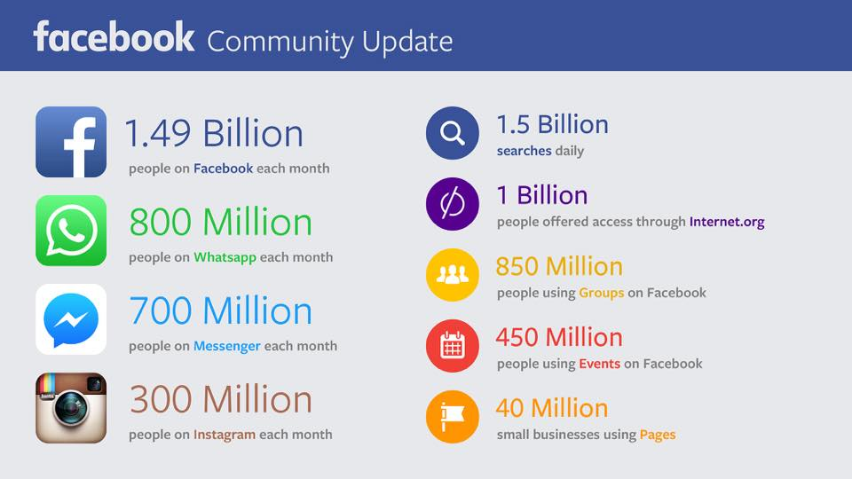
The Facebook family is constantly growing
Stay Tuned Online
Djakovo, Croatia, 12-19.09.2015
#StayTunedOnline

Slide 5
When using Facebook:
As an organization, you should have a page not a profile. Profiles are for individuals.
Update your Facebook page as often as you can, with the latest news and issues that you would like to share with your community.
Keep Facebook posts rather short and conversational, and if possible include an image
Encourage the dialogue and discussion through wall posts, status updates and news feeds.
Post stories about issues that concern you
Share photos, videos, links that could be interesting to your community
Create Facebook events to advertise meetings, events, campaigns that you are organising, invite as many friends as possible
Stay Tuned Online
Djakovo, Croatia, 12-19.09.2015
#StayTunedOnline

Slide 6
Facebook page insights (Facebook analytics)
Facebook’s Page Insights offers page administrators valuable Page insights through dynamic and interactive graphs and visuals. The data can be accessed simply by visiting an organization’s Facebook Page and looking for the tab that will direct you to the Page’s Insights.
1. Examine peaks and valleys for Likes on the Page
2. Examine engagement rates and reach for each post
3. Determine the best time to post by reviewing when your fans are online
4. Export data to archive and analyse insights offline
Stay Tuned Online
Djakovo, Croatia, 12-19.09.2015
#StayTunedOnline

Slide 7
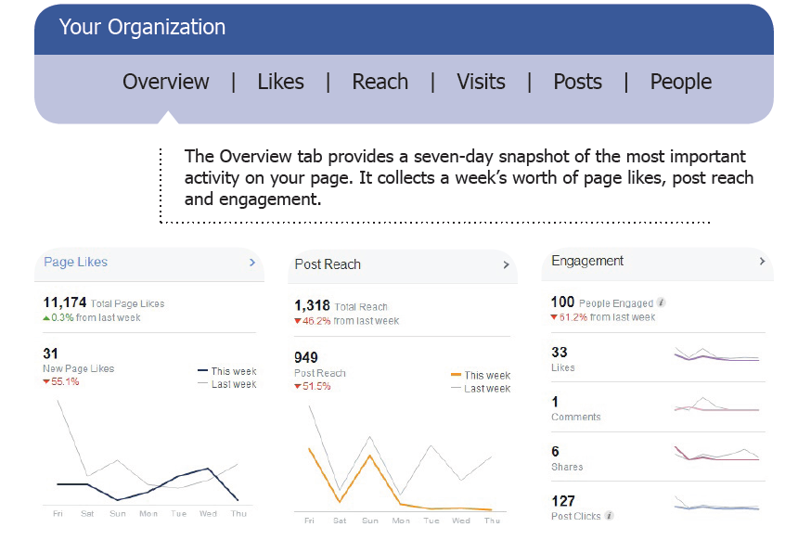
Facebook page insights (Facebook analytics)
Stay Tuned Online
Djakovo, Croatia, 12-19.09.2015
#StayTunedOnline

Slide 8



Thank you for your attention!
#
StayTunedOnline

