Slide 1



Communication and message developement
Training course “Stay Tuned Online” #StayTunedOnline
www.cetstaytuned.wordpress.com
Đakovo, Croatia
12-19.09.2015

Slide 2
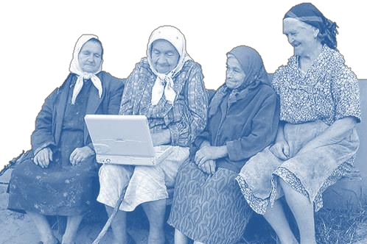
What is COMMUNICATION?
If someone ask you „What is Communication?“, what would you say?

Slide 3
Strategy (and plan)
Budget
Activity
Measurement and management

Slide 4
Strategic planning
 | What? | I | II | III | IV | Resourses? | Who?
RESEARCH | Police reports | X
IDENTIFICATION | Polles |  | X
 | Focus groups |  |  | X
COMMUNICATION
MOTIVATION |  |  |  |  | X
 |  |  |  |  | X

Slide 5
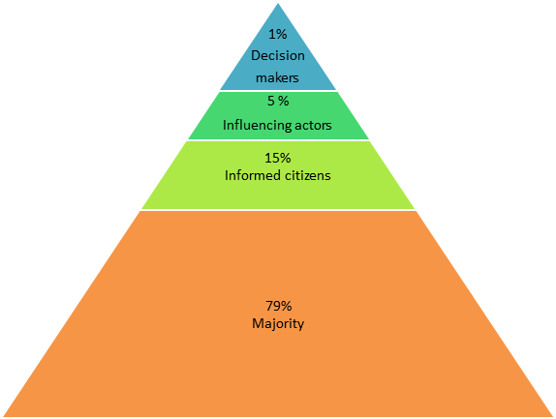
Pyramid of participation
79% of citizens are not informed and usualy do not want to be informed!
LET`S DO A TEST
Take half of an A4 paper (A5)
Scrunch it and make small ball of it
On my sign, throw
it at me

Slide 6

SIX ELEMENTS OF A MESSAGE: If a message is to be successful, it must have certain characteristics:
Clear
Consistent
Unique
Convincing
Truthful
Important
Emotional
K.I.S.S.
1) Keep it short and simple!
2) Keep it significant and sharable!

Slide 7
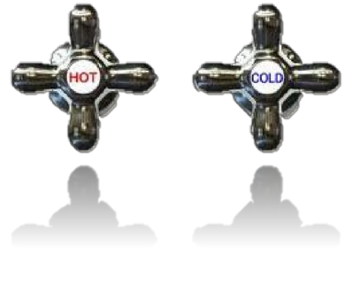
Channels of communication
„The medium is the message”
- Marshall McLuhan
Hot Medium:
Extends single sense in high definition
HD=well filled in with data, sharp, detailed
Little audience participation required
Examples:
photograph
radio
phonetic alphabet
print
lecture
film
books
Cool Medium:
Extends to more senses
Low definition
Offers little information
Requires recipient to fill in missing information
High participation
Examples:
cartoon
telephone
ideographic/pictographic writing
speech (orality)
seminar, discussion
television
comics

Slide 8
